Slide 1
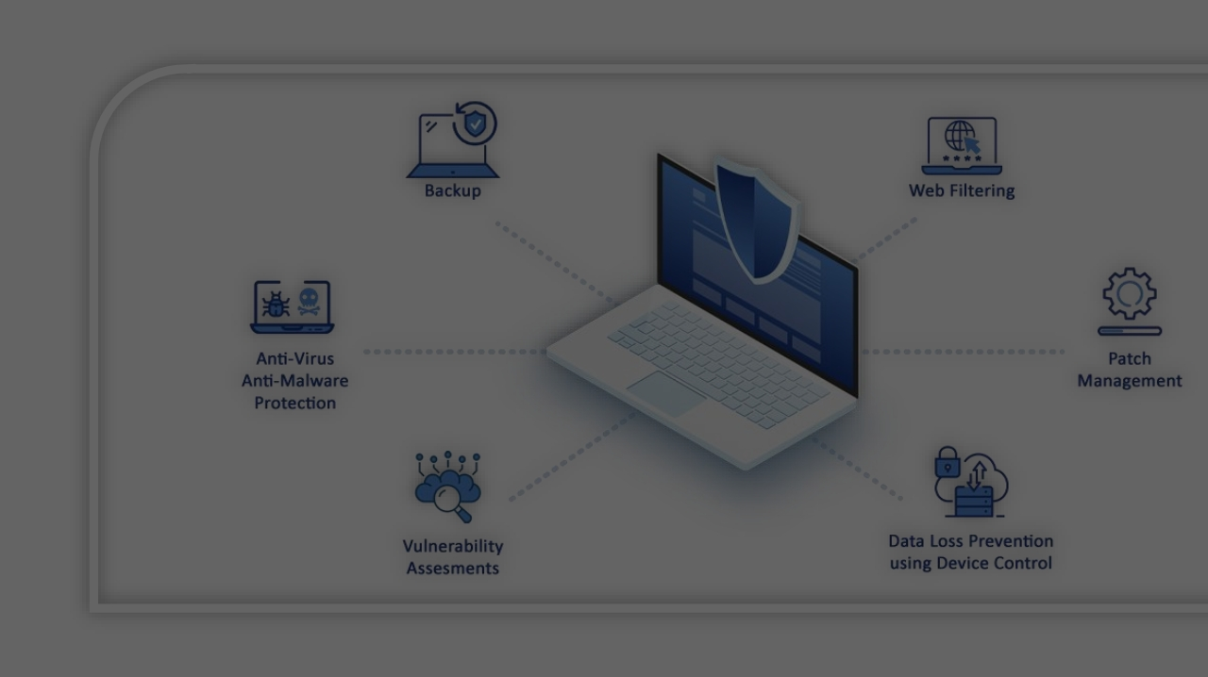

Endpoint
protection in
Cybersecurity

Slide 2
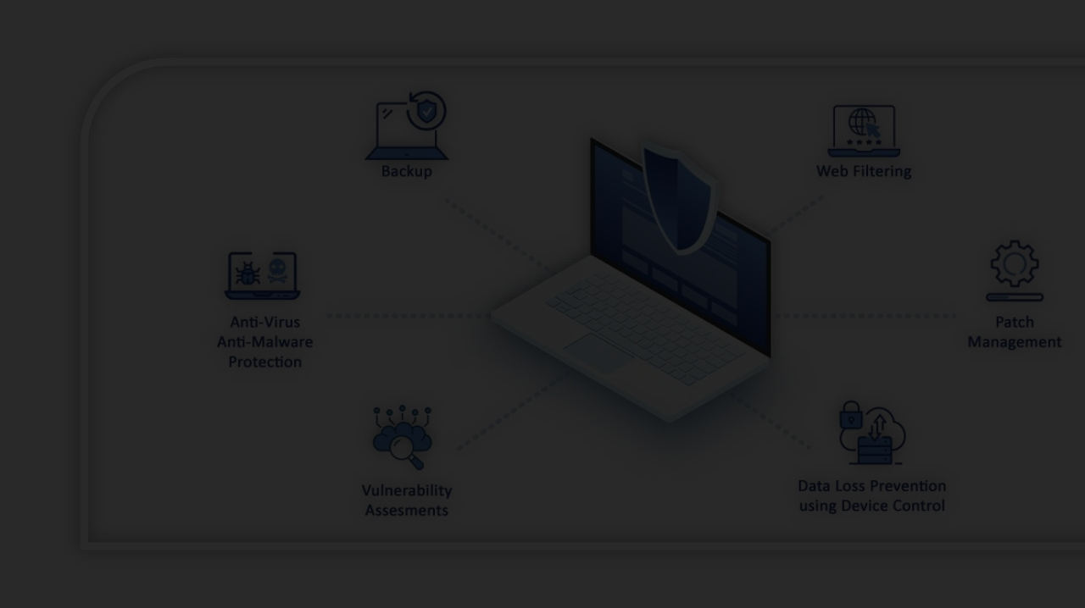

Endpoint protection is a comprehensive concept encompassing various aspects of cybersecurity. At its core, endpoint protection revolves around the critical task of monitoring and safeguarding endpoints against cyber threats.
Endpoint
protection in
Cybersecurity

Slide 3
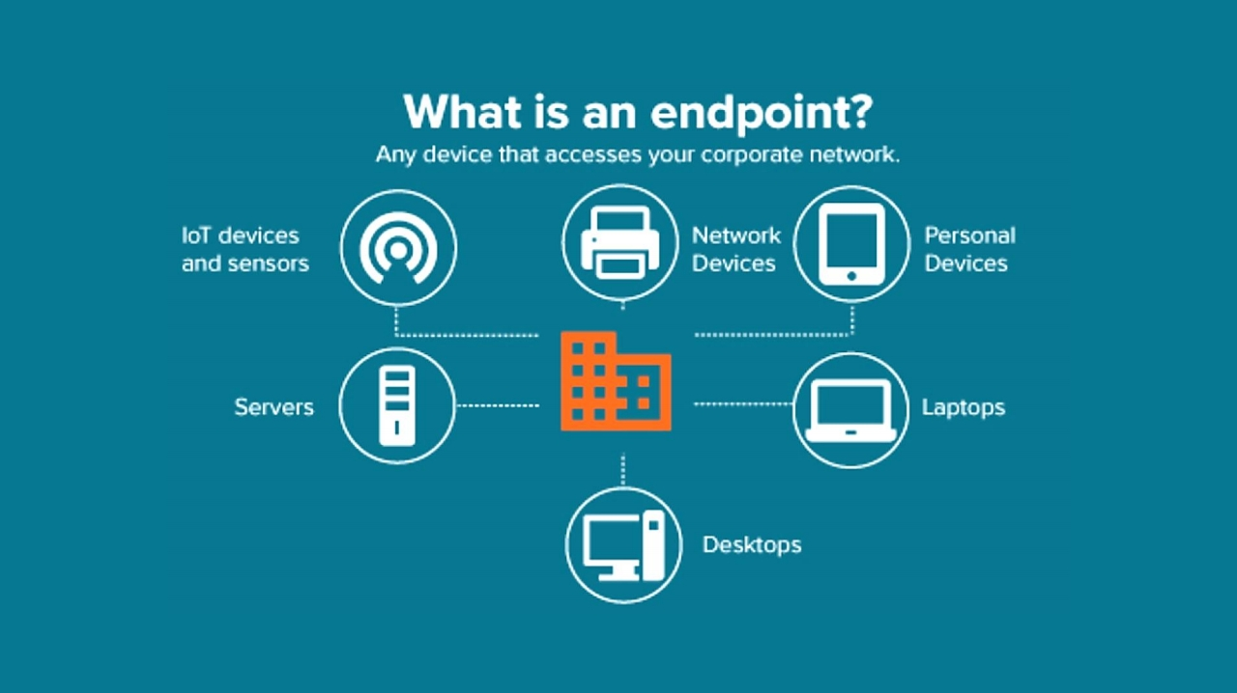

Slide 4

Anti-Malware
One of the foundational elements of endpoint protection is anti-malware software, which includes the familiar antivirus solutions. These anti-malware systems play a critical role in identifying and preventing infections caused by various forms of malicious software, including viruses, worms, and other malware types.
Anti-Malware
Next-Generation
Endpoint Protection
Endpoint Detection
Extended Detection
Antivirus (NGAV)
Platform (EPP)
and Response (EDR)
and Response (XDR)

Slide 5

Next-Generation Anti-Virus (NGAV)
Next-Generation Antivirus (NGAV) has emerged as a powerful tool for endpoint protection. NGAV is designed to counteract new and evolving forms of malware by incorporating advanced features like machine learning and behavioral threat analysis.
Next-Generation
Endpoint Protection
Endpoint Detection
Extended Detection
Anti-Malware
Antivirus (NGAV)
Platform (EPP)
and Response (EDR)
and Response (XDR)

Slide 6

Endpoint Protection Platform Endpoint Protection Platforms (EPP) mark a
significant evolution in the realm of endpoint
security. EPP combines a multitude of protective
measures, including traditional antivirus, Next-
Generation Antivirus (NGAV), personal firewalls,
encryption, USB device control, vulnerability
assessment, and more, to provide a
comprehensive defense against malware threats
attempting to breach endpoints.
Next-Generation
Endpoint Protection
Endpoint Detection
Extended Detection
Anti-Malware
Antivirus (NGAV)
Platform (EPP)
and Response (EDR)
and Response (XDR)

Slide 7
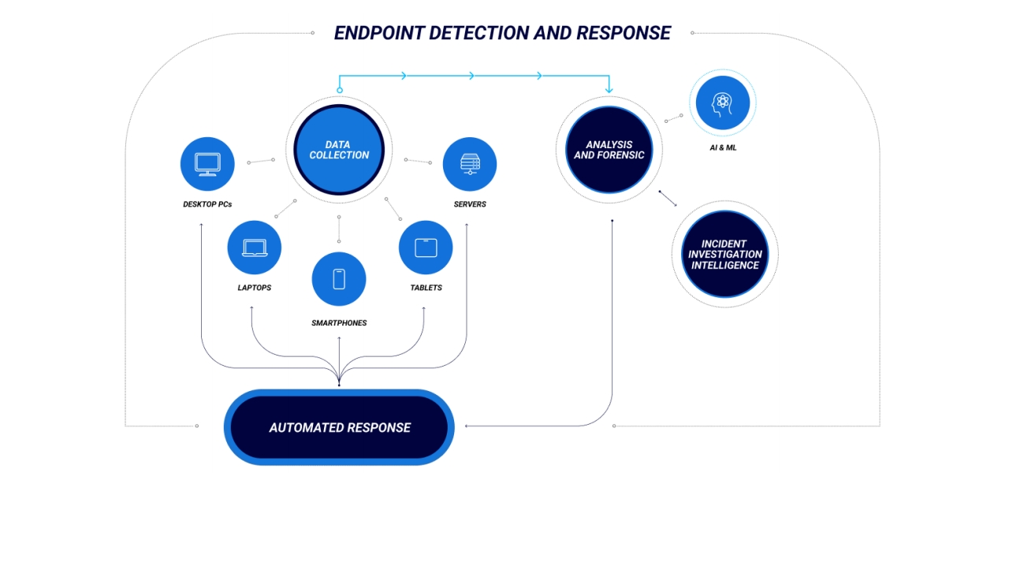
Next-Generation
Endpoint Protection
Endpoint Detection
Extended Detection
Anti-Malware
Antivirus (NGAV)
Platform (EPP)
and Response (EDR)
and Response (XDR)

Slide 8
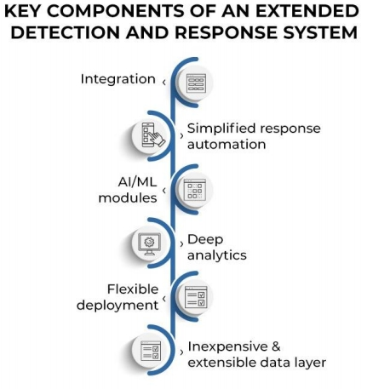
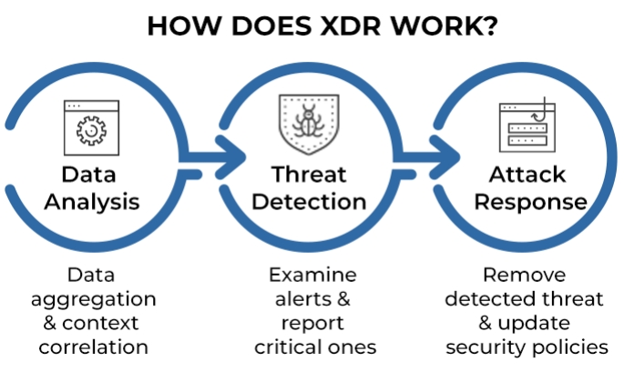
Extended Detection and Response (XDR)
Next-Generation
Endpoint Protection
Endpoint Detection
Extended Detection
Anti-Malware
Antivirus (NGAV)
Platform (EPP)
and Response (EDR)
and Response (XDR)

Slide 9
Anti-Malware
Next-Generation Antivirus (NGAV)
Wrap
Endpoint Protection Platform (EPP)
Up
Endpoint Detection and Response (EDR)
Extended Detection and Response (XDR)

