Slide 1


SIEM Solutions
in
Cybersecurity

Slide 2
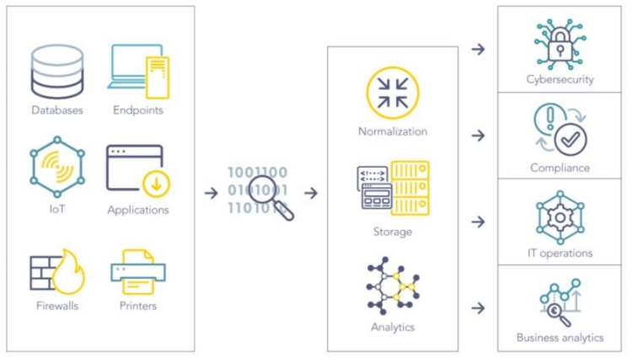
SIEM Introduction
SIEM software collects and
aggregates log data generated
throughout the entire IT
infrastructure, from cloud
systems and applications to
network and security devices,
such as firewalls and antivirus.

Slide 3
SIEM Introduction
Enterprises must monitor and guard their data to protect themselves from increasingly advanced cyber threats in the digital economy. Companies have more data to collect and analyze than ever before.

Slide 4
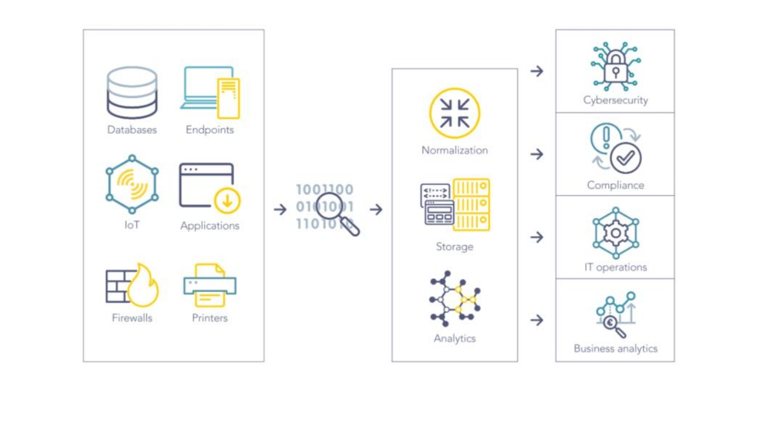

Slide 5
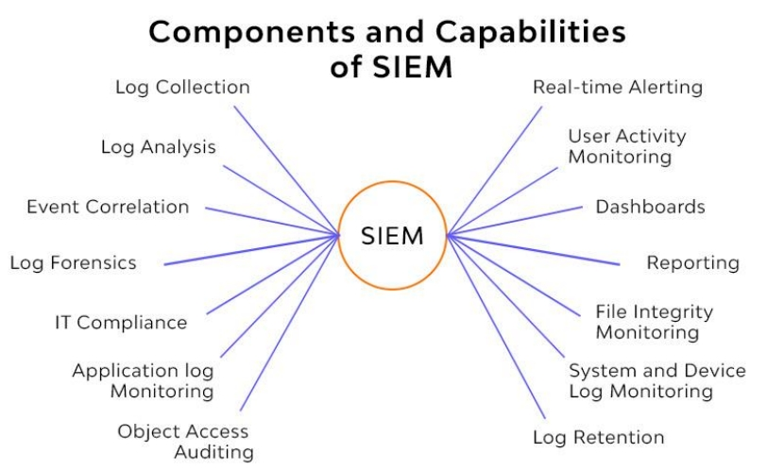
Log Management
Log
Management's
Broad Scope
SIEM's
Analytical
Power
Centralized
Insights

Slide 6
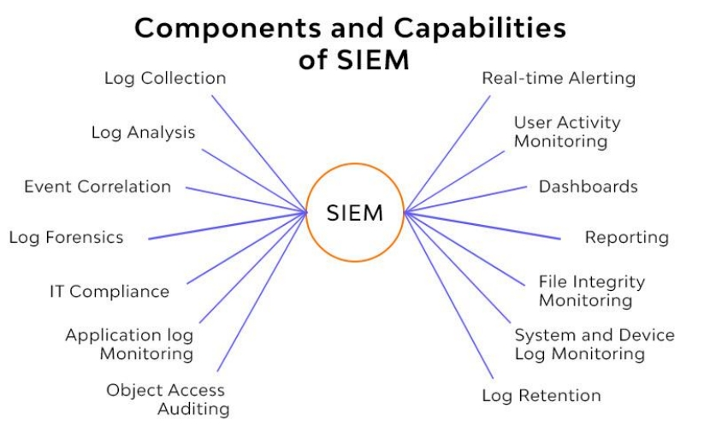
Alerting
Analyzing
Events
Escalating
Alerts
Notifying
Security Staff

Slide 7
Dashboards and Visualisation
Dashboard
and
Visualization
Pattern
Identification
Data
Retention

Slide 8
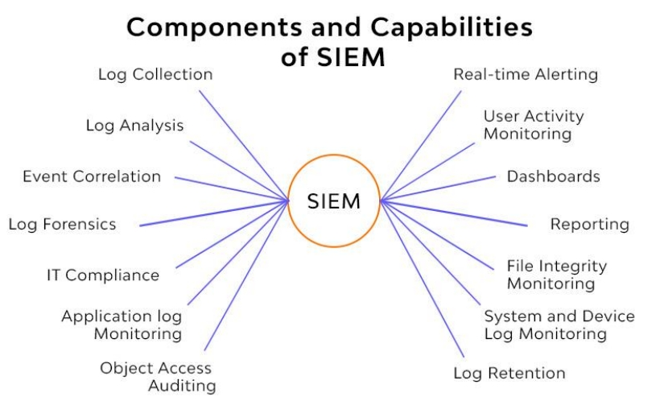
Date Retention
Storing
Historical
Data
Supporting
Forensic
Investigations

Slide 9
Threat Hunting
Proactive
Threat
Hunting
Manual or
Automated
Query and
Analysis

Slide 10
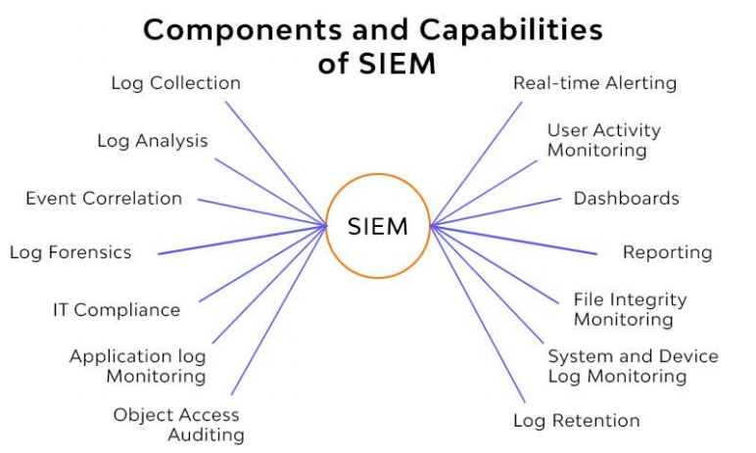
Incident Response
Case
Management and
Collaboration
Knowledge
Sharing
Integration with
Ticketing
Solutions
Communication
Tool

Slide 11
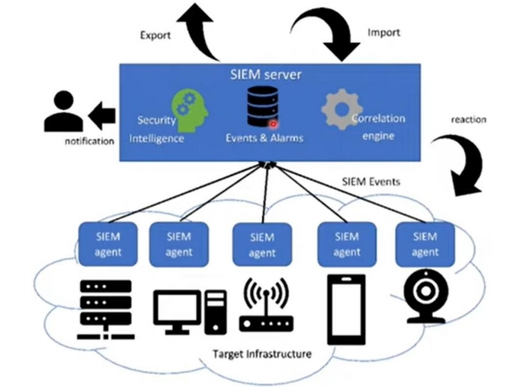
SIEM Solutions
There's a variety of SIEM (Security Information and
Event Management) solutions
available in the market,
including Splunk, Exabeam,
LogRhythm, FortiSIEM, IBM
QRadar, Secureworks, and
even Elasticsearch with SIEM
capabilities.

Slide 12
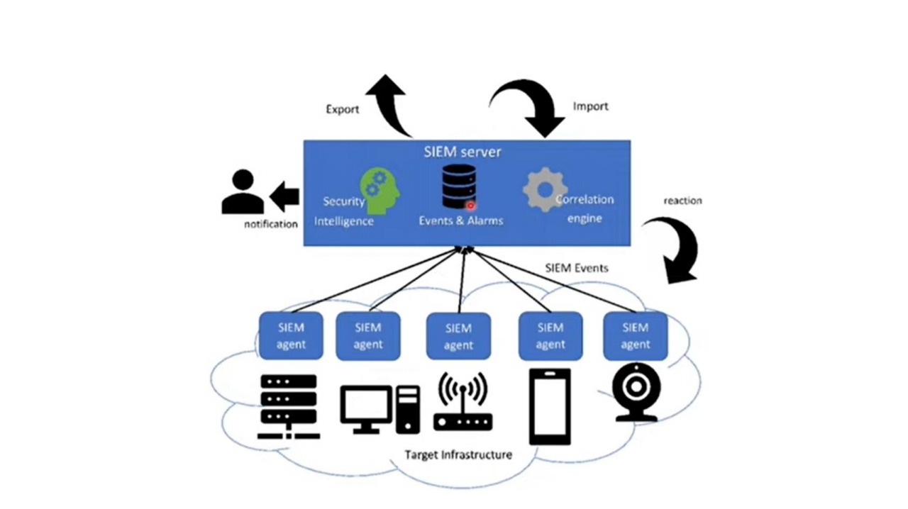
SIEM Solutions Deployment

Slide 13
SIEM Solutions Functional Components

Slide 14
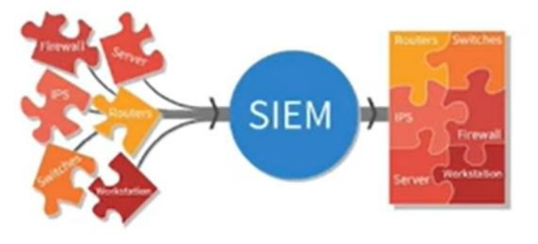

Slide 15
SIEM stands for Security Information and Event Management.
SIEM is a powerful cybersecurity tool that collects, manages, and analyzes log data.
Wrap
It offers features like alerting, visualization, and long-term data retention.
Up
SIEM aids in threat hunting and incident response.
SIEM systems can be deployed with or without agents.
Active monitoring and a dedicated security team are essential for maximizing SIEM effectiveness.

