Slide 1

An Intrusion Detection System (IDS) is a vital tool in cybersecurity. It detects unusual digital activity and raises alarms when necessary. Analysts then investigate and take actions, such as isolating compromised systems or blocking unauthorized access. In essence, an IDS plays a crucial role in safeguarding the digital realm.

Slide 2
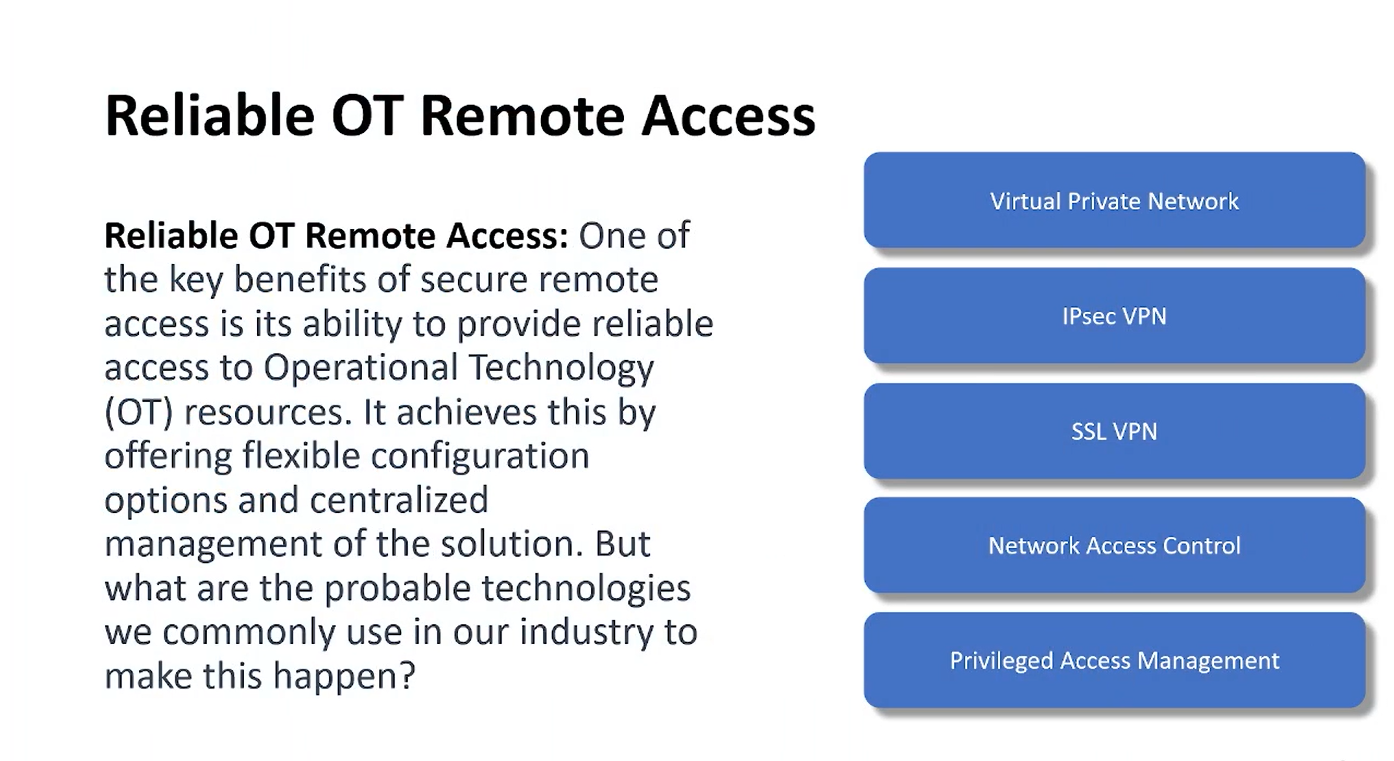
An Intrusion Detection System (IDS) is a vital tool in cybersecurity. It detects unusual digital activity and raises alarms when necessary. Analysts then investigate and take actions, such as isolating compromised systems or blocking unauthorized access. In essence, an IDS plays a crucial role in safeguarding the digital realm.

Slide 3
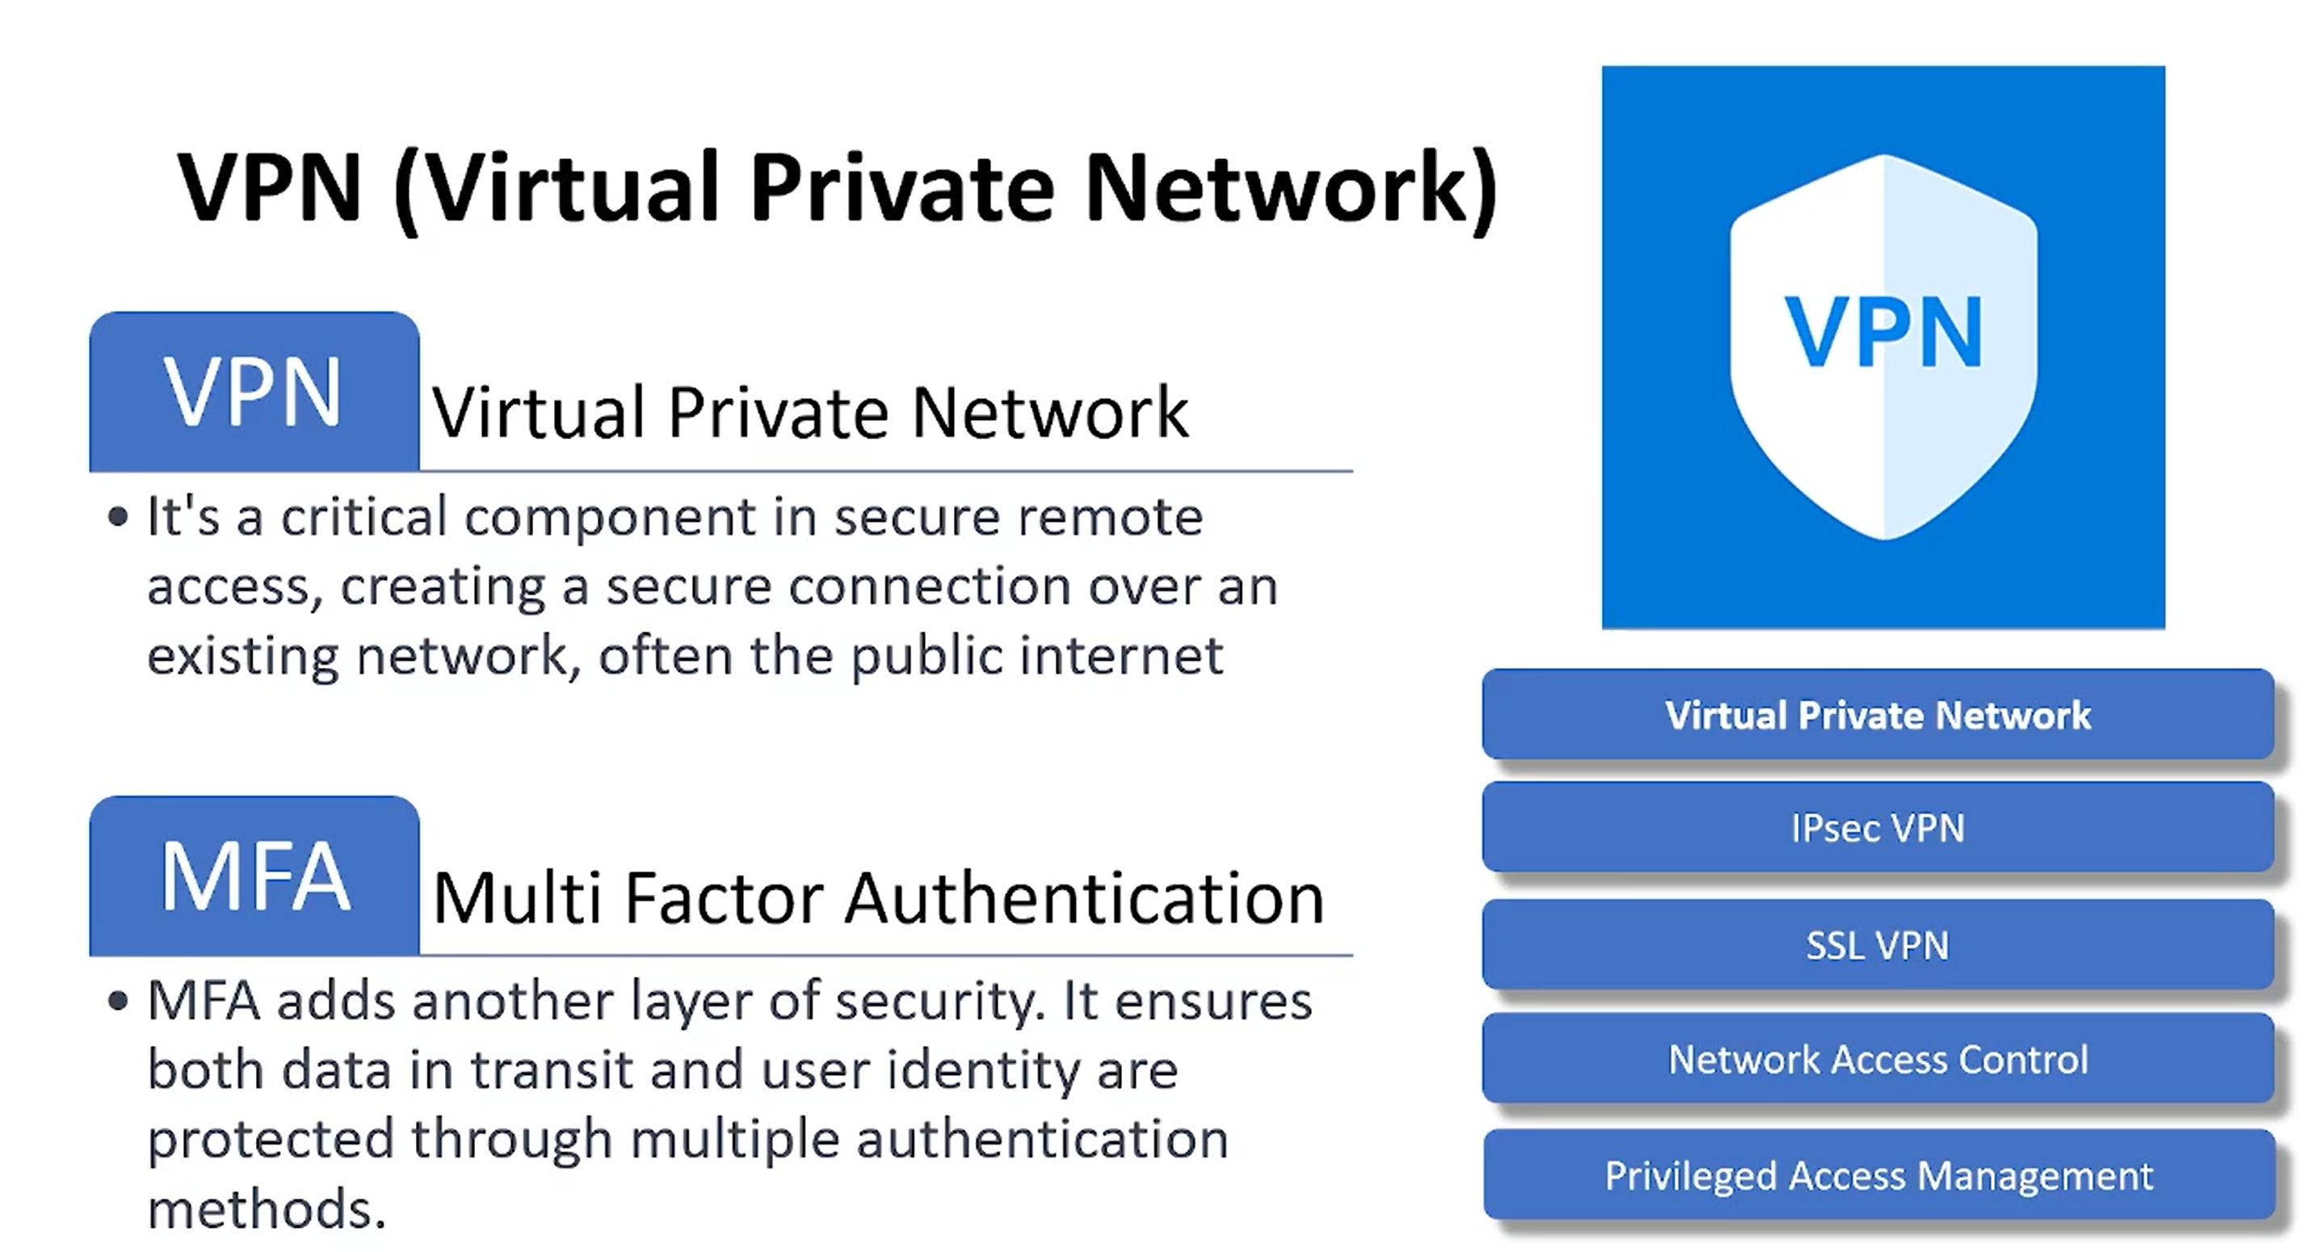
An Intrusion Detection System (IDS) is a vital tool in cybersecurity. It detects unusual digital activity and raises alarms when necessary. Analysts then investigate and take actions, such as isolating compromised systems or blocking unauthorized access. In essence, an IDS plays a crucial role in safeguarding the digital realm.

Slide 4
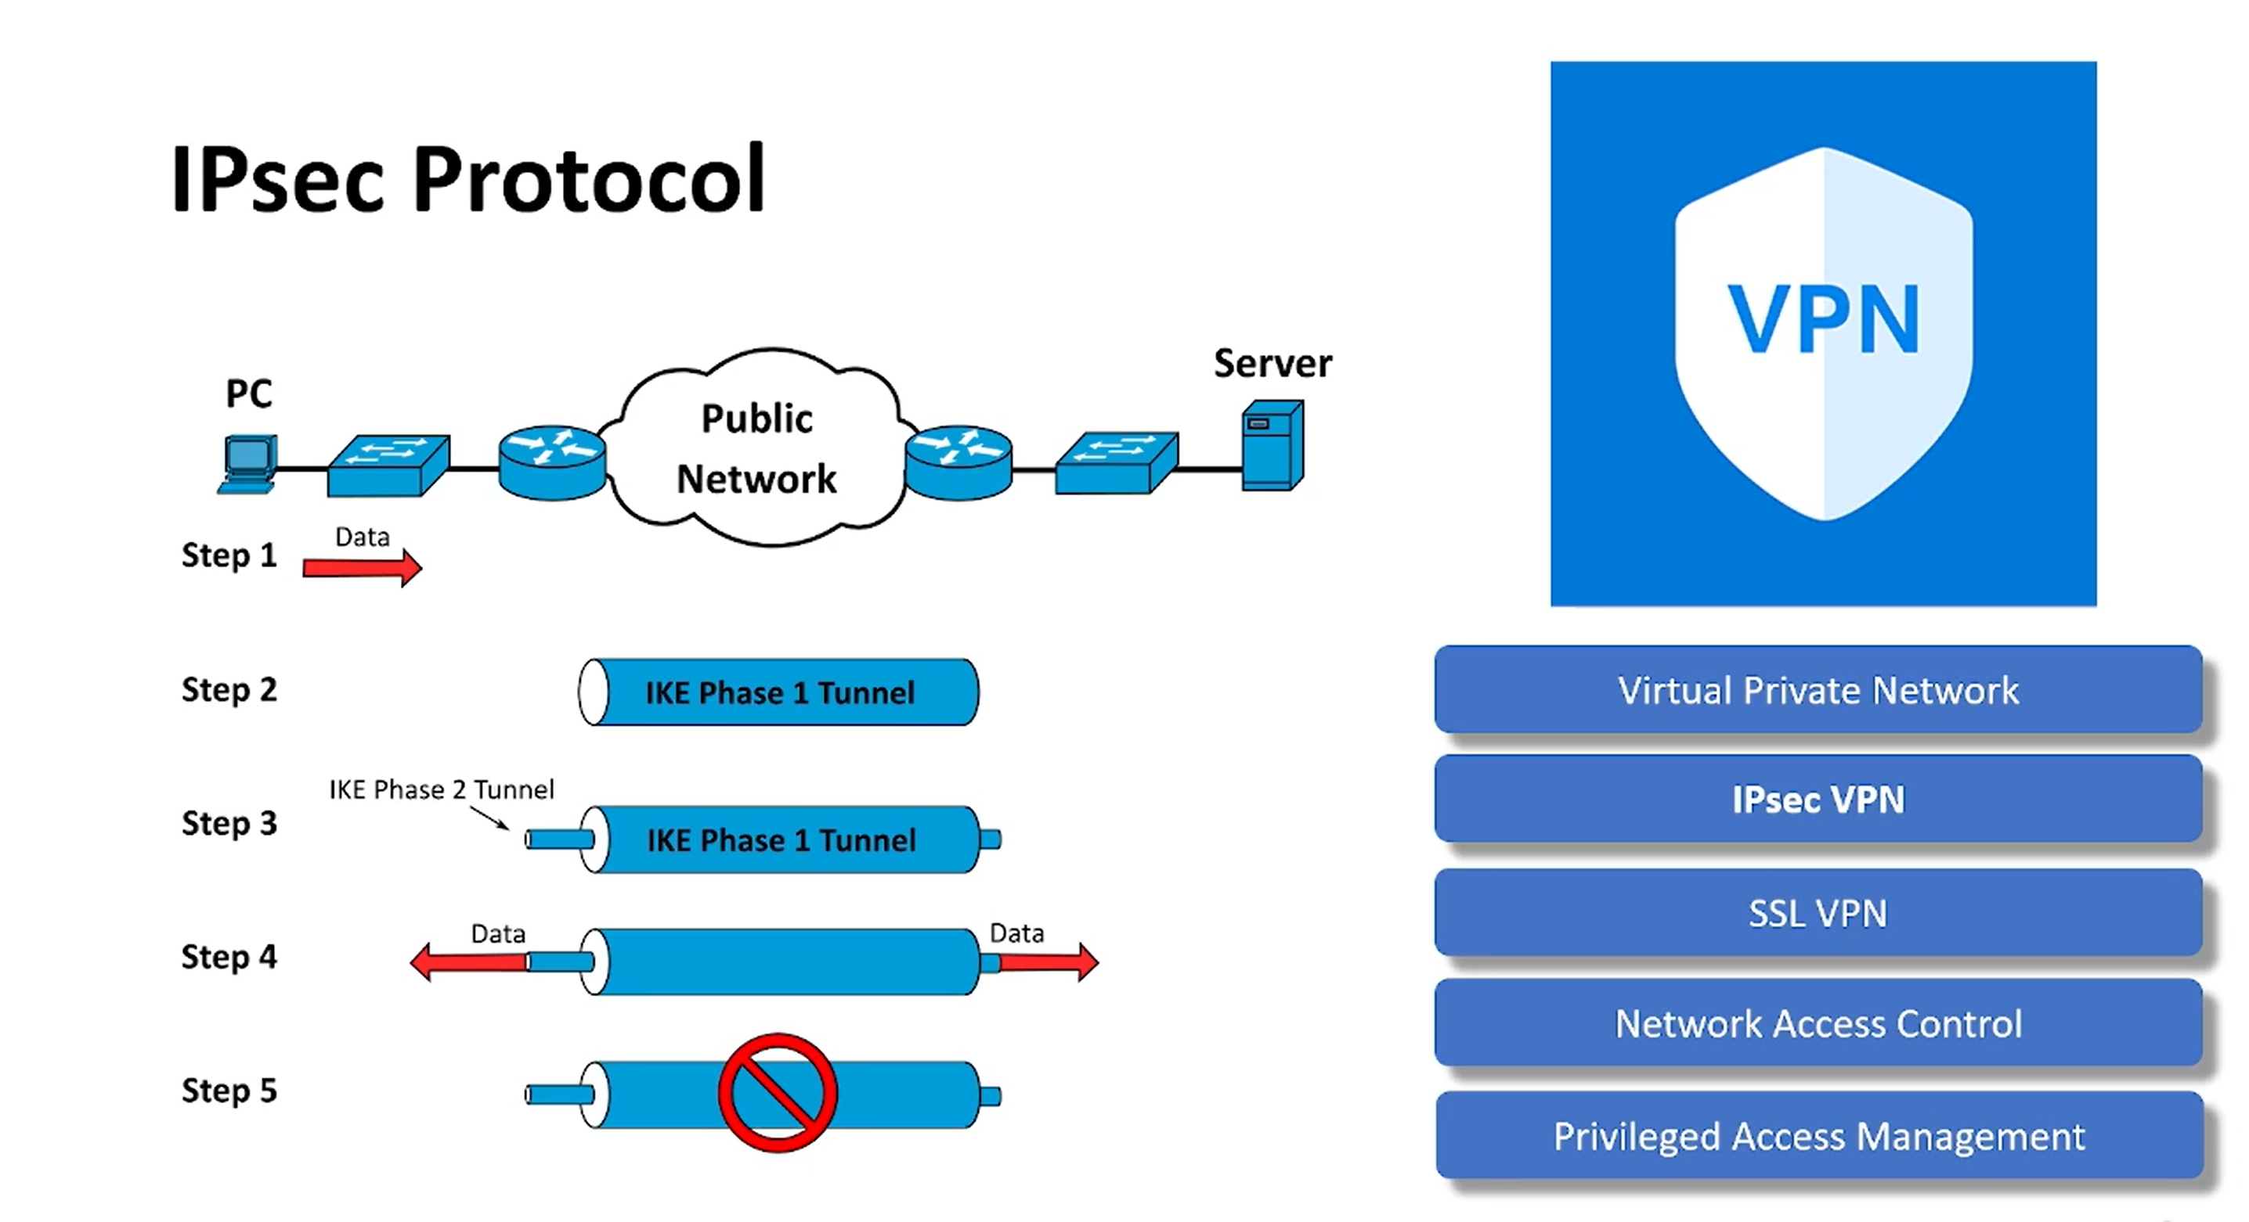
An Intrusion Detection System (IDS) is a vital tool in cybersecurity. It detects unusual digital activity and raises alarms when necessary. Analysts then investigate and take actions, such as isolating compromised systems or blocking unauthorized access. In essence, an IDS plays a crucial role in safeguarding the digital realm.

Slide 5
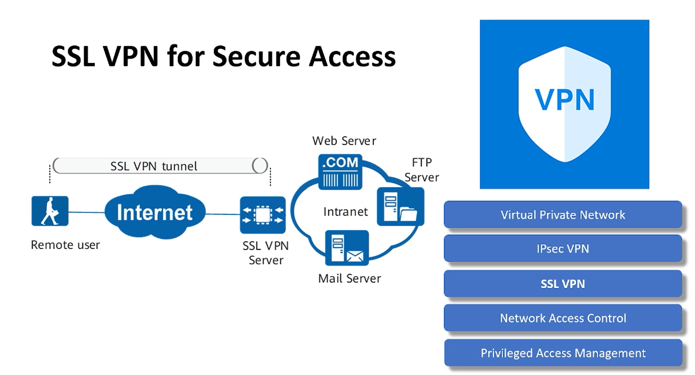
An Intrusion Detection System (IDS) is a vital tool in cybersecurity. It detects unusual digital activity and raises alarms when necessary. Analysts then investigate and take actions, such as isolating compromised systems or blocking unauthorized access. In essence, an IDS plays a crucial role in safeguarding the digital realm.

Slide 6
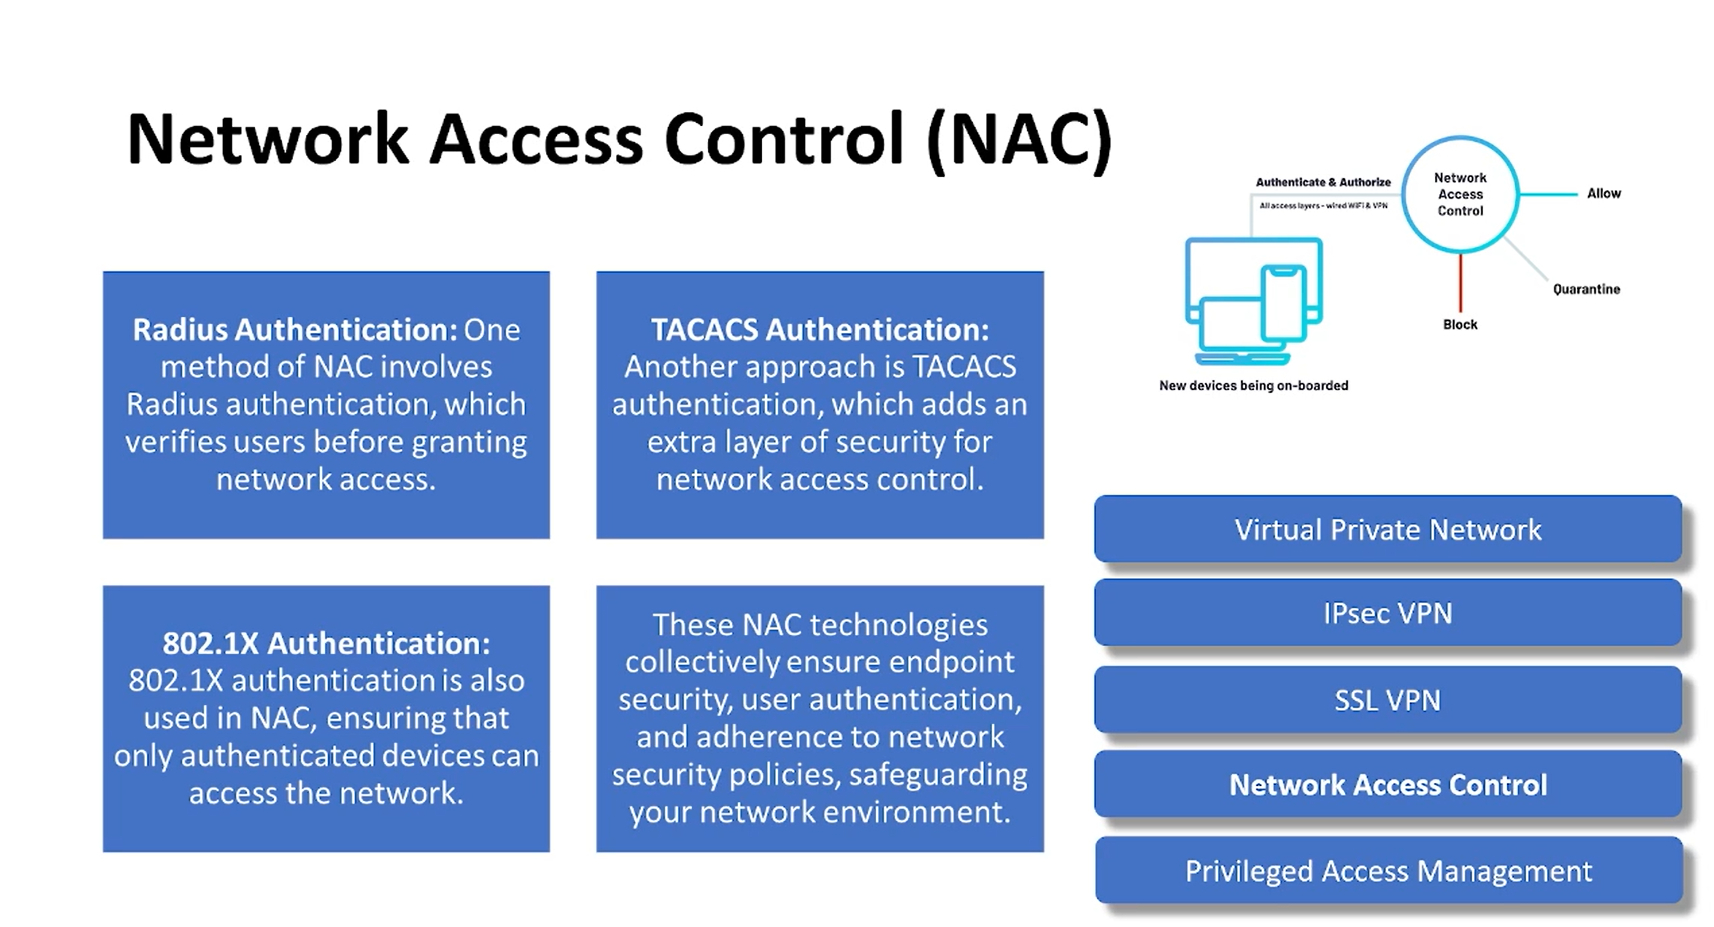
An Intrusion Detection System (IDS) is a vital tool in cybersecurity. It detects unusual digital activity and raises alarms when necessary. Analysts then investigate and take actions, such as isolating compromised systems or blocking unauthorized access. In essence, an IDS plays a crucial role in safeguarding the digital realm.

Slide 7
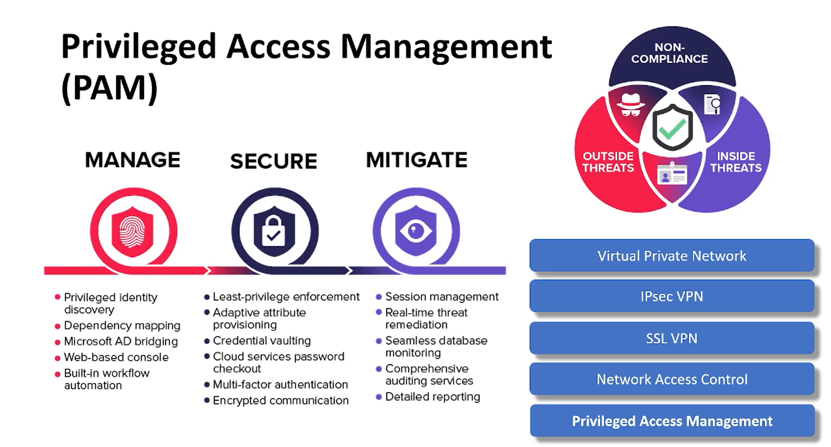
An Intrusion Detection System (IDS) is a vital tool in cybersecurity. It detects unusual digital activity and raises alarms when necessary. Analysts then investigate and take actions, such as isolating compromised systems or blocking unauthorized access. In essence, an IDS plays a crucial role in safeguarding the digital realm.

Slide 8
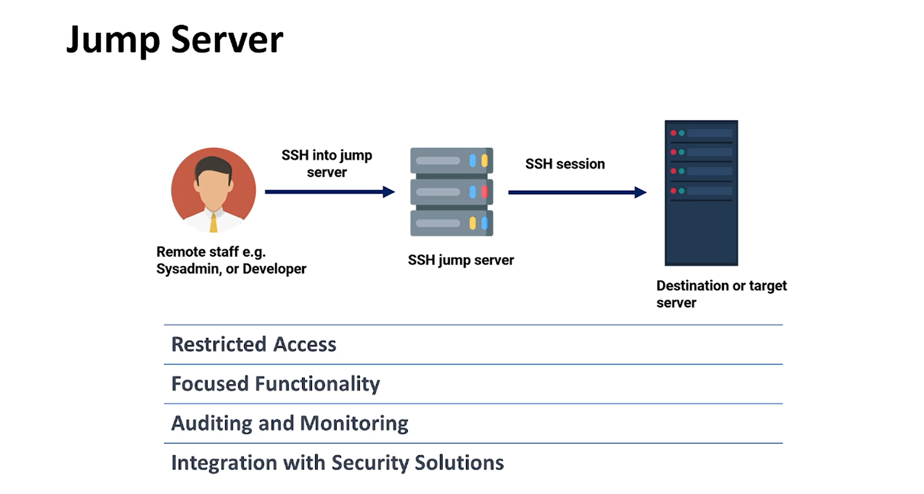
An Intrusion Detection System (IDS) is a vital tool in cybersecurity. It detects unusual digital activity and raises alarms when necessary. Analysts then investigate and take actions, such as isolating compromised systems or blocking unauthorized access. In essence, an IDS plays a crucial role in safeguarding the digital realm.

Slide 9
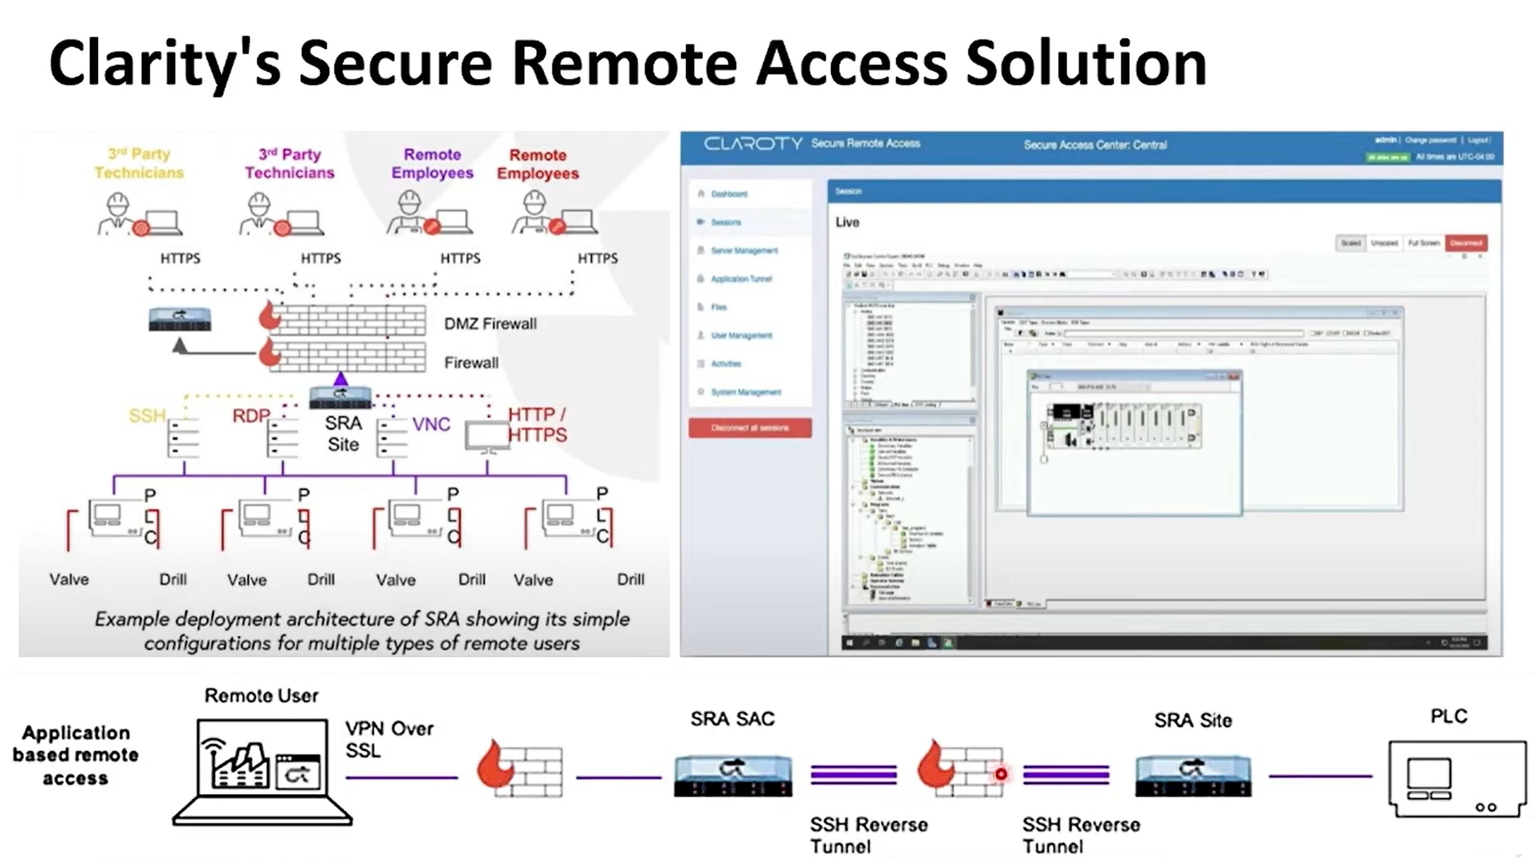
An Intrusion Detection System (IDS) is a vital tool in cybersecurity. It detects unusual digital activity and raises alarms when necessary. Analysts then investigate and take actions, such as isolating compromised systems or blocking unauthorized access. In essence, an IDS plays a crucial role in safeguarding the digital realm.

Slide 10
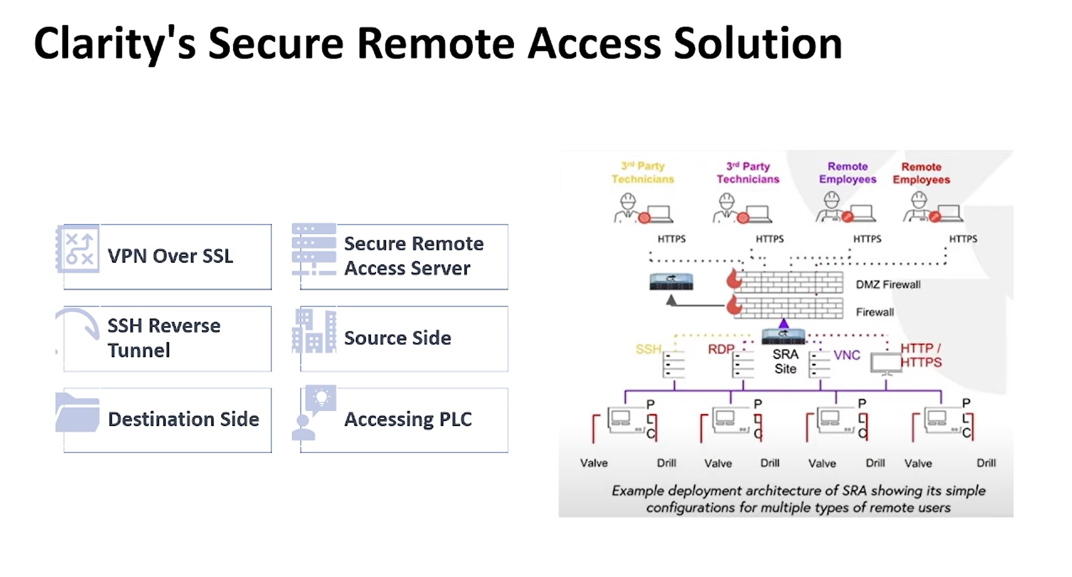
An Intrusion Detection System (IDS) is a vital tool in cybersecurity. It detects unusual digital activity and raises alarms when necessary. Analysts then investigate and take actions, such as isolating compromised systems or blocking unauthorized access. In essence, an IDS plays a crucial role in safeguarding the digital realm.

Slide 11
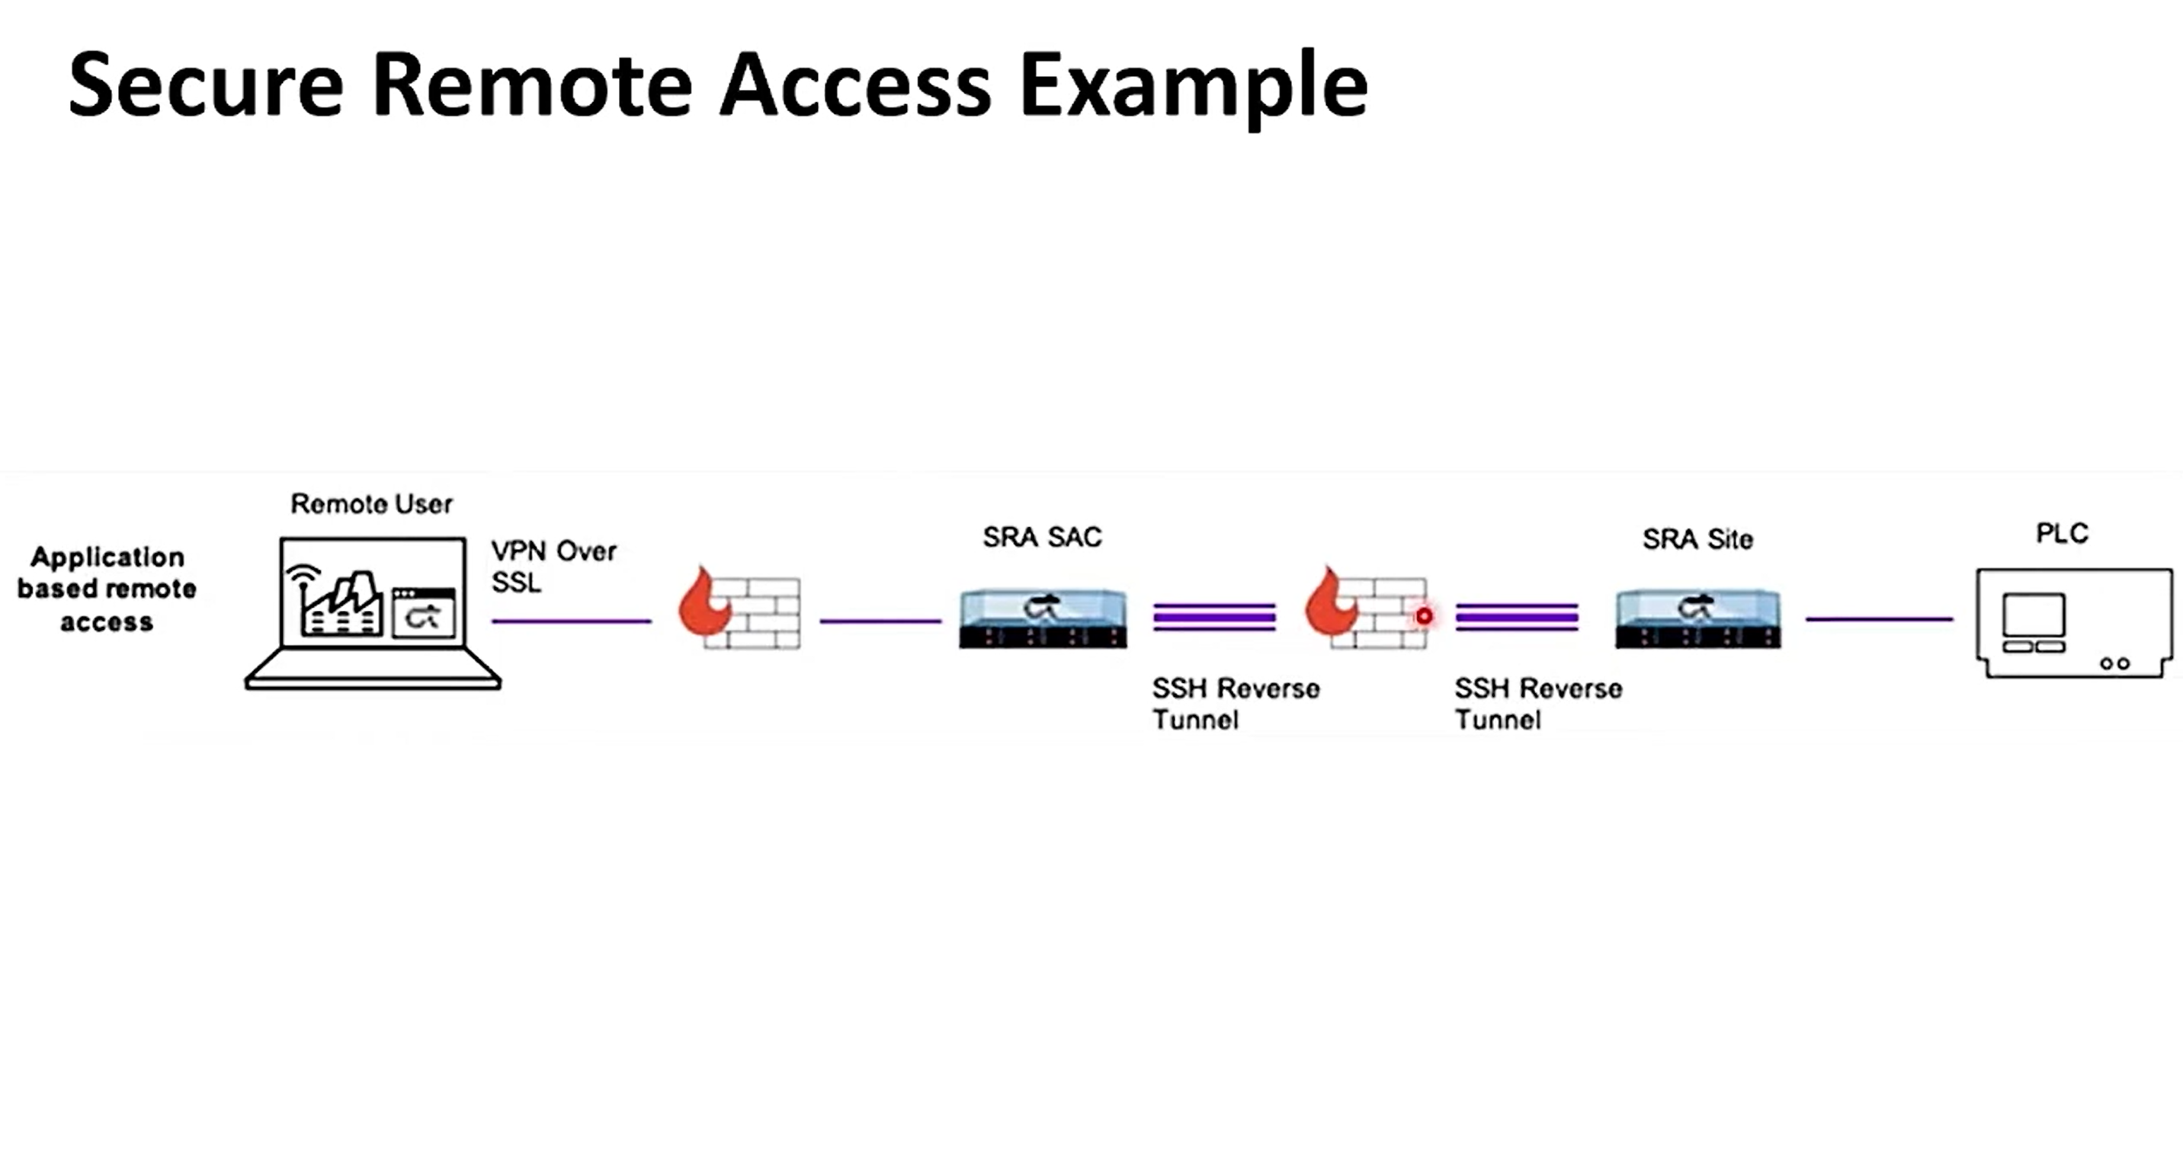
An Intrusion Detection System (IDS) is a vital tool in cybersecurity. It detects unusual digital activity and raises alarms when necessary. Analysts then investigate and take actions, such as isolating compromised systems or blocking unauthorized access. In essence, an IDS plays a crucial role in safeguarding the digital realm.

Slide 12
An Intrusion Detection System (IDS) is a vital tool in cybersecurity. It detects unusual digital activity and raises alarms when necessary. Analysts then investigate and take actions, such as isolating compromised systems or blocking unauthorized access. In essence, an IDS plays a crucial role in safeguarding the digital realm.

Slide 13
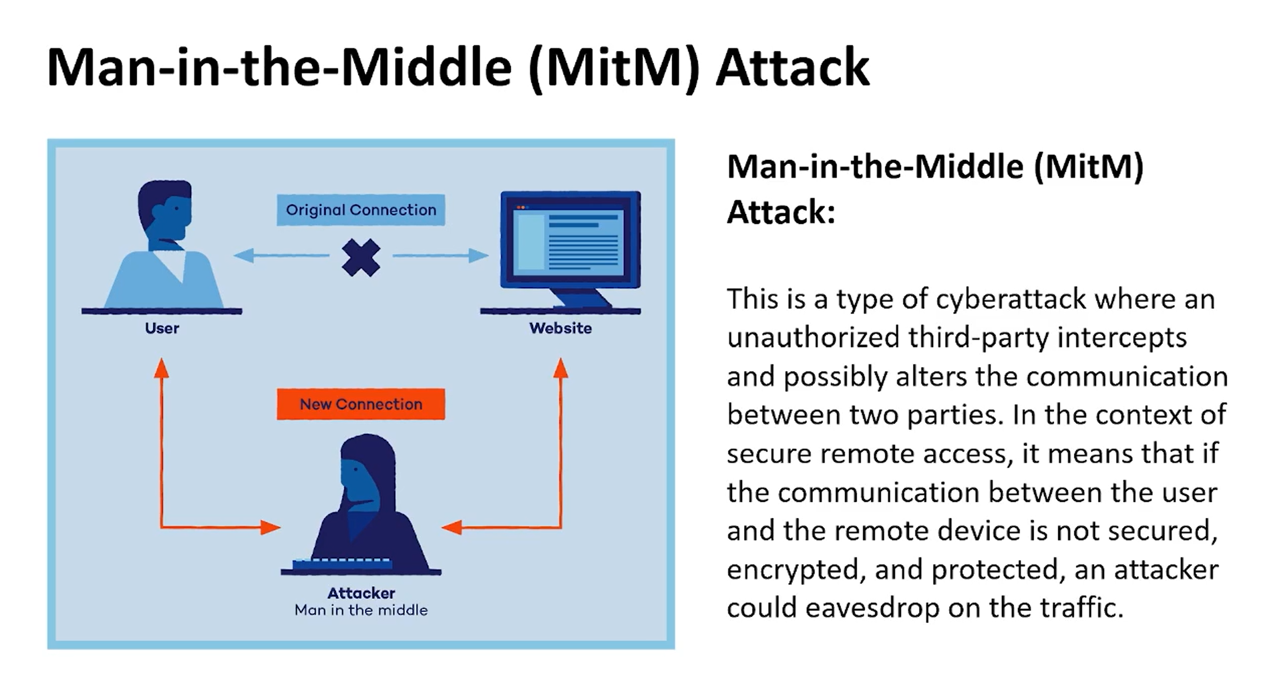
An Intrusion Detection System (IDS) is a vital tool in cybersecurity. It detects unusual digital activity and raises alarms when necessary. Analysts then investigate and take actions, such as isolating compromised systems or blocking unauthorized access. In essence, an IDS plays a crucial role in safeguarding the digital realm.

Slide 14
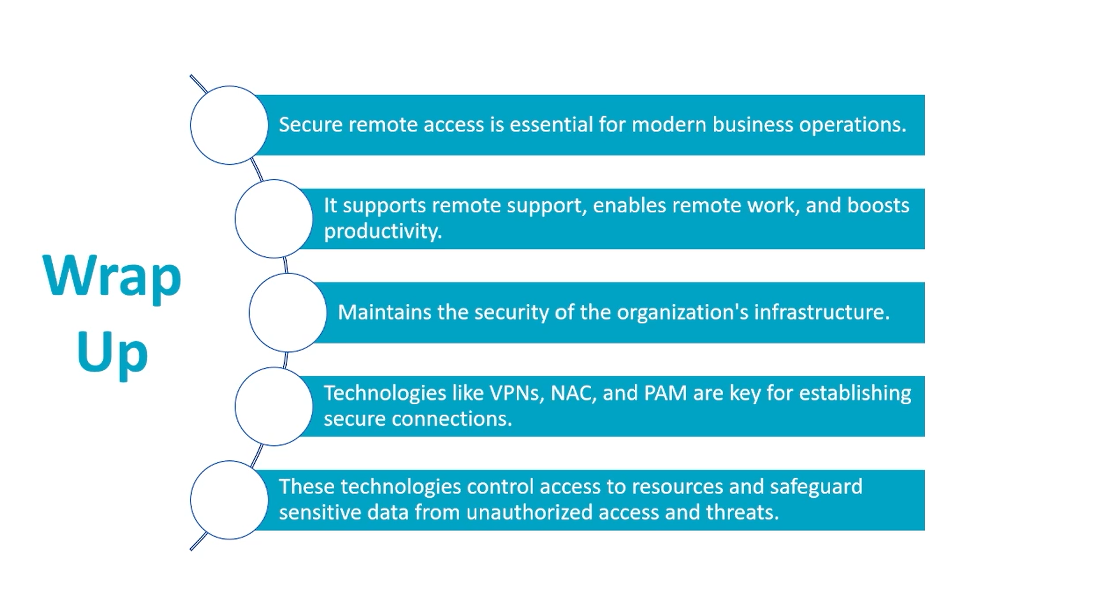
An Intrusion Detection System (IDS) is a vital tool in cybersecurity. It detects unusual digital activity and raises alarms when necessary. Analysts then investigate and take actions, such as isolating compromised systems or blocking unauthorized access. In essence, an IDS plays a crucial role in safeguarding the digital realm.

