Slide 1


Network
Discovery in
Cybersecurity

Slide 2
Simple Network Management
Protocol (SNMP)
Network
Discovery
Link Layer Discovery Protocol
(LLDP)
Methods
Internet Control Message
Protocol (ICMP)

Slide 3


This protocol employs
SNMP polling to identify
Simple Network Management
Protocol (SNMP)
devices and store their values in an OID table. This table is queried using SNMP to retrieve information like
device names, CPU usage,
memory percentages, and
disk availability
SIMPLE NETWORK
LINK LAYER DISCOVERY
INTERNET CONTROL
MANAGEMENT
PROTOCOL (LLDP)
MESSAGE PROTOCOL
PROTOCOL (SNMP)
(ICMP)

Slide 4

LLDP enables devices to
share data with directly
Link Layer Discovery Protocol (LLDP)
connected neighbors at
regular intervals, aiding in
mutual identification within a network. To witness LLDP in action, capturing a Wireshark dump of an ICS Network reveals its
communications.
SIMPLE NETWORK
LINK LAYER DISCOVERY
INTERNET CONTROL
MANAGEMENT
PROTOCOL (LLDP)
MESSAGE PROTOCOL
PROTOCOL (SNMP)
(ICMP)

Slide 5

This software utility serves
to verify device accessibility
Internet Control Message Protocol (ICMP)
within an IP network,
aligning with the common
practice of checking device
presence and connectivity
through techniques like
pinging.
SIMPLE NETWORK
LINK LAYER DISCOVERY
INTERNET CONTROL
MANAGEMENT
PROTOCOL (LLDP)
MESSAGE PROTOCOL
PROTOCOL (SNMP)
(ICMP)

Slide 6

Network Discovery Purpose

Slide 7


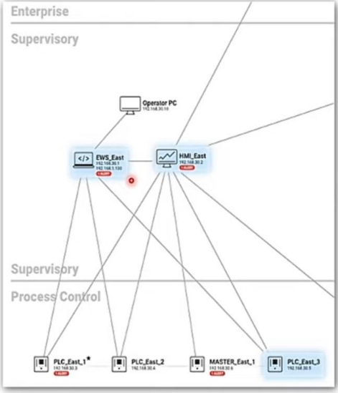
Active
Querying
Passive
Querying
These solutions employ a dual approach, incorporating both active and passive queries to construct a comprehensive network map.

Slide 8
Active
Querying
Passive
Querying
Network discovery serves as a comprehensive technology or solution that offers a holistic view of your network's intricacies

Slide 9

Air Gaps Full Coverage System Failure
Air gap systems are deliberately isolated from the main network, rendering them impervious to external connectivity.

Slide 10
Air Gaps Full Coverage System Failure
Striving Full network coverage is a perpetual goal. Many intrusion detection and management tools rely on credentials or endpoint agents, leading to complexities and potential omissions of unmanaged devices.

Slide 11
Air Gaps Full Coverage System Failure
Striving for comprehensive network coverage is a perpetual goal. Many intrusion detection and management tools rely on credentials or endpoint agents, leading to complexities and potential omissions of unmanaged
devices.

Slide 12
Network discovery is essential for complex networks.
It integrates with security measures using protocols like SNMP, LLDP, and ICMP.
Wrap
Challenges: air gap systems, potential failures during querying.
Up
Recommended approach: cautious testing and segmentation.
Provides insight into network architecture and stability.
This chapter has highlighted its importance, protocols, challenges, and strategies for further exploration of network dynamics.

