Slide 1

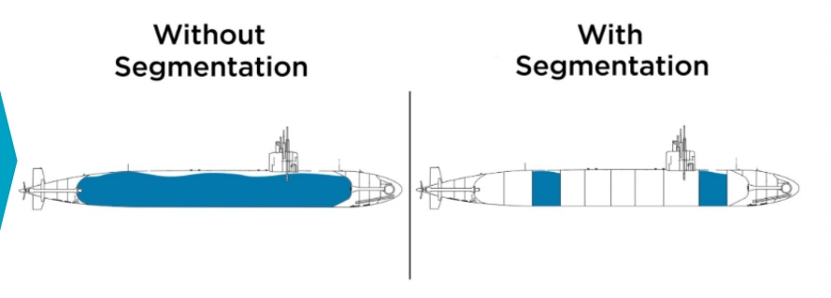
Network
Segmentation
in
Cybersecurity

Slide 2
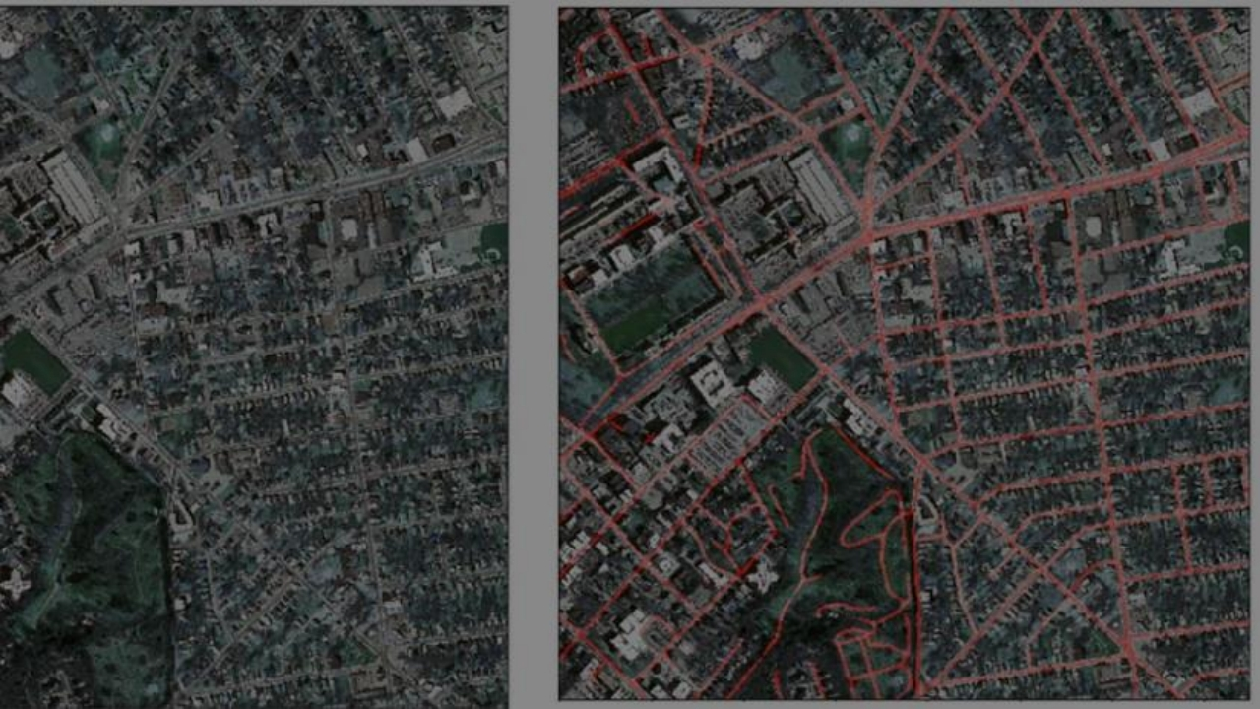
Network Performance
• Segregation, also known as network partitioning or isolation, works as a traffic controller for data within the network. It divides the available bandwidth into distinct sections, each serving specific
purposes.

Slide 3




Operational Performance
REDUCED NETWORK
EFFICIENT TRAFFIC
IMPROVED RESOURCE
ENHANCED SECURITY TARGETED
CONGESTION
FLOW
ALLOCATION
MONITORING AND
MANAGEMENT

Slide 4

Consider the scenario where a malware outbreak occurs –
without segmentation, the
malware can propagate freely
across the entire network,
causing widespread damage.
However, when segmentation is implemented, the malware's impact is
confined to the segment where it
originated. This containment prevents the attack from spreading to other sections of the network, limiting the potential damage and reducing the
scope of the breach.

Slide 5
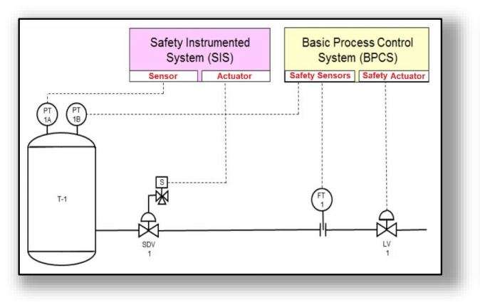
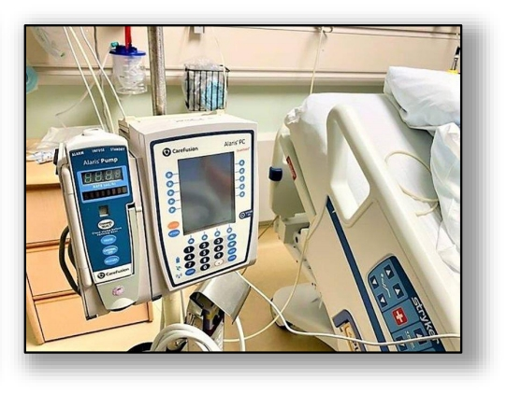
Safeguarding Vulnerable Devices
Safety Instrumented Systems Infusion Pumps

Slide 6

By implementing segmentation,
the organization can create
distinct segments for systems that handle payments and those that do not. This division effectively limits the scope of compliance efforts to only those systems directly involved in
payment processing.

Slide 7
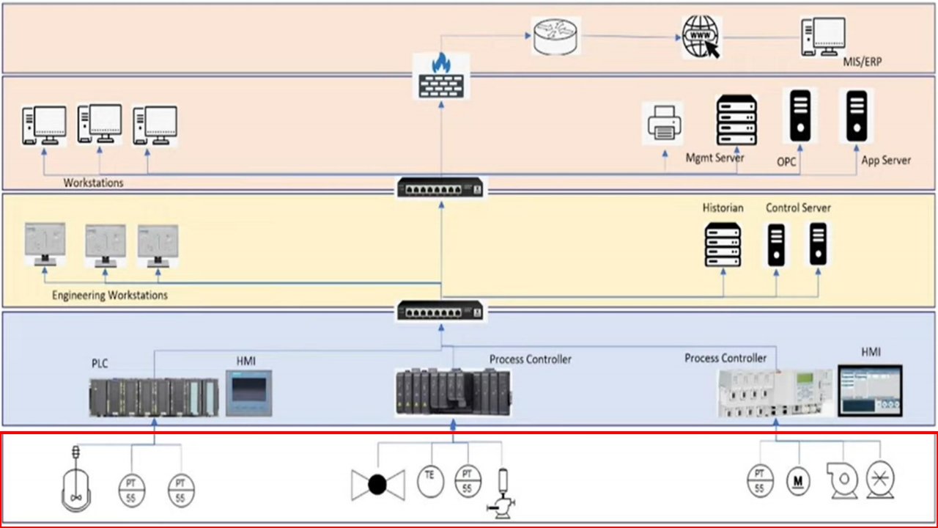

Slide 8
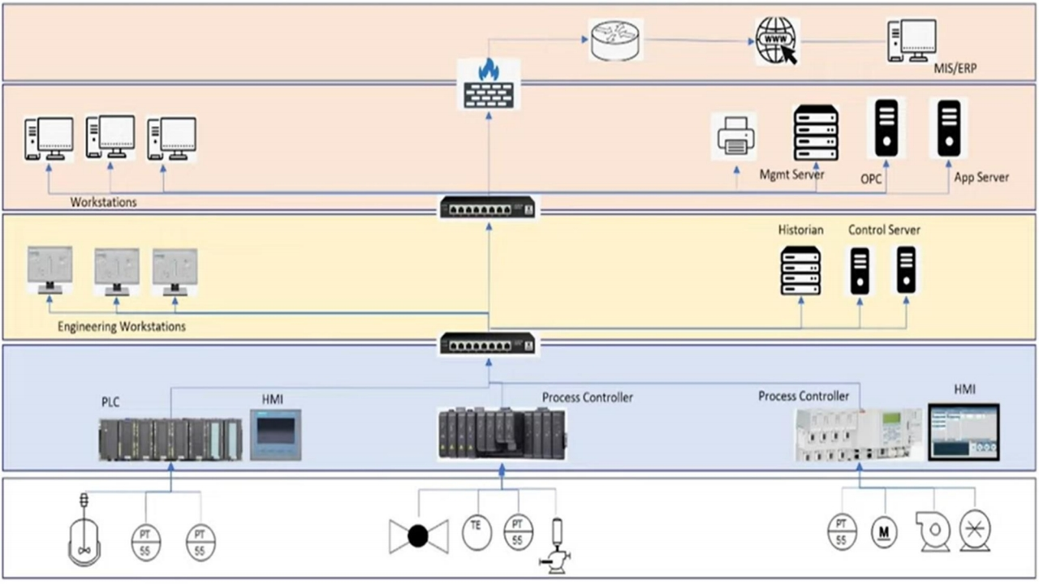

Slide 14

Firewalls play a fundamental role in achieving segmentation. Additionally, routers and Layer 3 switches equipped with access controllers can be utilized for this purpose. The most effective methods for segmentation involve the use of firewalls and routers, along with VLANs to enhance network security and control.

Slide 15


Slide 16
Network segmentation benefits:
Enhances performance by reducing congestion. Improves security via segment isolation. Grants traffic flow control.
Assists in compliance and risk management. Contains threats effectively.
Offers scalability and flexibility.
Wrap
Up
Effective implementation requires robust security and strategic network design.

