Slide 1
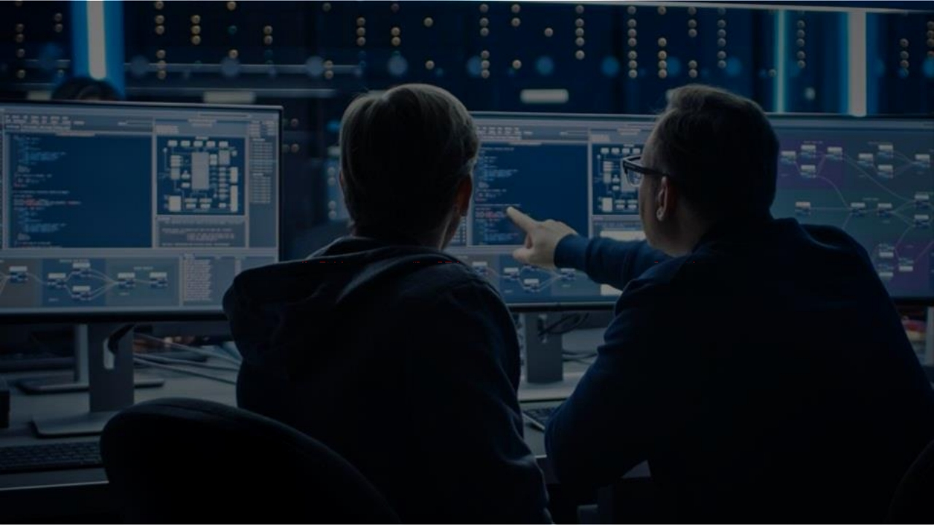
Cyber Security In-depth

Slide 2
Module 1: Course
Introduction
Module 2: Overview
of Control Systems
Module 3: Cyber
Security Introduction
Module 4:
IEC 62443
Foundational
Requirements
Module 5:
Cyber Security In-
Depth
Module 6:
Course Close Out

Slide 3

Asset Management: Strengthening Security
• Systematic identification and management
of data, personal devices, systems, and
Asset
facilities.
Management:
• Prioritization of assets based on significance for robust security.
Strengthening
Security
• Encompasses diverse elements such as data, personal devices, systems, and facilities within the organization.

Slide 4
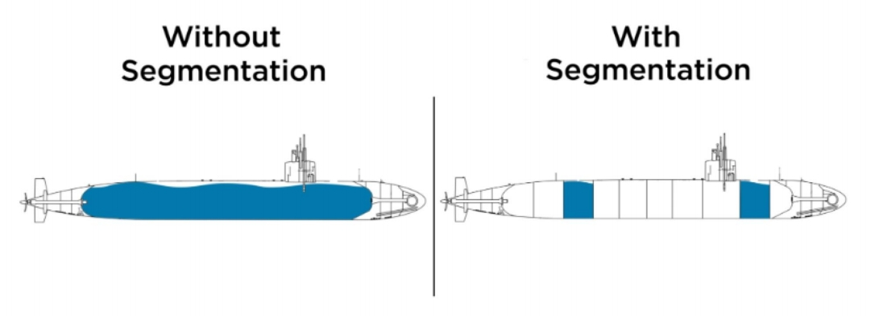
Network Segmentation

Slide 5
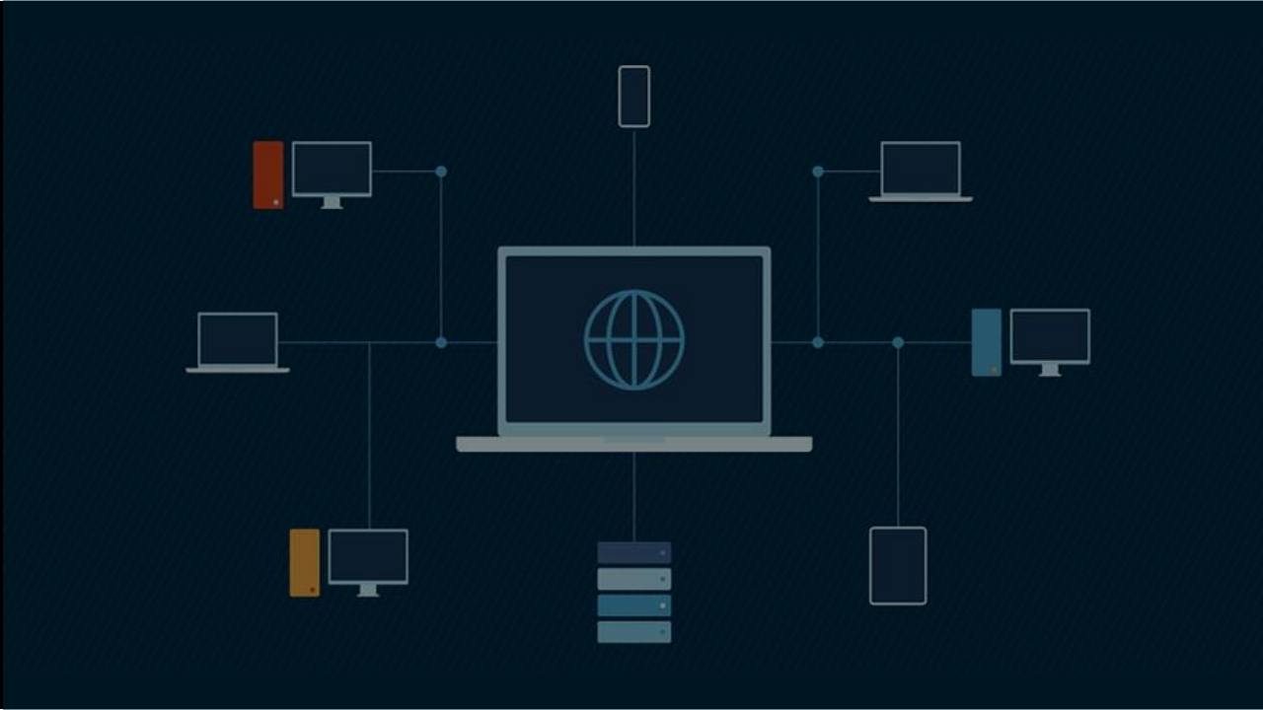
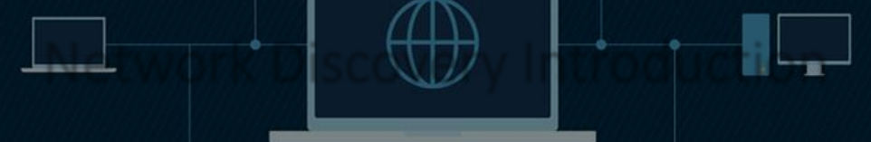
Network Discovery Introduction

Slide 6
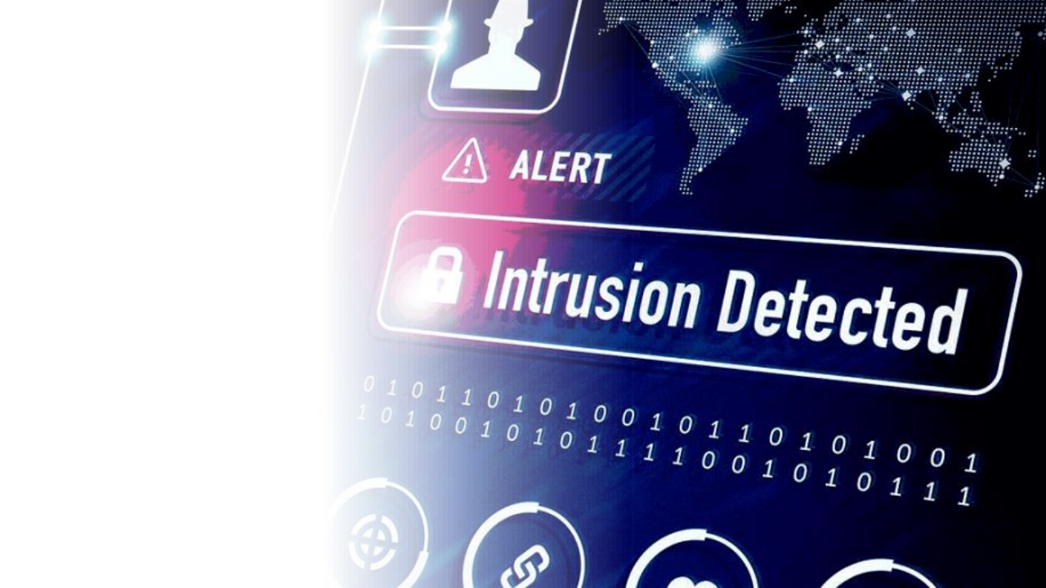
Intrusion
Detection
An Intrusion Detection System (IDS) is a vital tool in cybersecurity. It detects unusual digital activity and raises alarms when necessary. Analysts then investigate and take actions, such as isolating
compromised systems or blocking
unauthorized access. In essence, an IDS plays a crucial role in safeguarding the digital realm.

Slide 7
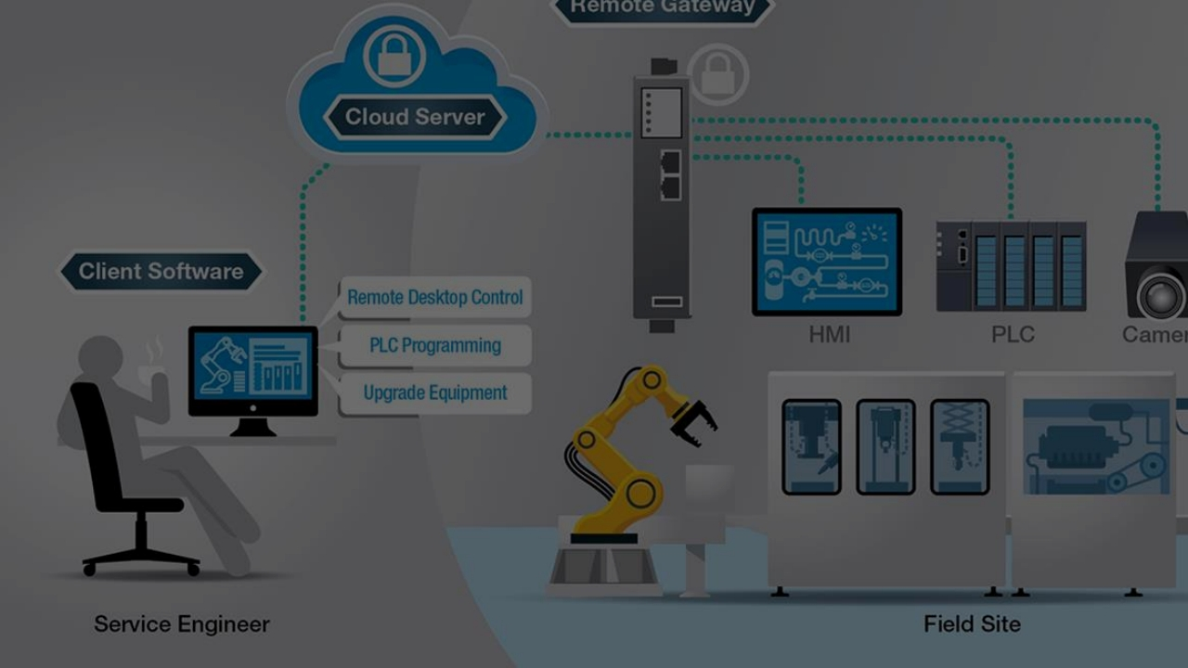
Secure Remote Access

Slide 8
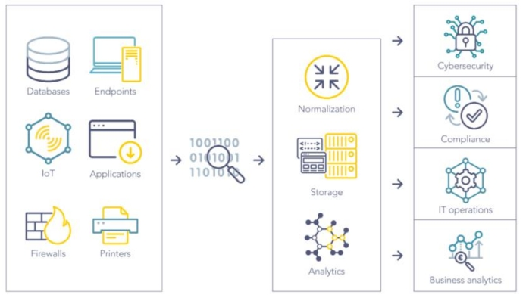
SIEM Introduction
SIEM software collects and
aggregates log data
generated throughout the
entire IT infrastructure,
from cloud systems and
applications to network and
security devices, such as
firewalls and antivirus.

Slide 9
