Slide 1

FR1 – Identification, authentication and access control
FR2 – Use Control
FR3 – System Integrity
FR 5 – From
FR4 – Data Confidentiality
IEC 62443
FR5 – Restrict Data Flow
FR6 – Timely response to event
FR7 – Resource Availability

Slide 2
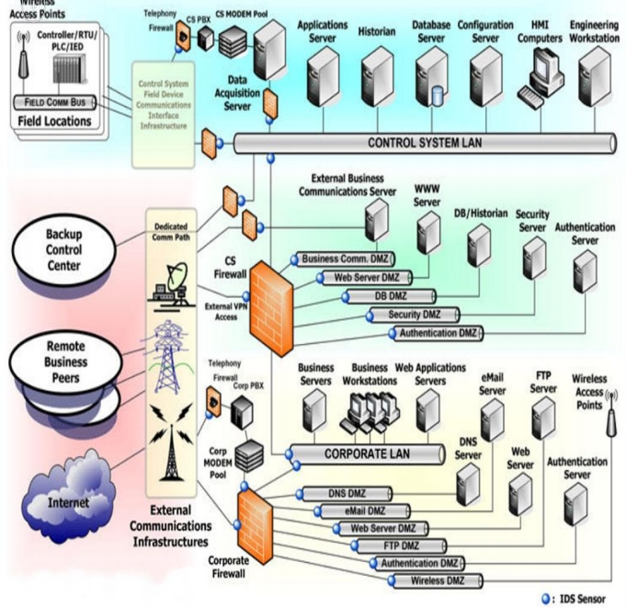
Introduction
• Importance of data flow control in Industrial
Control Systems (ICS)
• Segmentation of control
system architecture into
zones and conduits
• Alignment with the Purdue model's logical separation
approach

Slide 3
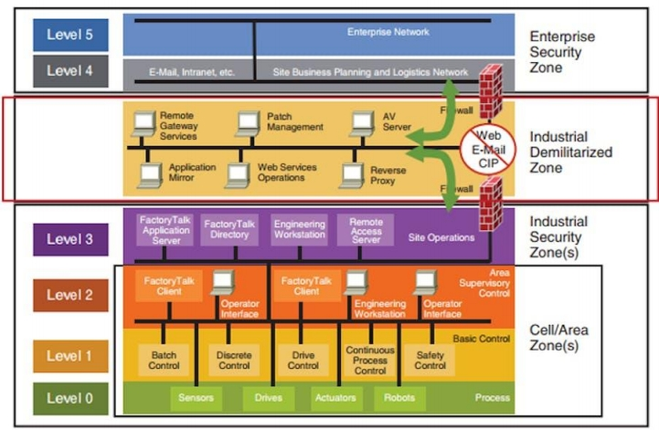
Purdue Model
The primary requirement for data flow control is to prevent unnecessary and
undesired communication
between different parts of
the control system.

Slide 4
Purdue Model
Following the principles of the Purdue model, we can determine the appropriate
zones within the control
system architecture.

Slide 5

Scenario:
Manufacturing
Plant Hierarchy:
• Illustrating zones: Process
Control, Supervisory Control,
HMI, Corporate Network
• Variability in criticality and sensitivity across zones

Slide 6


Firewalls
Data Flow
Control
VLAN (Virtual LAN)
Technologies:
Unidirectional Gateways (Data
Diodes)

Slide 7




Stricter access controls and prevention of unauthorized communication
Benefits of
Enhanced data confidentiality and security
Effective Data
Flow Control
Efficient collaboration and communication
within control environment
Regulatory compliance and stakeholder
confidence

Slide 8
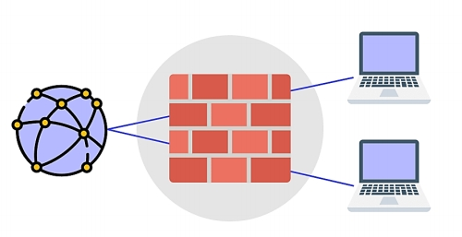
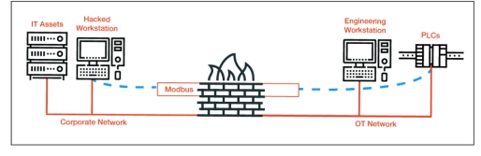
Firewalls
• Guardians of zone boundaries
• Enforce predefined rule sets
• Control incoming and outgoing traffic based on IP, protocols, and ports
• Prevention of unauthorized data flow between zones

Slide 9
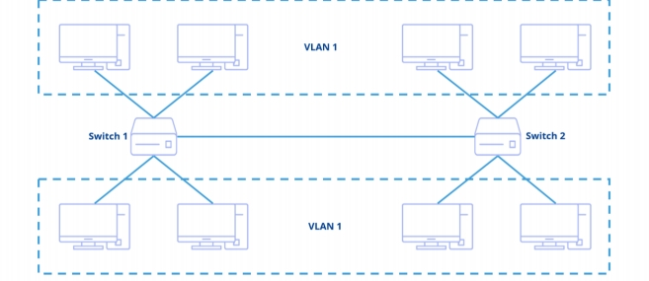
VLAN (Virtual LAN)
• Logical network separation within a single physical infrastructure
• Each VLAN operates as an isolated network • Controlled communication between VLANs • Ideal when physical separation is not feasible

Slide 10
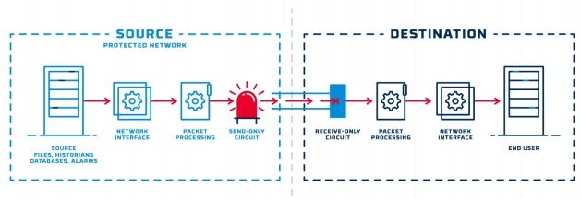
Unidirectional Gateways
(Data Diodes)
• Establish one-way flow of information between zones
• Enables secure transmission from high-security to low-security zones
• Prevents reverse communication
• Sharing critical data without compromising security

Slide 11

Implementation
When implementing data flow control, it is essential to consider the criticality of systems and the potential impact of any disruptions.

Slide 12




Implementation Strategy
Determine criticality
and sensitivity of zones
Strategically place
firewalls at interaction
points
Implement VLANs for
logical separation
Deploy unidirectional
gateways for one-way
data transmission

Slide 13
Significance of data flow control in ICS security
Wrap
Strengthened security posture
through effective implementation
Up
Optimized collaboration while ensuring
confidentiality and compliance

