Slide 1

FR1 – Identification, authentication and access control
FR2 – Use Control
FR3 – System Integrity
FR 4 – Data
FR4 – Data Confidentiality
Confidentiality
FR5 – Restrict Data Flow
FR6 – Timely response to event
FR7 – Resource Availability

Slide 2
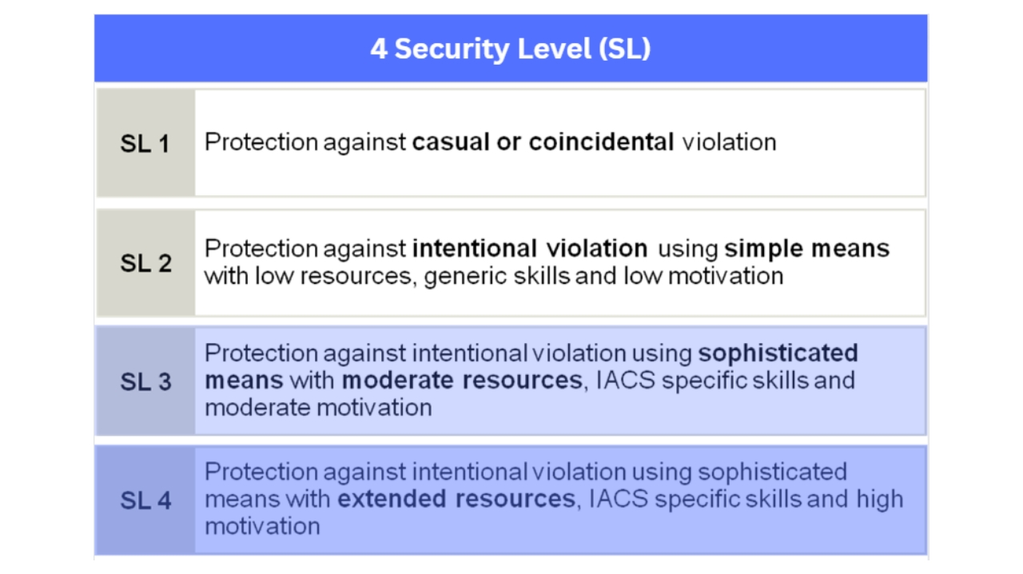

Slide 3
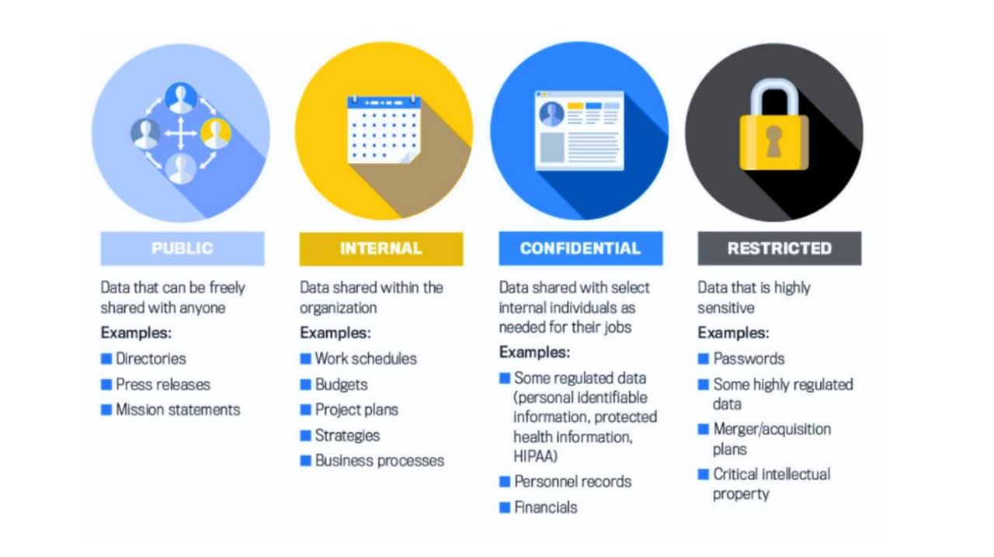

Slide 4
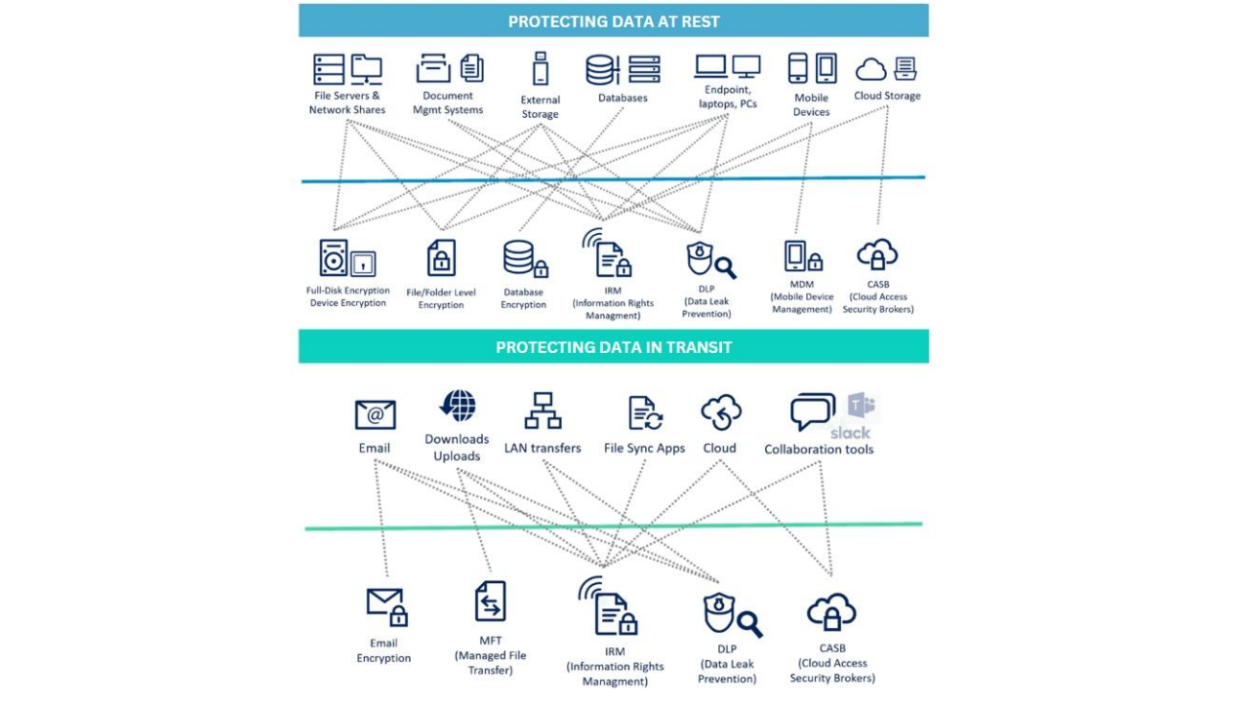

Slide 5
Measures to Ensure Data Confidentiality
1. Secure
Encrypted
Protocols
6. Disabling
Insecure
Versions
7. Account
Suspension
and Privilege
Withdrawal
2. VPN
Tunnels
3. Email
Encryption
4. Real-time
Alerts
5. Policy
Enforcement

Slide 6
Measures to Ensure Data Confidentiality
1. Secure
Encrypted
Protocols
6. Disabling
Insecure
Versions
7. Account
Suspension
and Privilege
Withdrawal
2. VPN
Tunnels
3. Email
Encryption
4. Real-time
Alerts
5. Policy
Enforcement

Slide 7
Data Confidentiality as per IEC 62443 SL3 & SL4
Restrict Access to Data
Encrypt Data
Implement a Confidentiality Policy
Implement a Data Retention Policy
Develop and Implement a Cyber Security Program
Take Physical Security Measures

Slide 8

Restrict Access to Data
Encrypt Data
Implement a Confidentiality Policy
Implementing least privilege access control ensures confidentiality by granting authorized users minimal necessary permissions, minimizing risks of unauthorized disclosures or modifications, and limiting access to relevant data for their roles.
Implement a Data Retention Policy
Develop and Implement a Cyber Security Program
Take Physical Security Measures

Slide 9

Restrict Access to Data
Encrypt Data
Implement a Confidentiality Policy
Implement a Data Retention Policy
Encryption ensures data confidentiality by converting information into unreadable form using complex algorithms, preventing
Develop and Implement a Cyber Security Program
unauthorized decryption and maintaining security in storage, communication, and transmission.
Take Physical Security Measures

Slide 10

Restrict Access to Data
Encrypt Data
Implement a Confidentiality Policy
Implement a Data Retention Policy
A confidentiality policy is essential to secure data, guiding employees to handle sensitive information carefully through encrypted
Develop and Implement a Cyber Security Program
communication and secure practices, reducing the risk of unauthorized disclosure.
Take Physical Security Measures

Slide 11

Restrict Access to Data
Encrypt Data
Implement a Confidentiality Policy
Implement a Data Retention Policy
Data retention and disposal policies are vital for effective data management and security. These policies determine how long data should be stored and how to securely dispose of it, based on business needs and compliance.
Develop and Implement a Cyber Security Program
Take Physical Security Measures

Slide 12
Restrict Access to Data
Key components of a cybersecurity program include:
Encrypt Data
1.Risk Assessment
2.Data Protection Measures:
Implement a Confidentiality Policy
3.Physical Security
4.Security Policies and Procedures:
5.Incident Response Plan
Implement a Data Retention Policy
6.Employee Training
7.Regular Monitoring and Auditing:
8.Updates and Patches
Develop and Implement a Cyber Security Program
9.Vendor and Third-Party Management
Take Physical Security Measures

Slide 13
Restrict Access to Data
Key components of a cybersecurity program include:
Encrypt Data
1.Risk Assessment
2.Data Protection Measures:
Implement a Confidentiality Policy
3.Physical Security
4.Security Policies and Procedures:
5.Incident Response Plan
Implement a Data Retention Policy
6.Employee Training
7.Regular Monitoring and Auditing:
8.Updates and Patches
Develop and Implement a Cyber Security Program
9.Vendor and Third-Party Management
Take Physical Security Measures

Slide 14

Restrict Access to Data
Encrypt Data
Implement a Confidentiality Policy
Safeguarding data involves cyber and physical security measures; implementing office alarms, surveillance, access controls, and monitoring enhances protection against theft and unauthorized access, providing a comprehensive approach to data security.
Implement a Data Retention Policy
Develop and Implement a Cyber Security Program
Take Physical Security Measures

Slide 15
Data confidentiality is vital for organizations to protect sensitive information and uphold trust.
Implementing encryption, data classification, confidentiality policies, data retention policies, cybersecurity programs, and physical security measures enhances data confidentiality.
Wrap
Up
These measures help prevent unauthorized access or disclosures of sensitive data.
Prioritizing data confidentiality is crucial for overall security and maintaining trust with stakeholders.

