Slide 1

FR1 – Identification, authentication and access control
FR2 – Use Control
FR 3 –
FR3 – System Integrity
System
FR4 – Data Confidentiality
Integrity
FR5 – Restrict Data Flow
FR6 – Timely response to event
FR7 – Resource Availability

Slide 2
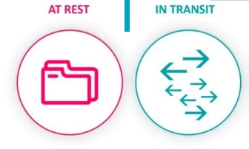
Data at Rest
Data Security
Data security encompasses safeguarding
data confidentiality, integrity, and availability, both at rest and in transit.
Data in Transit

Slide 3
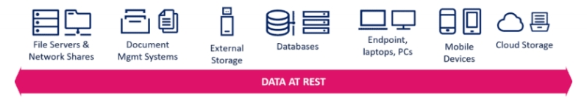
Data at Rest
Data at Rest
To fulfill FR 3, organizations should use encryption, access controls, monitoring, and backup processes to safeguard data at rest from unauthorized access or modifications, ensuring its integrity and availability.
Data in Transit

Slide 4

Data at Rest
Data in Transit
To address FR 3, organizations should use encryption, secure protocols, and authentication to safeguard data in transit, while continuous network monitoring detects threats and upholds data integrity.
Data in Transit

Slide 5

Beyond securing data at rest and in transit, it's crucial to extend protection to assets post- removal and prevent leaks, necessitating robust security measures across the data lifecycle.
Data Life Cycle

Slide 6

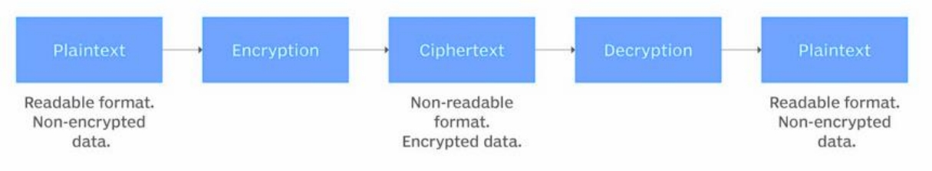
Cryptography
Cryptography secures industrial control systems with encryption, digital signatures, and hashing, protecting data confidentiality and integrity.

Slide 7

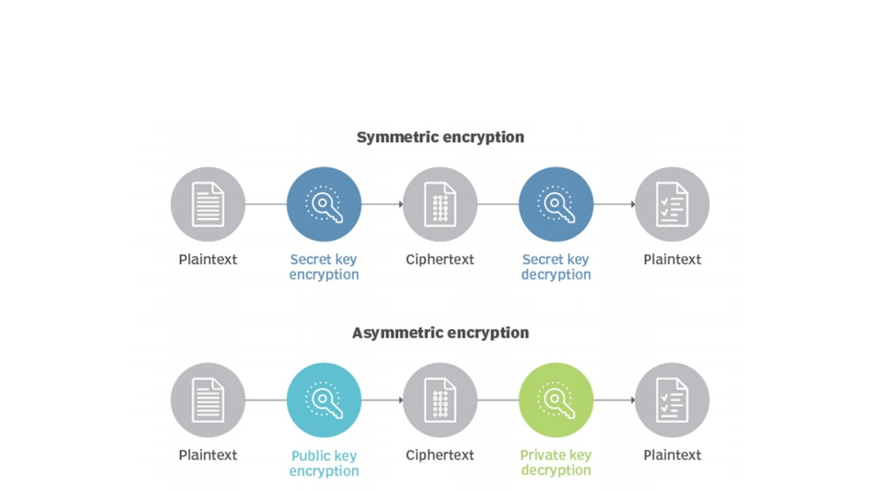
Encryption

Slide 8

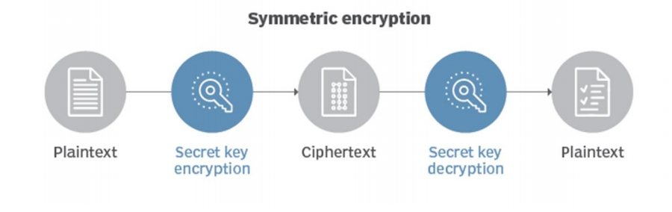
Encryption
Symmetric encryption uses a single secret key to both encrypt and decrypt data, ensuring its confidentiality and integrity during transmission and storage.

Slide 9
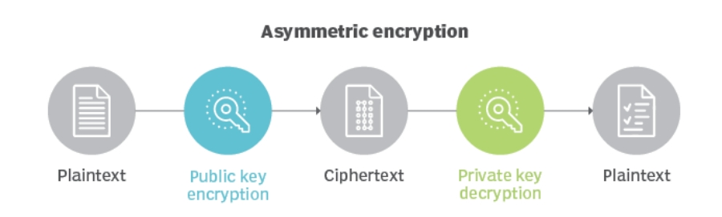
Encryption
Asymmetric encryption involves a pair of keys: a public key for encryption and a private key for decryption, enhancing security and enabling secure communication and authentication.

Slide 10





Identify and
Protect Critical
Secure Critical
Data in Transit
Data
Data Security for
Industrial Control
Systems
Recommendations
Implement
Ensure Data
Cryptographic
Confidentiality
Mechanisms
and Integrity

Slide 11
Focus on the third foundational requirement: safeguarding ICS integrity to prevent unauthorized manipulation.
Explores data security for data at rest and in transit, emphasizing the role of cryptography.
Wrap
Up
Covers encryption, digital signatures, hashing, and more as cryptographic techniques.
Recommendations include protecting critical data during transit, implementing encryption, and ensuring confidentiality and integrity.

