Slide 1
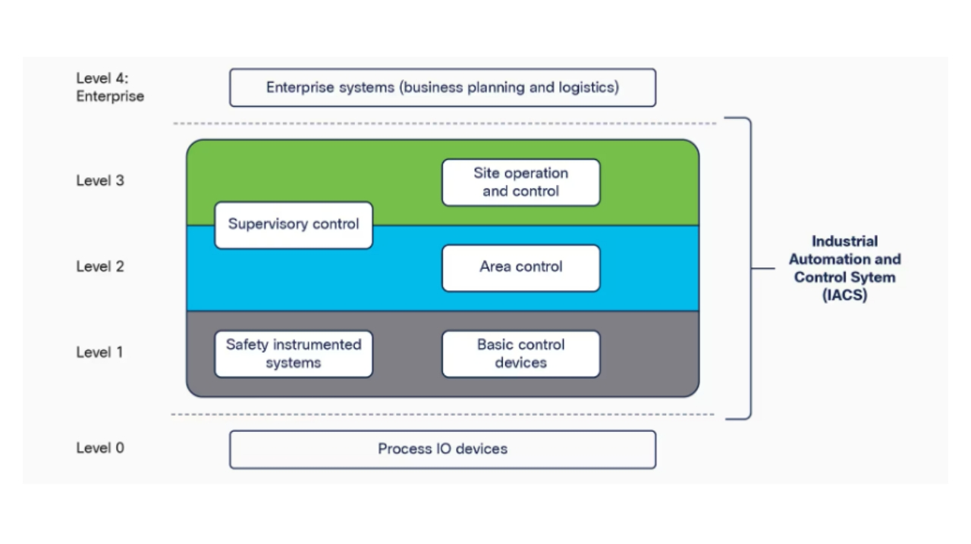

Slide 2
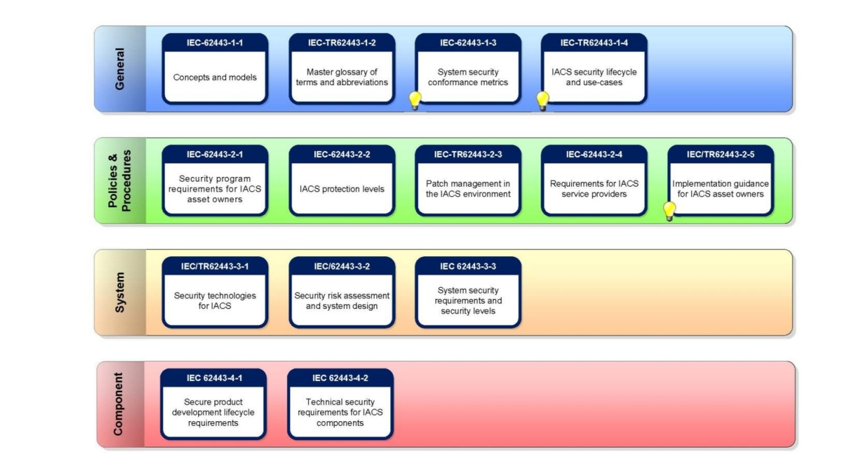

Slide 3
FR1 – Identification, authentication and access control
FR2 – Use Control
FR3 – System Integrity
FR4 – Data Confidentiality
FR5 – Restrict Data Flow
FR6 – Timely response to event
FR7 – Resource Availability

Slide 4
FR1 – Identification, authentication and access control
FR2 – Use Control
FR3 – System Integrity
FR4 – Data Confidentiality
FR5 – Restrict Data Flow
FR6 – Timely response to event
FR7 – Resource Availability

Slide 5
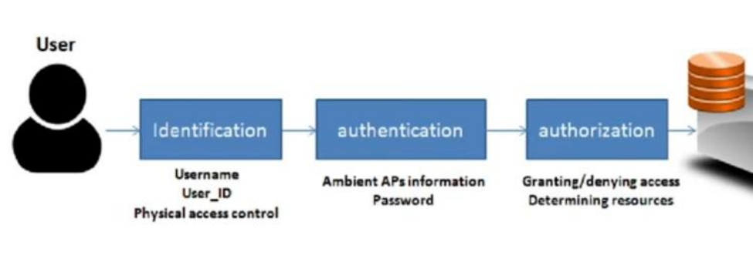
FR1 – Identification,
authentication and access
control

Slide 6
FR1 – Identification, authentication and access control
Attribute-Based Access Control (ABAC)
Role-Based Access Control (RBAC)
Mandatory Access Control
Discretionary Access Control (DAC)
Break Glass Access Control
Rule-Based Access Control
Physical Access Control

Slide 7
This lesson covered ICS cybersecurity foundational requirements based on IEC 62443 standard.
Seven key requirements were discussed: identification, authentication, system integrity, data confidentiality, restricted data flow, event response, and resource availability.
Wrap
Up
Access control types including ABAC, RBAC, DAC, and more were explained.
This knowledge aids in designing secure systems for industrial control environments.

