Slide 1
Module 1: Course
Introduction
Module 2: Overview
of Control Systems
Module 3: Cyber
Security Introduction
Module 4:
IEC 62443
Foundational
Requirements
Module 5:
Cyber Security In-
Depth
Module 6:
Course Close Out

Slide 2
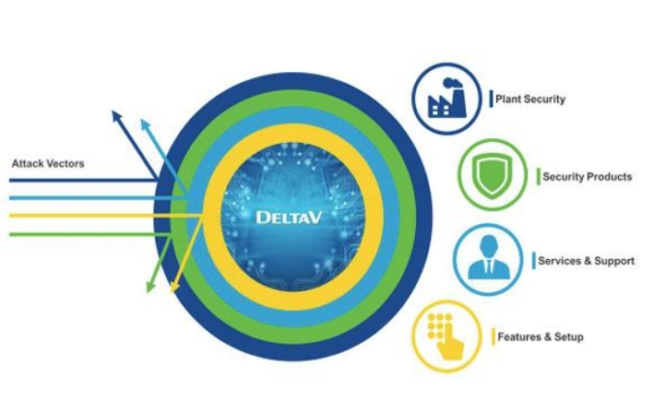
ICS Cyber Security Standards
BS EN61511 2017
Risk Assessment for Cybersecurity
Mitigating Strategies
ISA/IEC62443
Assess
Implement
Maintain a Defence in Depth Strategy

Slide 3
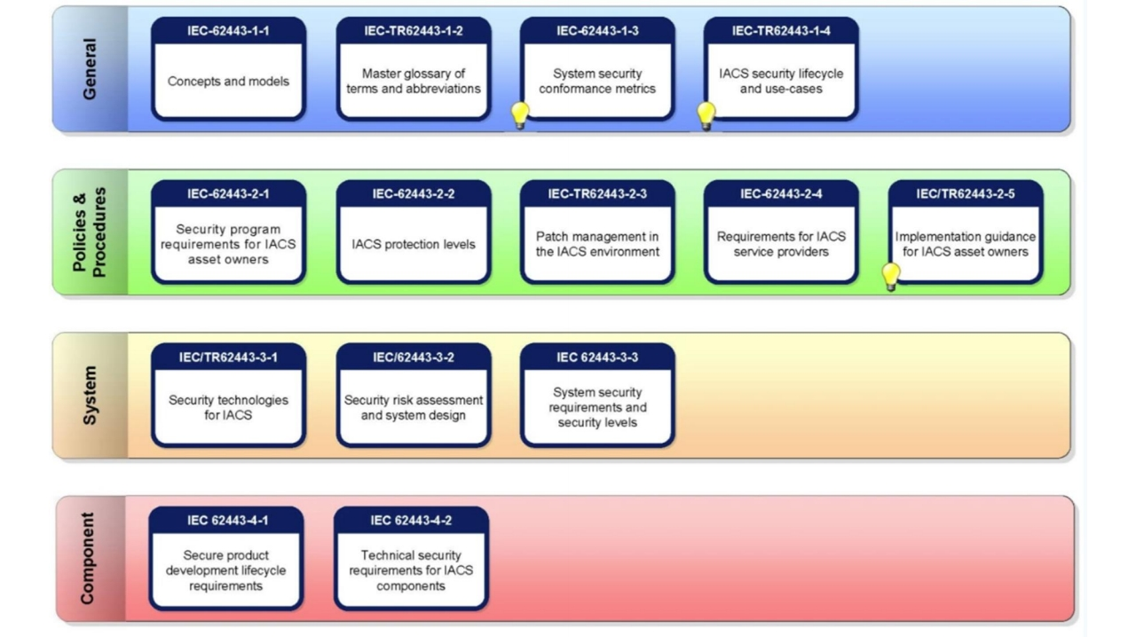

Slide 4
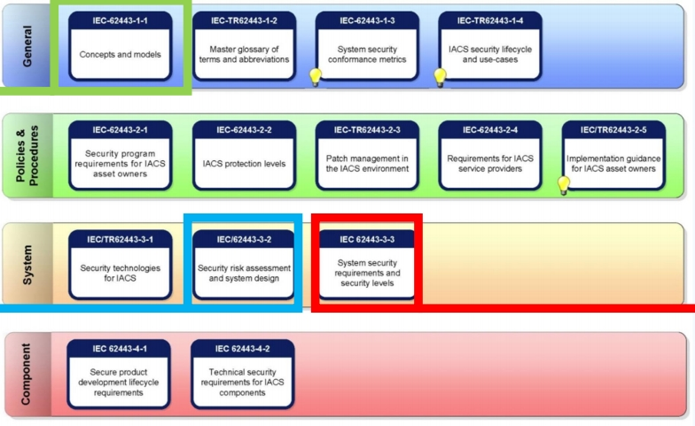
Foundational
requirements
contain methods
encompassing
People, Processes
and Technology to
attain required
IACS Security
Levels (SLs)
Defines
requirements for
Defines technical
Risk Assessing both
requirements for
existing IACS and
IACS security
new designs

Slide 5
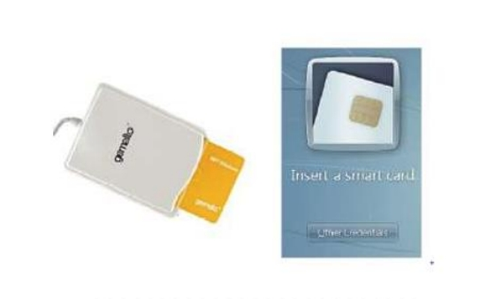
FR 1-Access
Control (AC)
1.Access Control (AC)
2.Reliably Identify and Authenticate 3.All Users (Humans, Software Processes, and Devices)

Slide 6

FR 2-Use Control
1.Use Control (UC)
2.Enforce Assigned Privileges
3.Authenticated User (Human, Software
Process, or Device)
4.Monitor the Use of Privileges

Slide 7
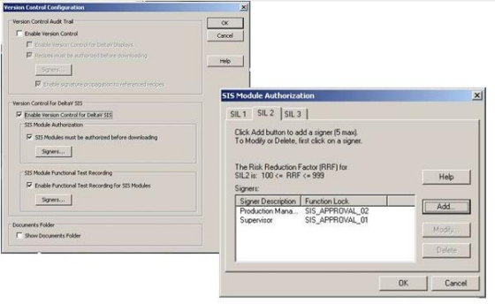
FR 3-System Integrity
1.System Integrity (SI)
2. Ensure the Integrity of the IACS
3. Prevent Unauthorized Manipulation

Slide 8
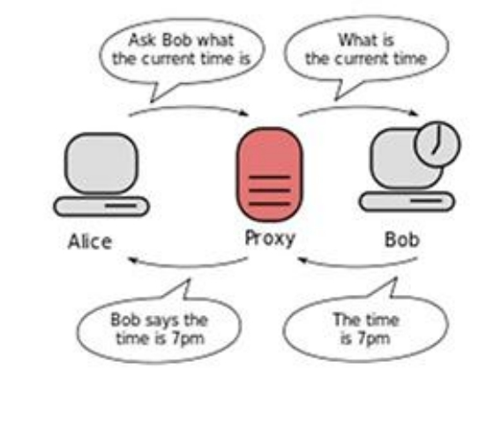
FR 4 -Data
Confidentiality (DC)
1.Data Confidentiality (DC)
2.Ensure the Confidentiality of
Information
3.On Communication Channels and
in Data Repositories
4.Prevent Unauthorized Disclosure

Slide 9
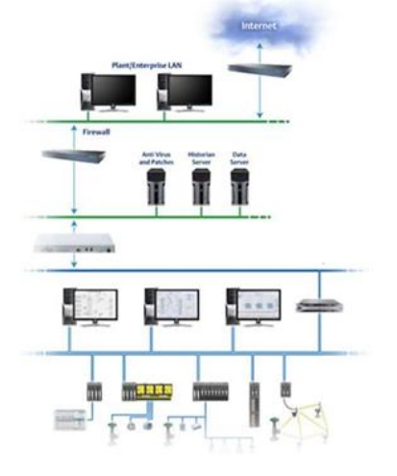
FR 5-Restrict Data
Flow (RDF)
1.Restrict Data Flow (RDF)
2.Segment the Control System via Zones and Conduits
3.Limit Unnecessary Flow of Data

Slide 10

FR 6-Timely
Response to Events
(TRE)
1.Timely Response to Events (TRE) 2.Respond to Security Violations
3.Notify the Proper Authority
4.Report Needed Evidence of the Violation 5.Take Timely Corrective Action

Slide 11
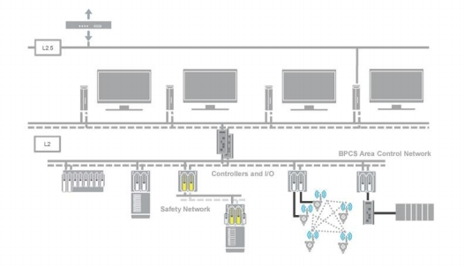
FR 7-Resource
Availability (RA)
1.Resource Availability (RA)
2.Ensure the Availability of the Control System 3.Against the Degradation or Denial of Essential Services

Slide 12
