Slide 1

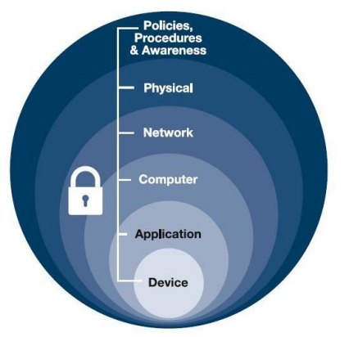
Defense in
Depth
Defense in depth is a strategic approach that leverages multiple layers of security measures
to protect an organization's assets.

Slide 2

Defense in depth
addresses security
vulnerabilities not
only inherent in
hardware and
software but also in
the human element.

Slide 3
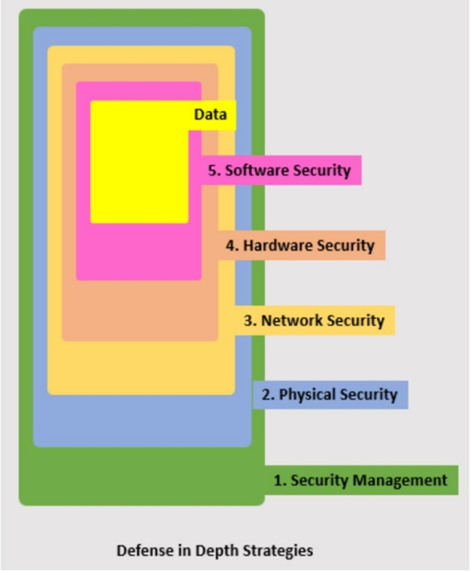

Slide 4
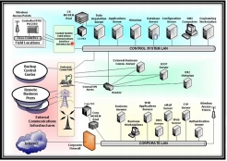
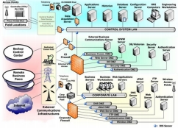
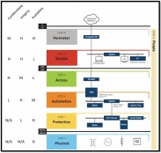
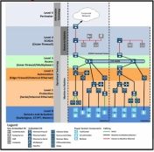

Slide 5
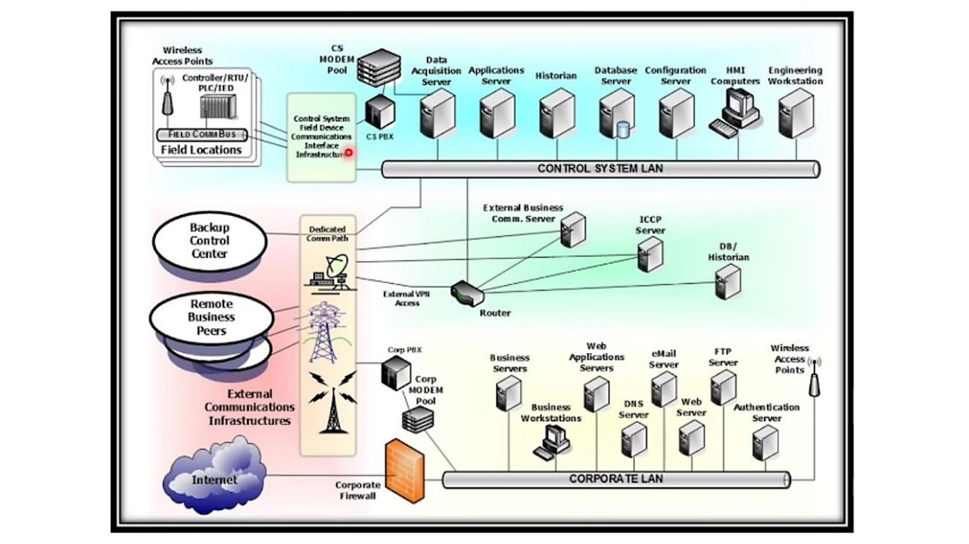

Slide 6
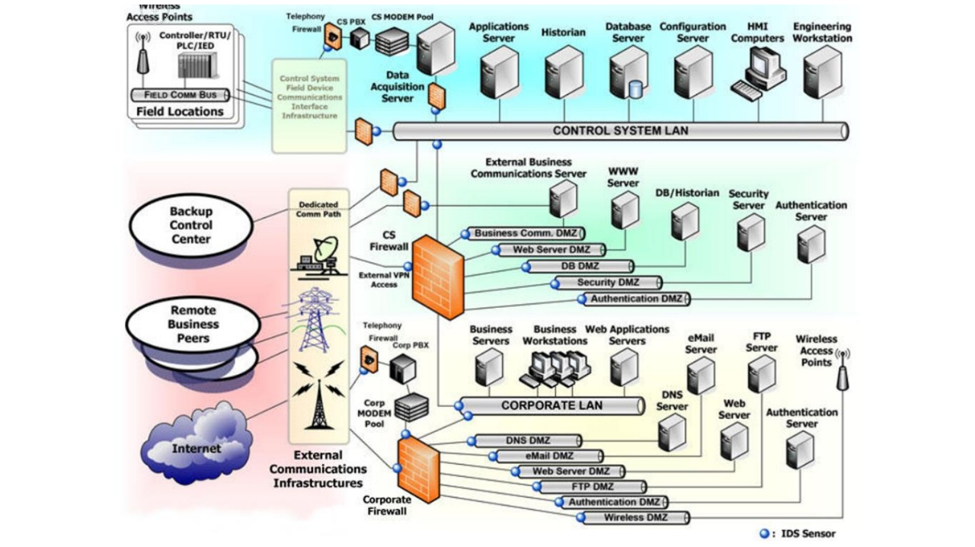

Slide 7
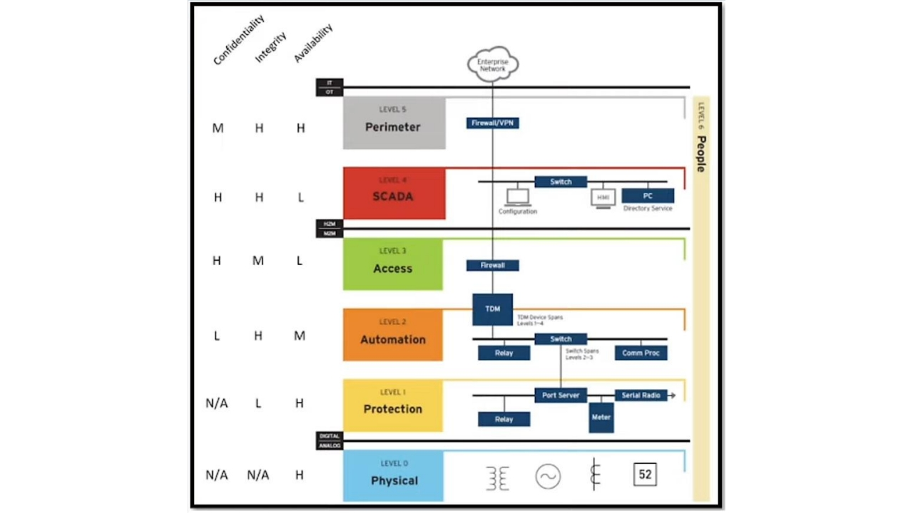

Slide 8
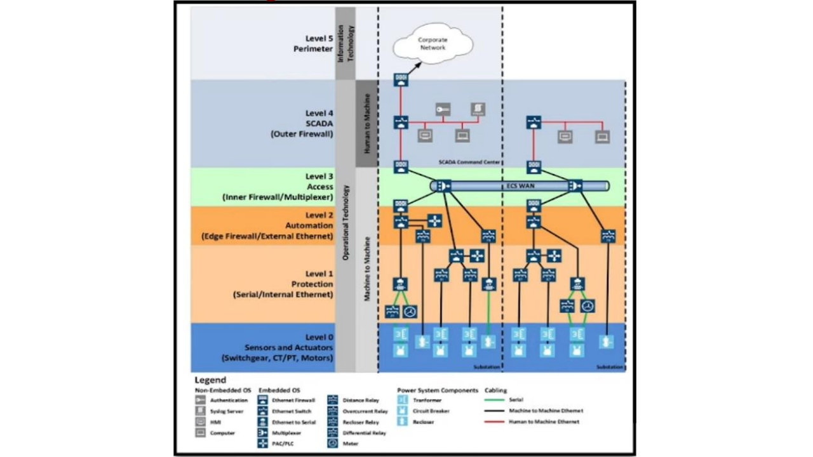

Slide 9
Defense in depth uses technology and controls at each level for comprehensive security.
It adapts to diverse challenges across levels.
Wrap
Multi-layered security reduces breach risks.
Up
Covers physical, network, admin controls, and analysis.
Ensures network security with specific technologies.
Offers a holistic approach to protect assets.

