Slide 1
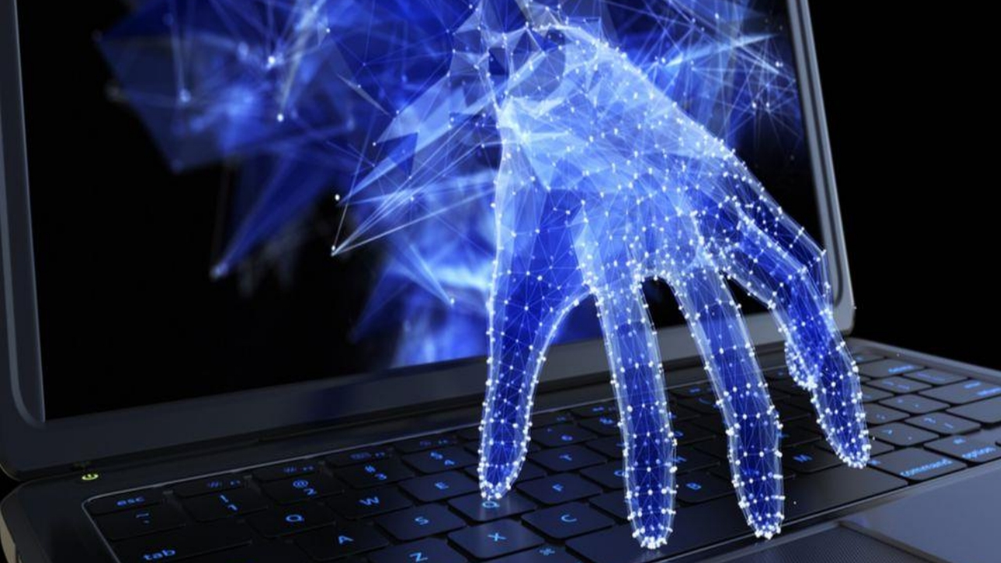

Cyber Attacks
Intro

Slide 2
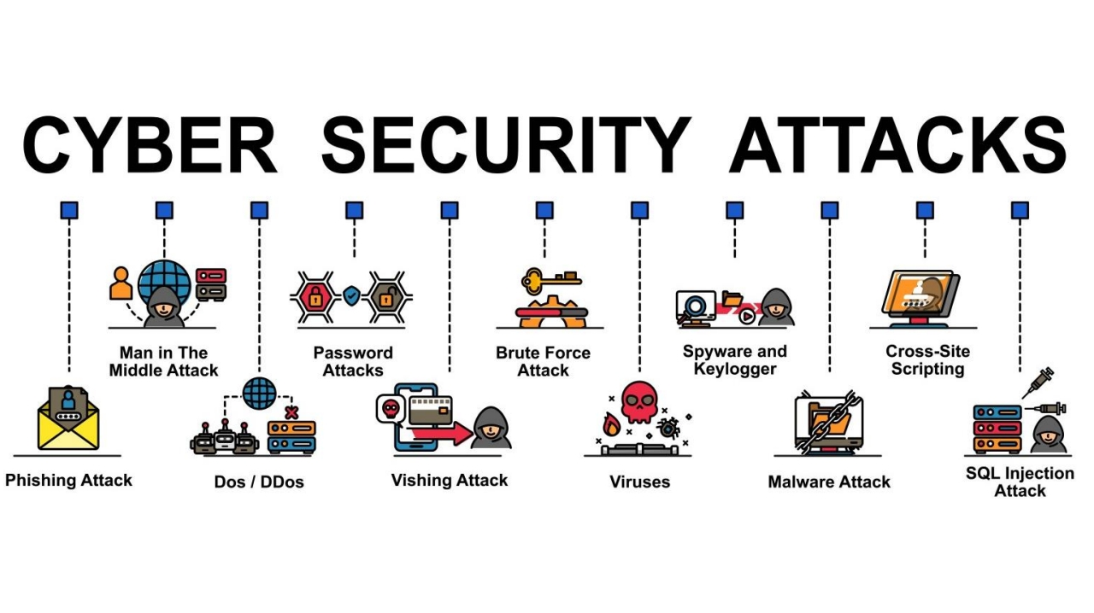

Slide 3
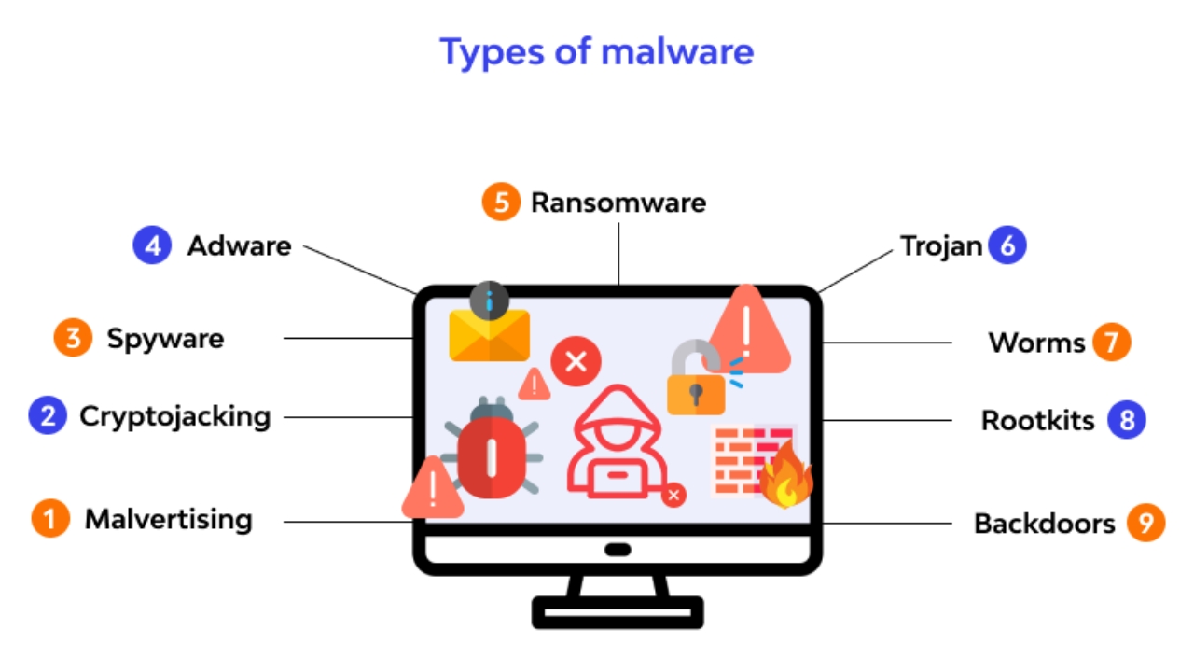

Slide 4
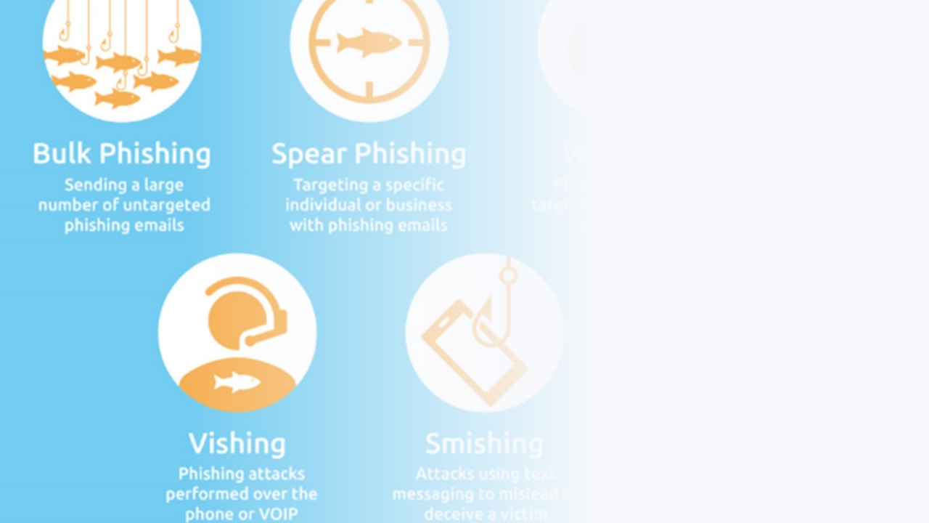
Phishing
Phishing is another prevalent
technique employed by cyber attackers. It involves the use of deceptive emails, messages, or
websites that mimic legitimate entities to trick individuals into revealing sensitive information, such as passwords, credit card details, or personal data.

Slide 5
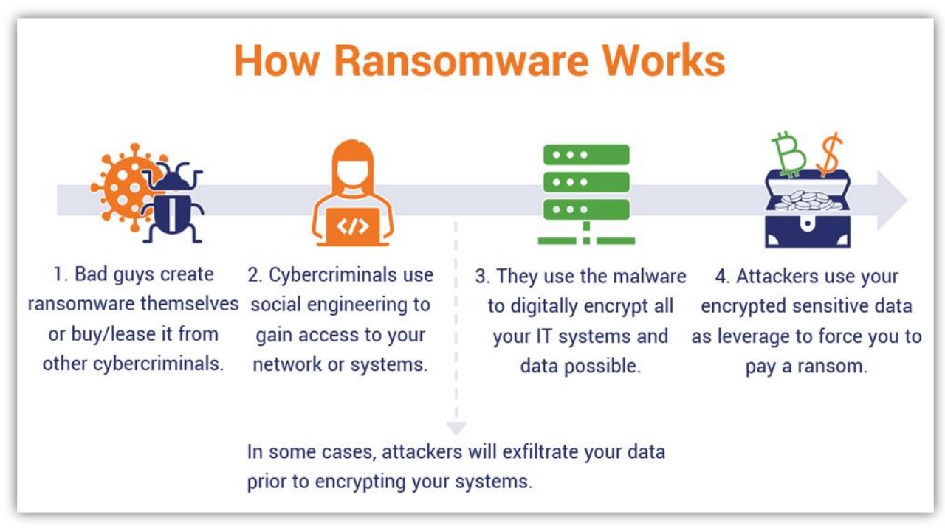

Slide 6
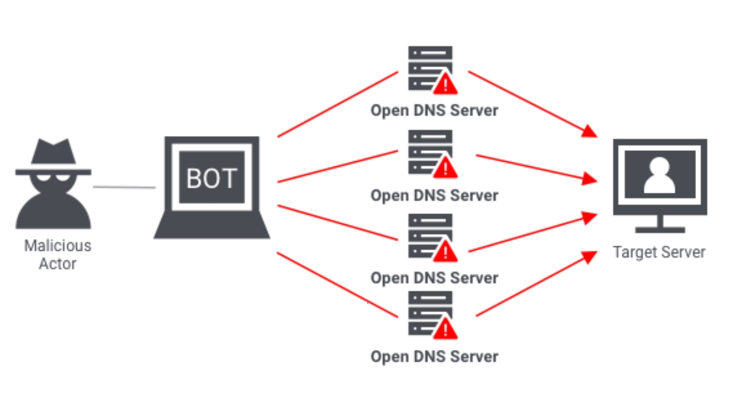

Slide 7
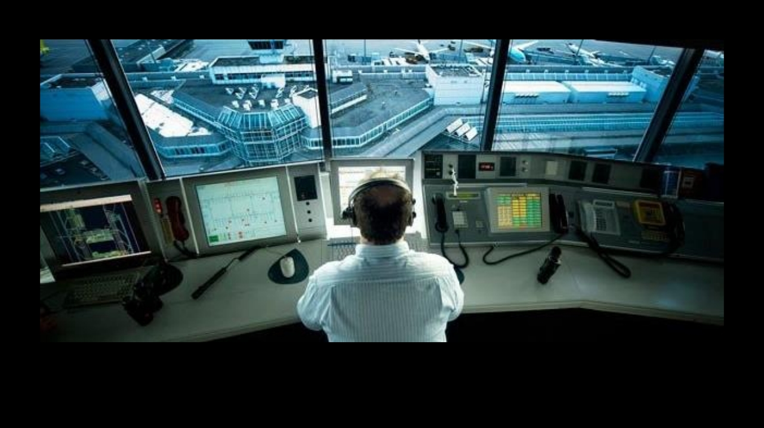
CYBER SECURITY ATTACKS

Slide 8
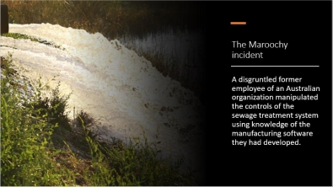
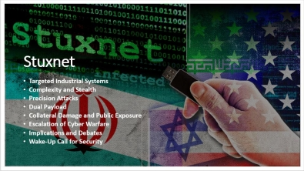
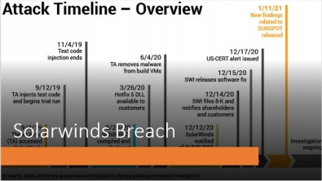

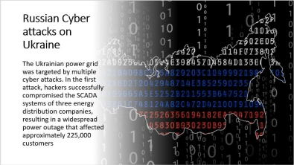
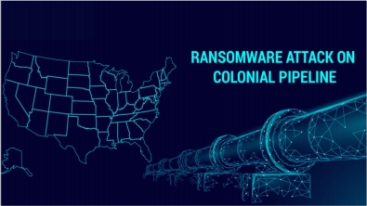

Slide 9
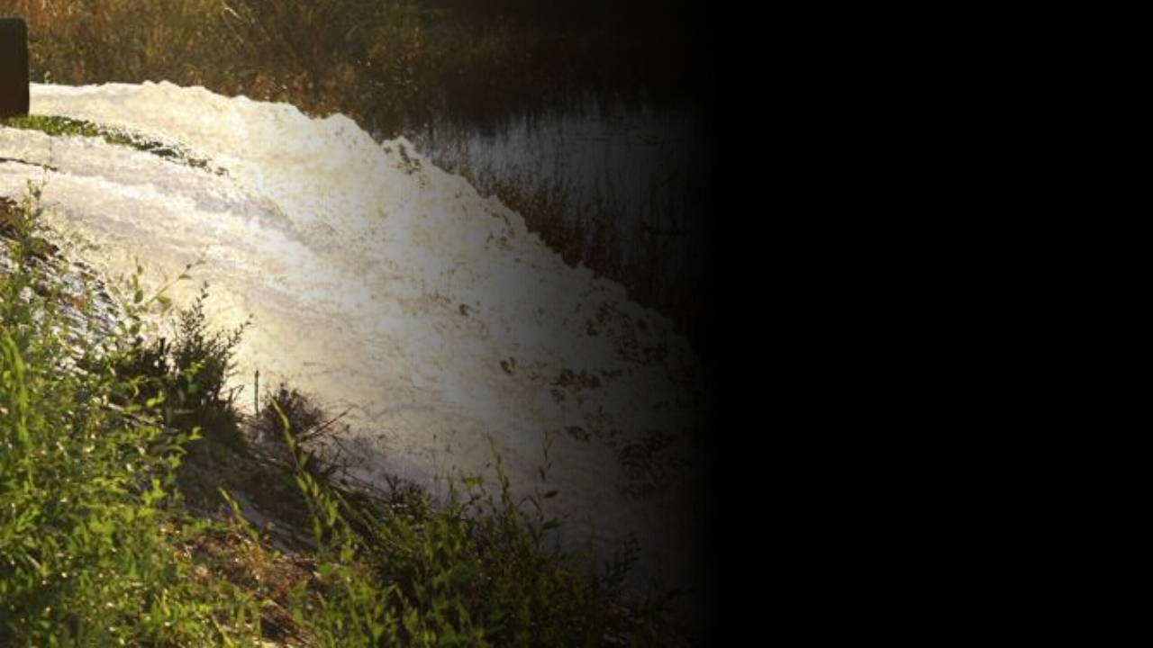
The Maroochy
incident
A disgruntled former
employee of an Australian
organization manipulated
the controls of the
sewage treatment system
using knowledge of the
manufacturing software
they had developed.

Slide 10
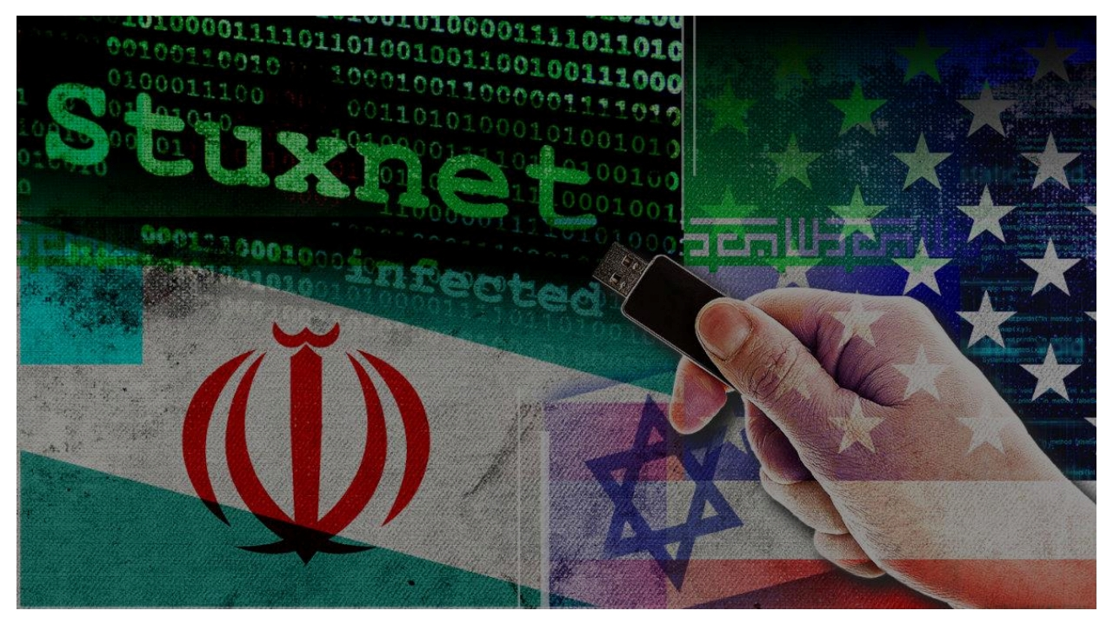
Stuxnet
• Targeted Industrial Systems
• Complexity and Stealth
• Precision Attacks
• Dual Payload
• Collateral Damage and Public Exposure • Escalation of Cyber Warfare
• Implications and Debates
• Wake-Up Call for Security

Slide 11
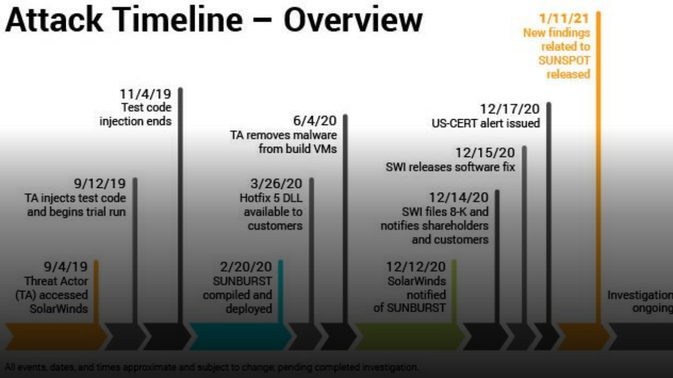
Solarwinds Breach

Slide 12
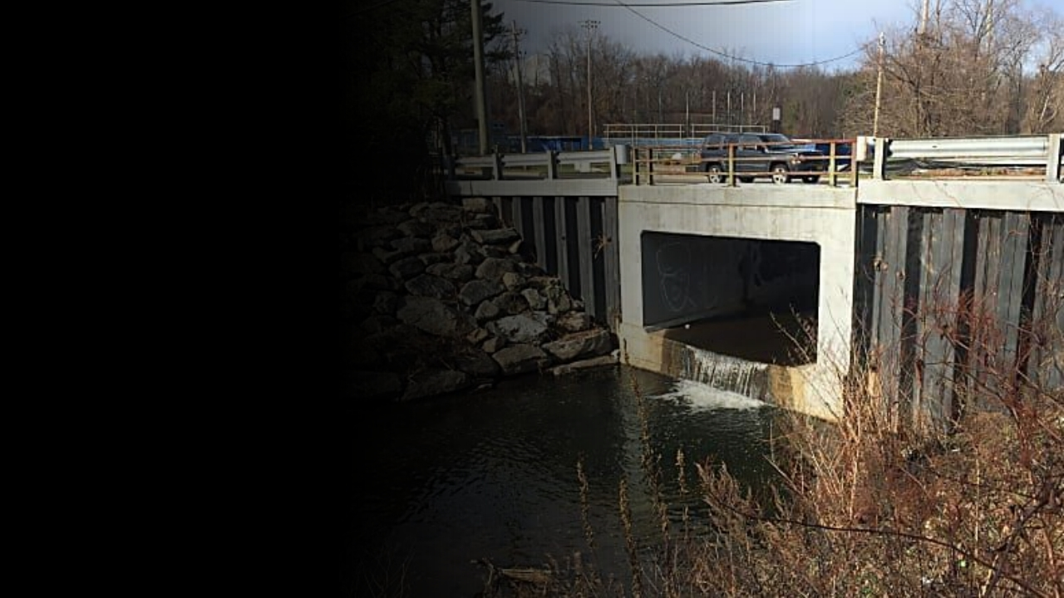
Bowman
Avenue Dam
attack

Slide 13
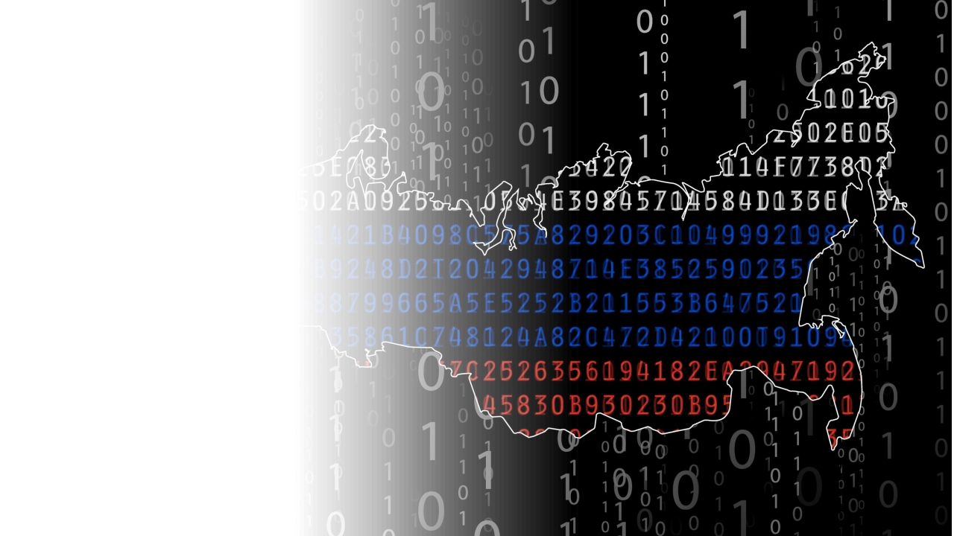
Russian Cyber
attacks on
Ukraine
The Ukrainian power grid
was targeted by multiple cyber attacks. In the first attack, hackers successfully
compromised the SCADA
systems of three energy
distribution companies,
resulting in a widespread
power outage that affected
approximately 225,000
customers

Slide 14
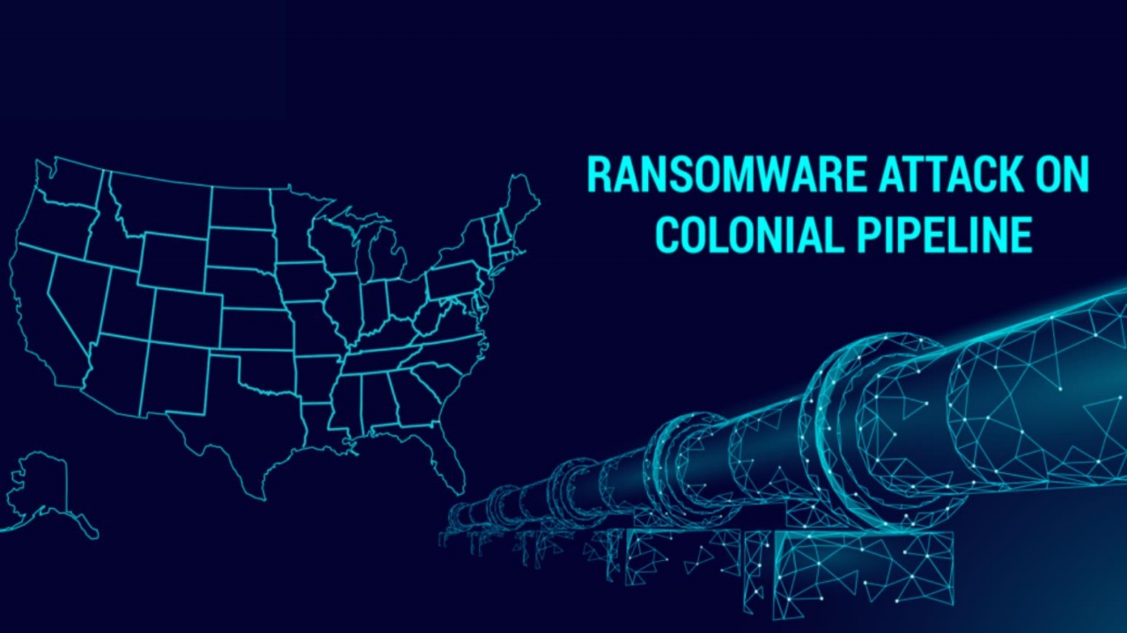

Slide 15
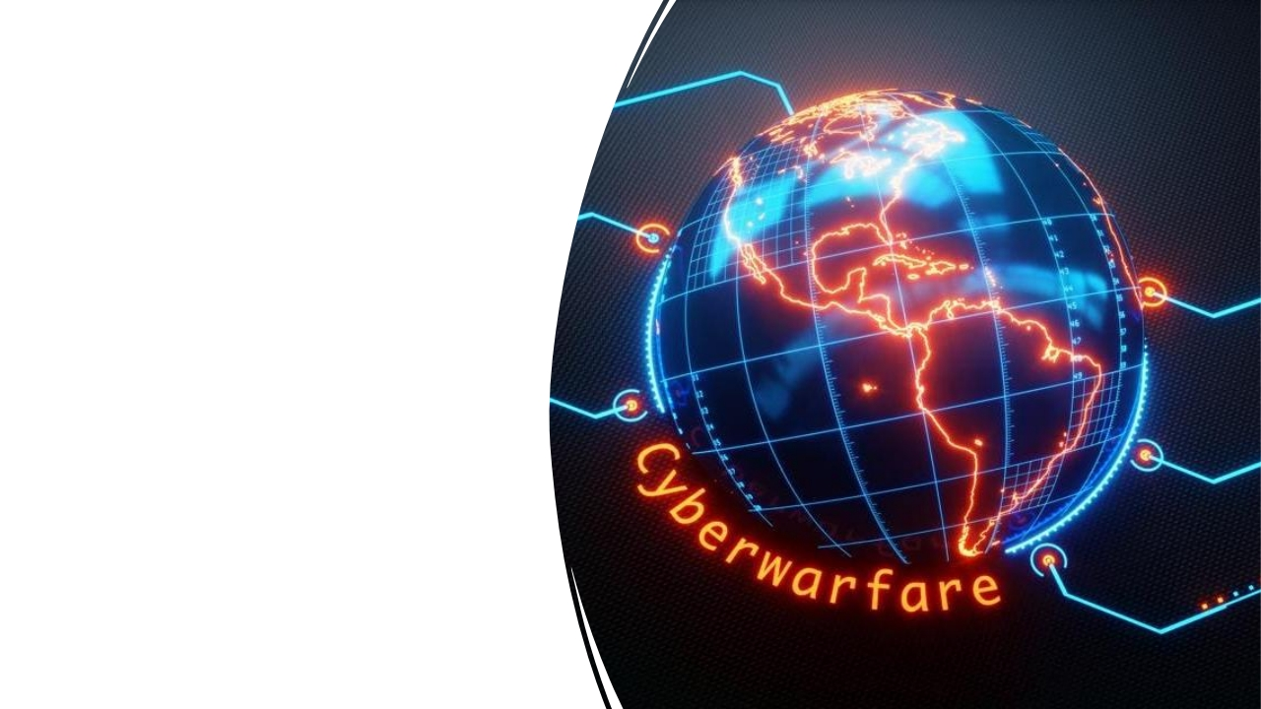
CYBER ATTACKS
EVOLUTION
Cyber attacks have evolved into a new arena of conflict between nations, blurring the
boundaries between
traditional warfare and digital
skirmishes. This emerging
form of warfare involves
governments using cyber
tools to achieve strategic
objectives,

Slide 16


Slide 17
Cyber attacks encompass diverse tactics, impacting individuals, organizations, and societies.
Notable events (Stuxnet, SolarWinds) emphasize the need for continuous vigilance.
Wrap
Understanding attack types and learning from incidents underscores preparedness and collaboration.
Up
Evolving threats require adapting and harnessing technology for stronger defenses.
Vigilance, awareness, and innovation are key to securing our interconnected world.

