Slide 1
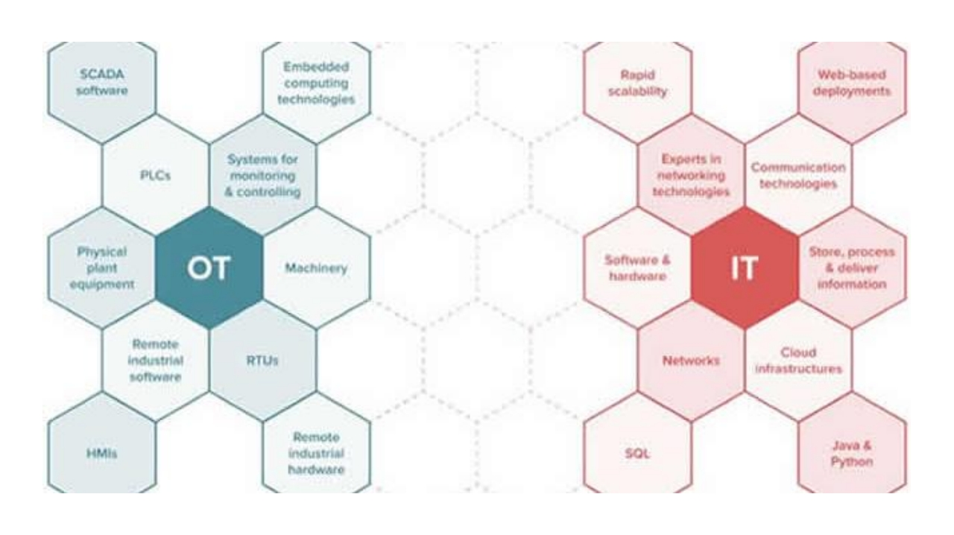

Slide 2
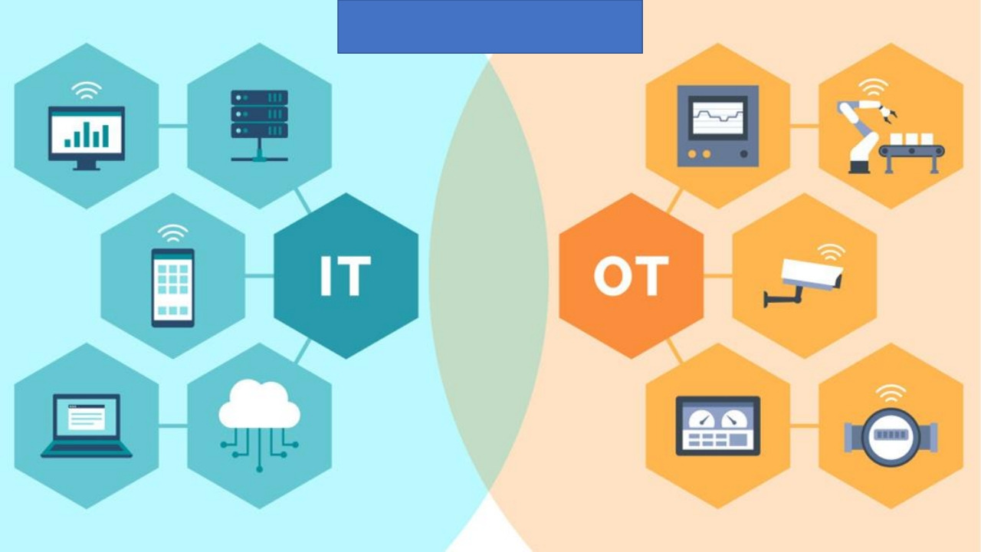
Performance

Slide 3
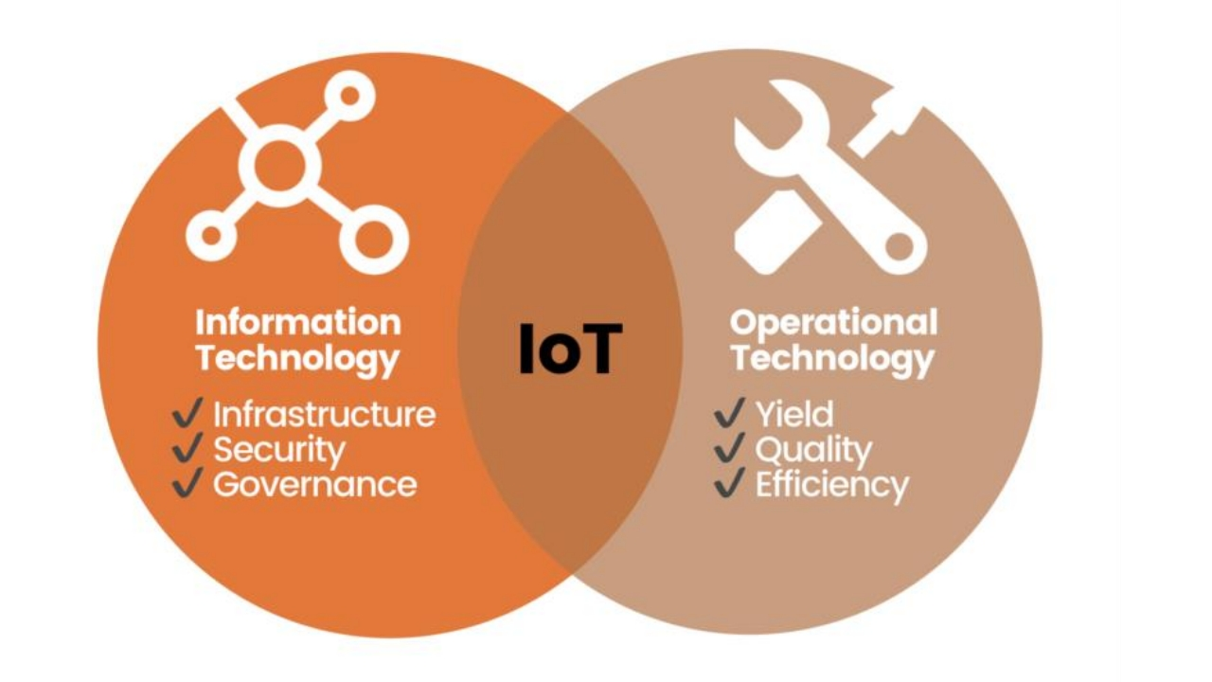

Slide 4
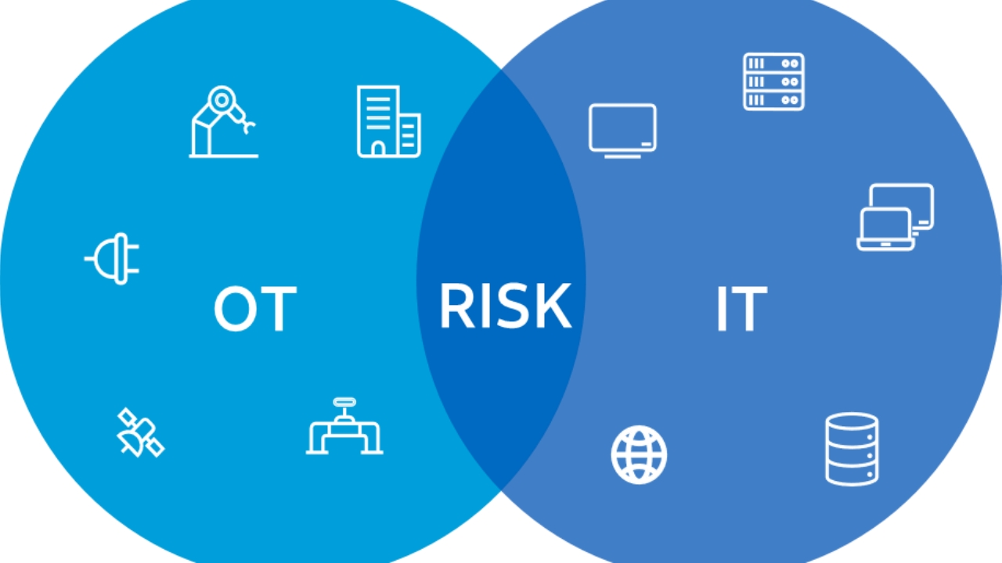

Slide 5
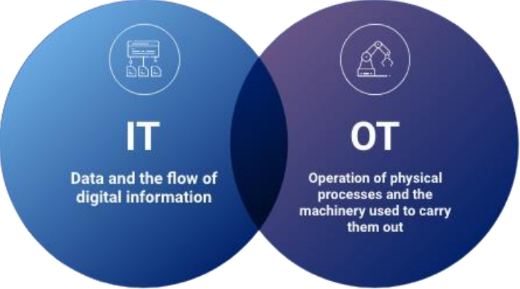
Systems
Operation

Slide 6

Software

Slide 7



Operational and Information Technology
Resource constraints Communications Change management

Slide 8






Resource constraints

Slide 9

Communications
Communications: In IT, standard communication protocols like TCP/IP are commonly used, and networks often rely on widespread internet
connectivity.

Slide 10





• IT Change: Timely, automated, secure updates.
• OT Change: Rigorous testing, incremental deployment, planned
outages.
• OT Constraints: Unsupported systems, end-of-life apps/switches.
Change management
• Understand Differences: Resources,
communication, IT vs. OT.

Slide 11
OT: Real-time focus, critical risks, specialized. IT: Data emphasis, diverse risks, general apps.
OT: Industrial software, real-time control. IT: General apps, data management.
Wrap
Up
OT: Limited resources, specific protocols. IT: More resources, standard protocols.
OT: Careful changes, testing needed. IT: Flexibility in changes.

