Slide 1

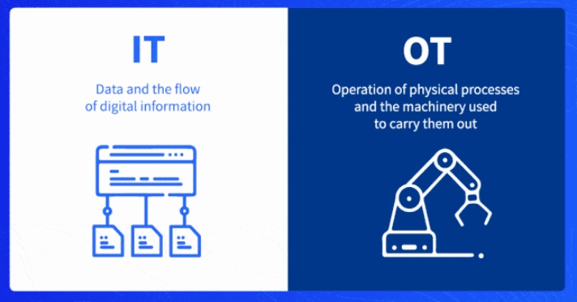
Difference
between OT
and IT
Networks

Slide 2
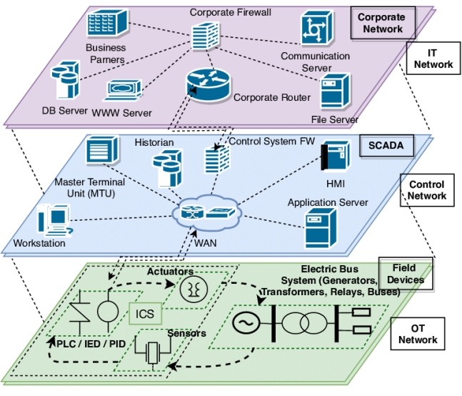
Confidentiality, Integrity
and Availability
In OT, the focus is on the CIA (Confidentiality, Integrity, and Availability) of the system. Availability is the most important aspect in OT, followed by integrity and then confidentiality. On the other hand, in IT, the priority is on CIA, with confidentiality being prioritized more
than availability.

Slide 3
Downtime, health &
Safety
OT systems have a higher impact on downtime, health, and safety. Errors in OT can directly impact the health and safety of individuals and even lead to disasters. This makes OT different from IT.

Slide 4
Performance
Non-Real Time & Real
Time
In terms of performance requirements, most processes in IT are non-real-time or near real-time, while in OT, all processes are real-time. Real-time in OT means that data flows with the product, and commands act on the product at the same time and location.

Slide 5
Delay
In terms of delay, IT systems may accept some jitter or delay, but in OT, delays or jitter are not acceptable due to the sensitive nature of the systems. Any delay or jitter can lead to incorrect readings or actions, causing production losses and safety issues.

Slide 6
Access Control
Regarding access control, IT systems can implement tightly restricted access control to prioritize confidentiality. In OT, access control should be strictly controlled but should not interfere with the human-machine interaction (HMI). Operators should have the necessary access without facing difficulties that can lead to operational delays.

Slide 7
Availability
• IT systems may accept responses such as rebooting, as it is acceptable to restart or reboot the system. Availability deficiencies can be tolerated depending on the system's operational
requirements.
• Outages in OT systems must be planned and scheduled well in advance to minimize disruption.

Slide 8
Operational Technology (OT) networks:
Control industrial processes.
Wrap
Information Technology (IT) networks:
Manage organization's information.
Up
Importance of understanding distinctions between OT and IT networks:

