Slide 1

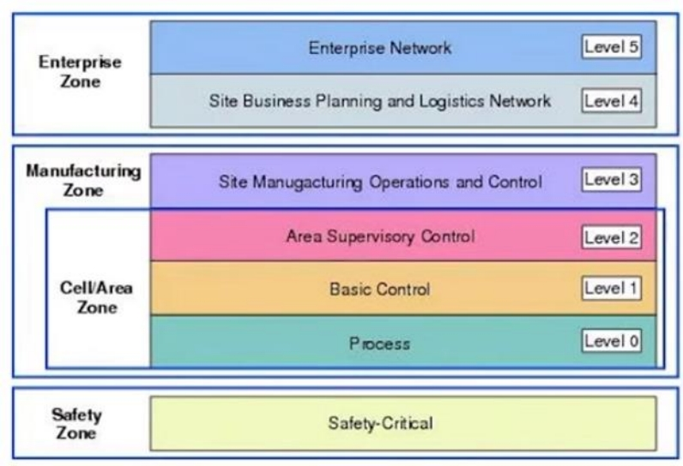
Purdue Model
Overview

Slide 2
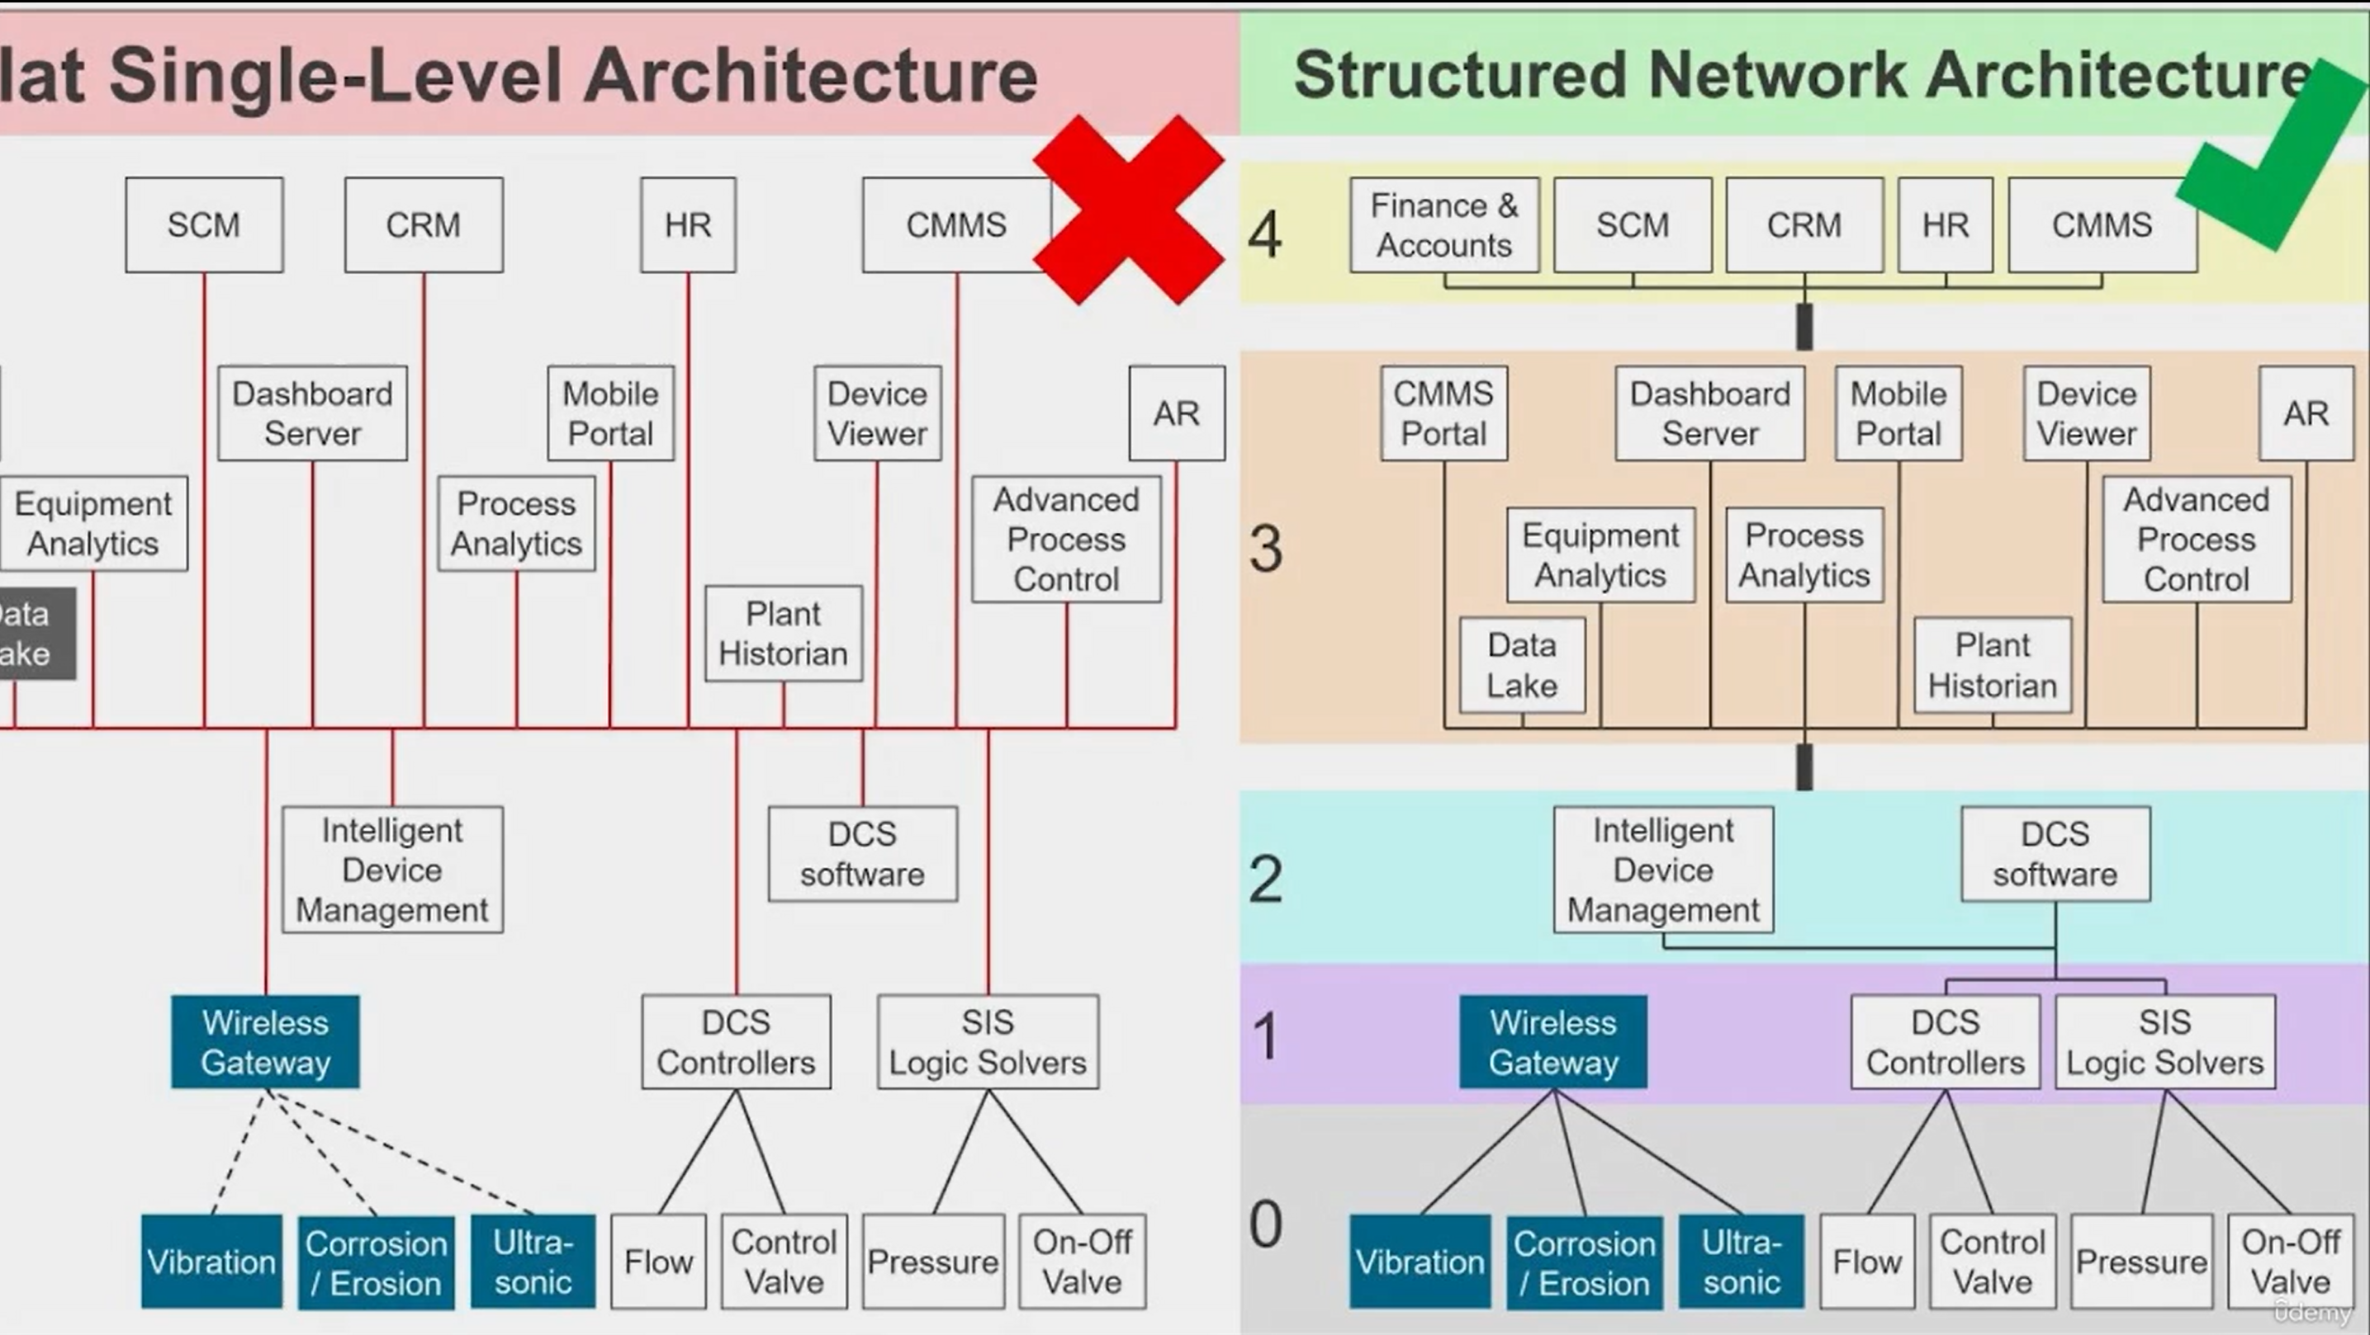
Purdue Model Overview

Slide 3
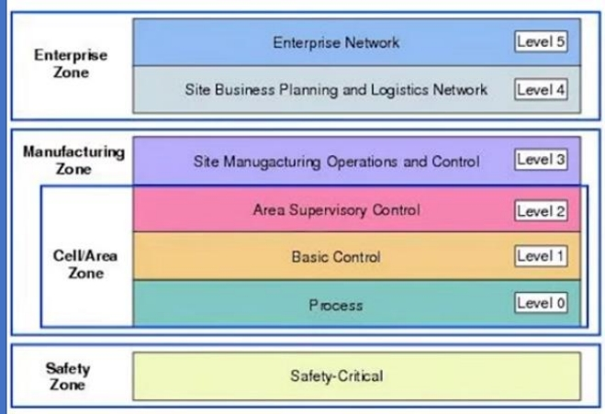
Level 0 – Process: Consists of a wide variety of sensors, actuators and devices involved in the basic manufacturing processes.
The Purdue model for Control Heirarchy is a common and well-understood model in Manufacturing industry that segments devices and equipment into hierarchical functions.
Level 1 – Basic Control: Consists of basic controllers that control and manipulate the manufacturing process, the key functions is to interface with thee Level 0 devices (I/O, linking devices, bridges, etc.).
Level 2 – Area Control
Level 2 represents the systems and functions associated with the runtime supervision and operation of an area of a production facility.
Level 3 – Site level
Level 3, the site level represents the highest level of industrial automation and control systems. The systems and applications that exist at this level manage site wide industrial automation and control functions.
Level 4 – Site Business Planning and Logistics
Level 4 is where the functions and systems that need standard access to services provided by the enterprise network reside.
Level 5 – Enterprise
Level 5 is where the centralized IT systems and functions exist. Enterprise resource management, business-to-business, and business-to-customer servicers typically reside at this level.

Slide 4
The Purdue model for Control Heirarchy is a common and well-understood model in Manufacturing industry that segments devices and equipment into hierarchical functions.
Level 0 – Process: Consists of a wide variety of sensors, actuators and devices involved in the basic manufacturing processes.
Level 1 – Basic Control: Consists of basic controllers that control and manipulate the manufacturing process, the key functions is to interface with thee Level 0 devices (I/O, linking devices, bridges, etc.).
Level 2 – Area Control
Level 2 represents the systems and functions associated with the runtime supervision and operation of an area of a production facility.
Level 3 – Site level
Level 3, the site level represents the highest level of industrial automation and control systems. The systems and applications that exist at this level manage site wide industrial automation and control functions.
Level 4 – Site Business Planning and Logistics
Level 4 is where the functions and systems that need standard access to services provided by the enterprise network reside.
Level 5 – Enterprise
Level 5 is where the centralized IT systems and functions exist. Enterprise resource management, business-to-business, and business-to-customer servicers typically reside at this level.

Slide 5

The Purdue model for Control Heirarchy is a common and well-understood model in Manufacturing industry that segments devices and equipment into hierarchical functions.
Level 0 – Process: Consists of a wide variety of sensors, actuators and devices involved in the basic manufacturing processes.
Level 1 – Basic Control: Consists of basic controllers that control and manipulate the manufacturing process, the key functions is to interface with thee Level 0 devices (I/O, linking devices, bridges, etc.).
Level 2 – Area Control
Level 2 represents the systems and functions associated with the runtime supervision and operation of an area of a production facility.
Level 3 – Site level
Level 3, the site level represents the highest level of industrial automation and control systems. The systems and applications that exist at this level manage site wide industrial automation and control functions.
Level 4 – Site Business Planning and Logistics
Level 4 is where the functions and systems that need standard access to services provided by the enterprise network reside.
Level 5 – Enterprise
Level 5 is where the centralized IT systems and functions exist. Enterprise resource management, business-to-business, and business-to-customer servicers typically reside at this level.

Slide 6
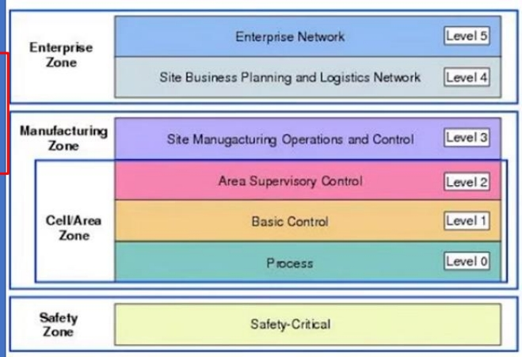
The Purdue model for Control Heirarchy is a common and well-understood model in Manufacturing industry that segments devices and equipment into hierarchical functions.
Level 0 – Process: Consists of a wide variety of sensors, actuators and devices involved in the basic manufacturing processes.
Level 1 – Basic Control: Consists of basic controllers that control and manipulate the manufacturing process, the key functions is to interface with thee Level 0 devices (I/O, linking devices, bridges, etc.).
Level 2 – Area Control
Level 2 represents the systems and functions associated with the runtime supervision and operation of an area of a production facility.
Level 3 – Site level
Level 3, the site level represents the highest level of industrial automation and control systems. The systems and applications that exist at this level manage site wide industrial automation and control functions.
Level 4 – Site Business Planning and Logistics
Level 4 is where the functions and systems that need standard access to services provided by the enterprise network reside.
Level 5 – Enterprise
Level 5 is where the centralized IT systems and functions exist. Enterprise resource management, business-to-business, and business-to-customer servicers typically reside at this level.

Slide 7
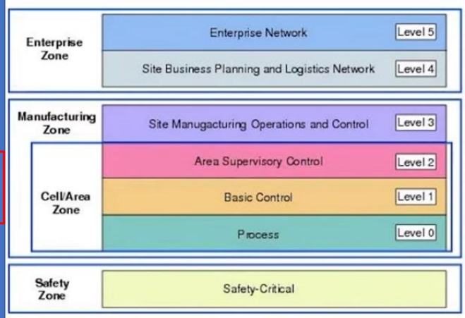
The Purdue model for Control Heirarchy is a common and well-understood model in Manufacturing industry that segments devices and equipment into hierarchical functions.
Level 0 – Process: Consists of a wide variety of sensors, actuators and devices involved in the basic manufacturing processes.
Level 1 – Basic Control: Consists of basic controllers that control and manipulate the manufacturing process, the key functions is to interface with thee Level 0 devices (I/O, linking devices, bridges, etc.).
Level 2 – Area Control
Level 2 represents the systems and functions associated with the runtime supervision and operation of an area of a production facility.
Level 3 – Site level
Level 3, the site level represents the highest level of industrial automation and control systems. The systems and applications that exist at this level manage site wide industrial automation and control functions.
Level 4 – Site Business Planning and Logistics
Level 4 is where the functions and systems that need standard access to services provided by the enterprise network reside.
Level 5 – Enterprise
Level 5 is where the centralized IT systems and functions exist. Enterprise resource management, business-to-business, and business-to-customer servicers typically reside at this level.

Slide 8
The Purdue model for Control Heirarchy is a common and well-understood model in Manufacturing industry that segments devices and equipment into hierarchical functions.
Level 0 – Process: Consists of a wide variety of sensors, actuators and devices involved in the basic manufacturing processes.
Level 1 – Basic Control: Consists of basic controllers that control and manipulate the manufacturing process, the key functions is to interface with thee Level 0 devices (I/O, linking devices, bridges, etc.).
Level 2 – Area Control
Level 2 represents the systems and functions associated with the runtime supervision and operation of an area of a production facility.
Level 3 – Site level
Level 3, the site level represents the highest level of industrial automation and control systems. The systems and applications that exist at this level manage site wide industrial automation and control functions.
Level 4 – Site Business Planning and Logistics
Level 4 is where the functions and systems that need standard access to services provided by the enterprise network reside.
Level 5 – Enterprise
Level 5 is where the centralized IT systems and functions exist. Enterprise resource management, business-to-business, and business-to-customer servicers typically reside at this level.

Slide 9
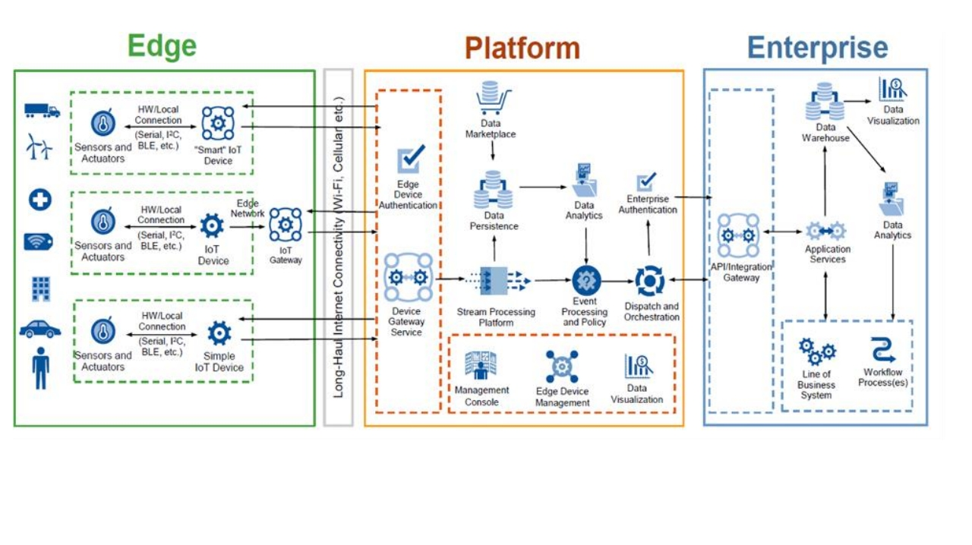

Slide 10
Purdue Model: Structured approach for organizing devices, systems, and functions in industrial control environments.
Wrap
Levels: Different levels with corresponding functions.
Up
Importance: Crucial for designing secure and efficient cybersecurity systems.

