Slide 1

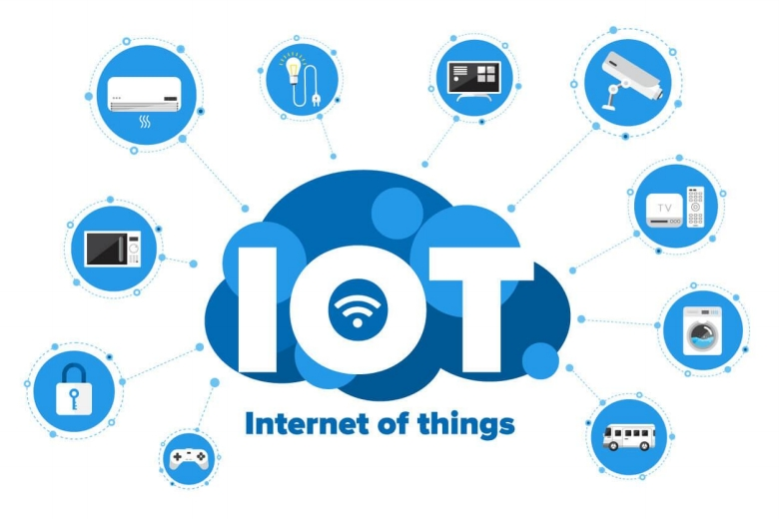
Industrial
Internet of
Things (IIOT)
Overview

Slide 2










1. Sensors and
2. Networked
3. Internet
Devices:
Connectivity
Integration
4. Enhancing
5. Business
Industrial Processes
Applications

Slide 3
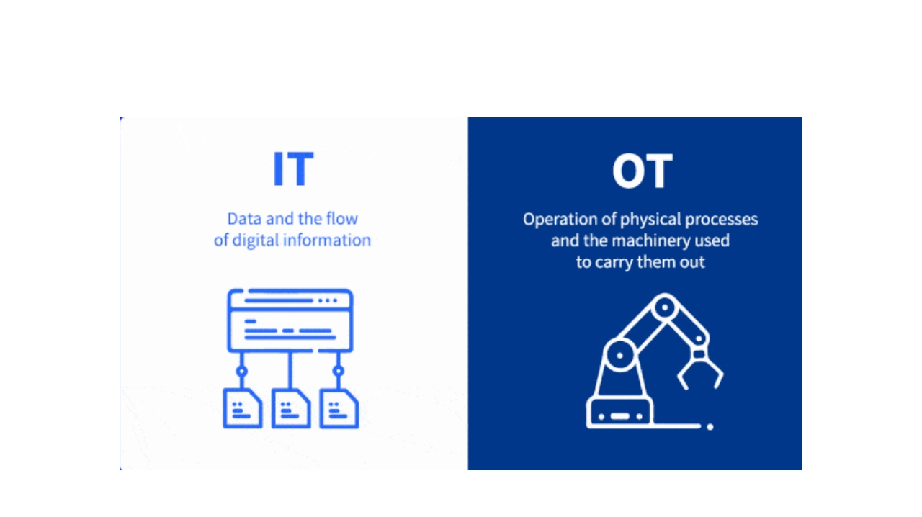
IT / OT Convergence

Slide 4
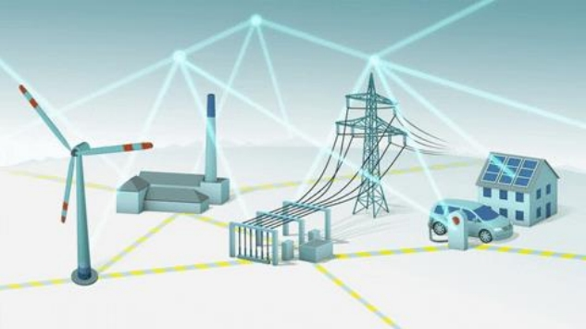


IoT Consortium

Slide 5
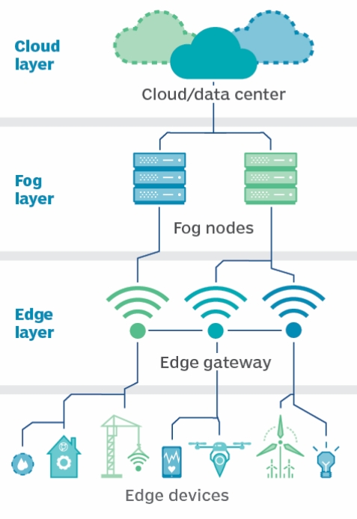
IIOT Network
Architecture

Slide 6
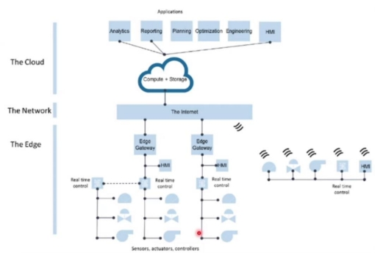
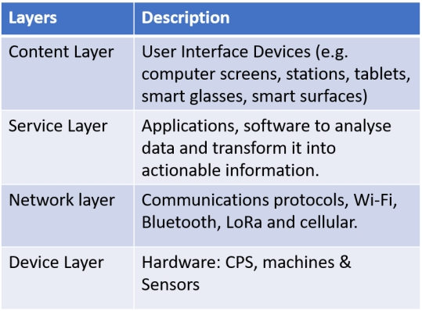
Additional Layers

Slide 7
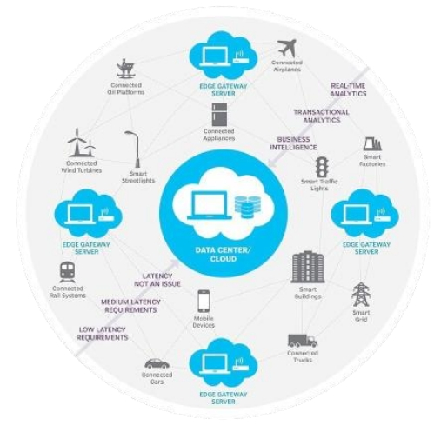
Edge Computing
Edge computing is a fundamental concept in IoT (Internet of Things) and IIoT (Industrial Internet of Things) that involves decentralized computing
infrastructure. Unlike traditional
centralized computing, edge computing
distributes computing resources and
application services along the
communication path between data
sources and the cloud.

Slide 8
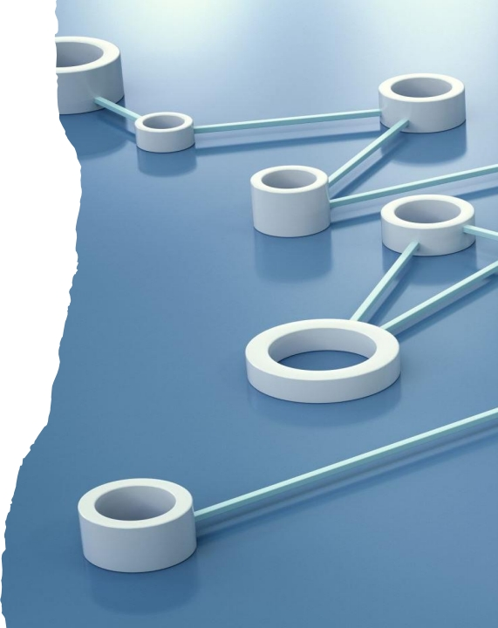
Edge Computing
Peer-to-peer networking fosters
collaboration and information sharing
among devices
improving object recognition
identification capabilities

Slide 9
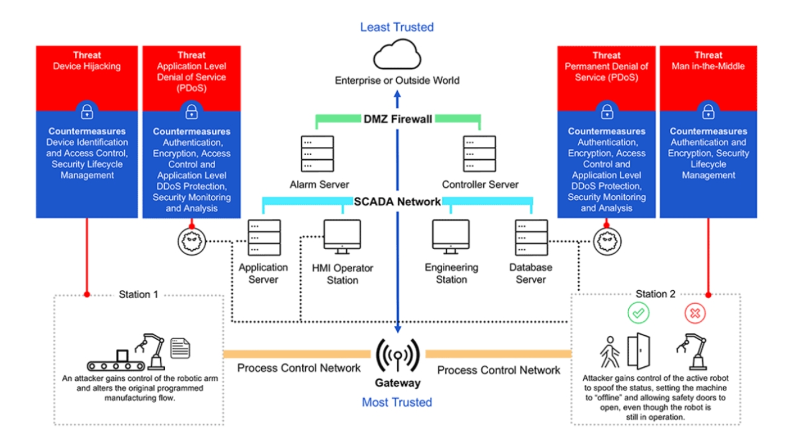

Slide 10
The architecture of the IIoT combines OT and IT systems for industrial advancements.
The IIoT utilizes interconnected devices, edge computing, and cloud services.
Wrap
It optimizes industrial processes and enables smarter decision-making.
Up
Proper governance, cybersecurity measures, and continuous improvement are essential for success.
The IIoT unlocks the potential for industrial innovation.

