Slide 1

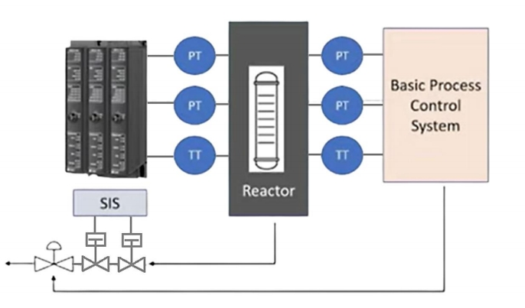
Safety
Instrumented
Systems (SIS)
Overview
What is SIS? SIS stands for Safety Instrumented System. These systems are the unsung heroes of industrial safety, designed to reduce the likelihood or consequences of hazardous situations by bringing the system to a safe state when needed.

Slide 2

Why are SIS Necessary?
In industries like oil and gas or chemical production, there
are critical processes and
systems that, if something goes wrong, can result in catastrophic consequences. Think of a sudden pressure surge in a chemical reactor or a leak in a high-pressure gas pipeline. In such situations,
you need a fail-safe mechanism to step in and mitigate the risks.

Slide 3

Chernobyl

Slide 4
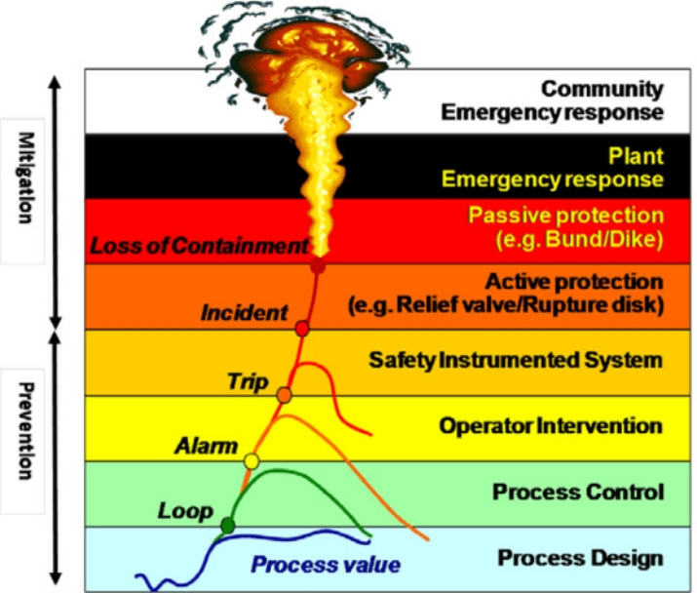
How SIS works
In order to minimize these risks,
process control systems are installed to maintain a safe operation of the plant, assisted by a robust alarm detection and reporting system, and operated by trained, qualified personnel.
But often, these measures alone cannot reduce the risk of injury, fire, explosion, or other risks to a tolerable level.
Regardless of the types of risks, the process design itself, the basic process control system, alarms, and operator intervention, provide the first layers of protection for the process.

Slide 5
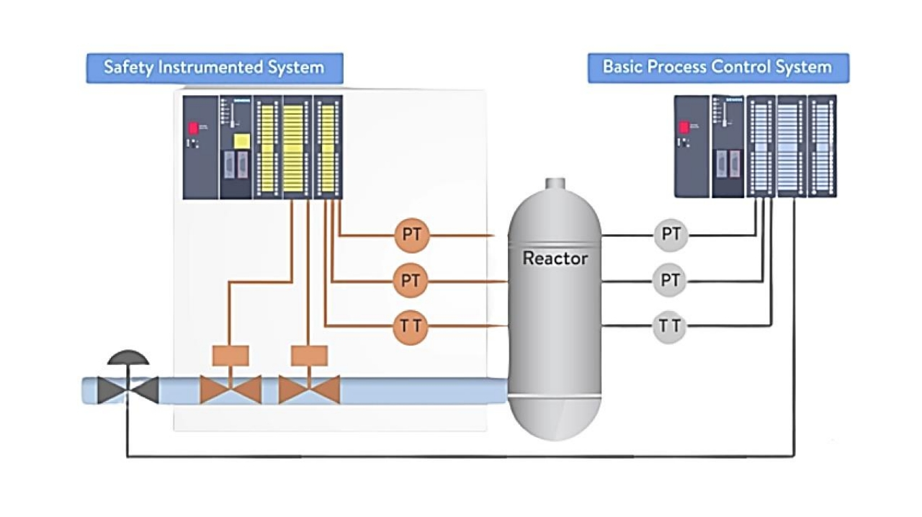

Slide 6



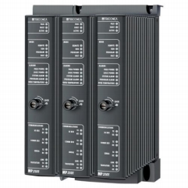
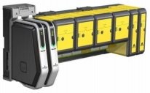

Safety Instrumented Systems (SIS) Providers

Slide 7
Safety Instrumented Systems (SIS) Providers

Slide 10
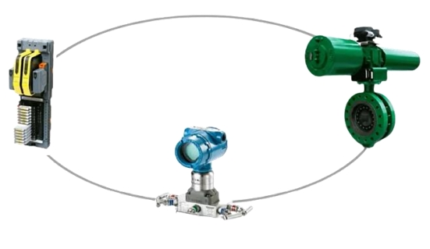
Components
of an SIF
LOGIC
FINAL
SOLVER
CONTROL
SENSOR
ELEMNT

Slide 11
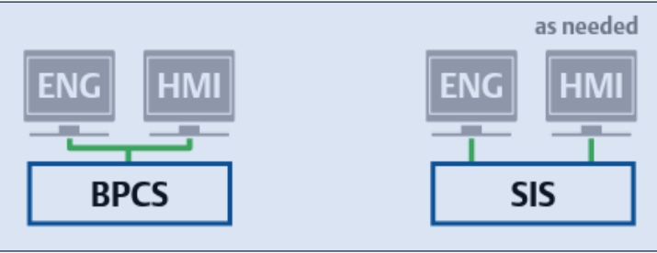
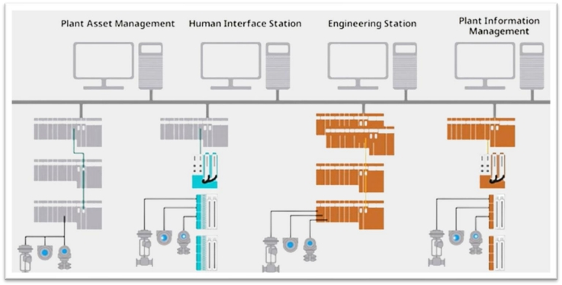
SIS Independence
Safety Instrumented Systems (SIS) are intentionally designed to be independent of the basic process control systems (BPCS) for several crucial reasons:
1.Isolation from BPCS Failures
2.Redundancy and Reliability
3.Different Purposes
4.Standards and Regulations

Slide 12
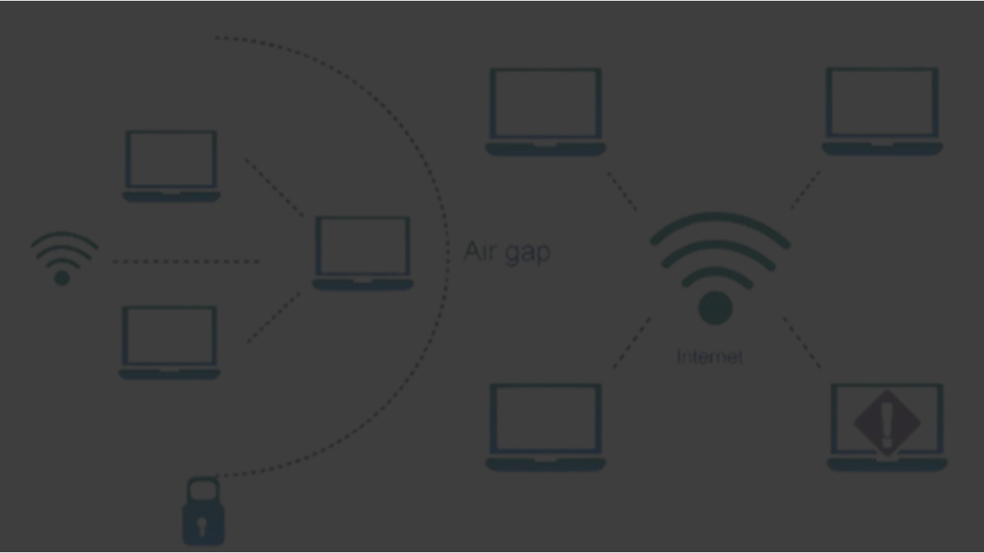
Air Gapping
Safety Instrumented Systems were often designed to operate independently and were physically and logically separated from the BPCS. Some facilities even implemented air gaps, which means there was no direct network communication between the SIS and BPCS. This separation was primarily for safety and security reasons, as it minimized the risk of unintended interactions or cyber threats compromising safety.

Slide 13
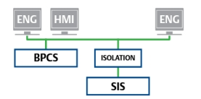
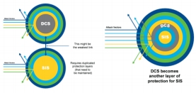

Integrated Control and Safety Systems (ICSS)

Slide 14
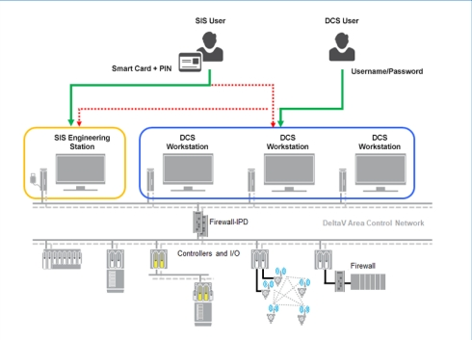
Cybersecurity for SIS Systems:
Safeguarding Safety Instrumented Systems (SIS) is critical. These systems are prime targets for adversaries due to their importance. To protect SIS:
SIS Systems Cybersecurity
1.Assess Risks
2.Segmentation
3.Access Control
4.Patching
5.Network Security
6.Continuous Monitoring
7.Policies
8.Vendor Collaboration
9.Incident Response
10.Compliance
11.Training
12.Redundancy
13.Anomaly Detection
14.Audits.

Slide 15
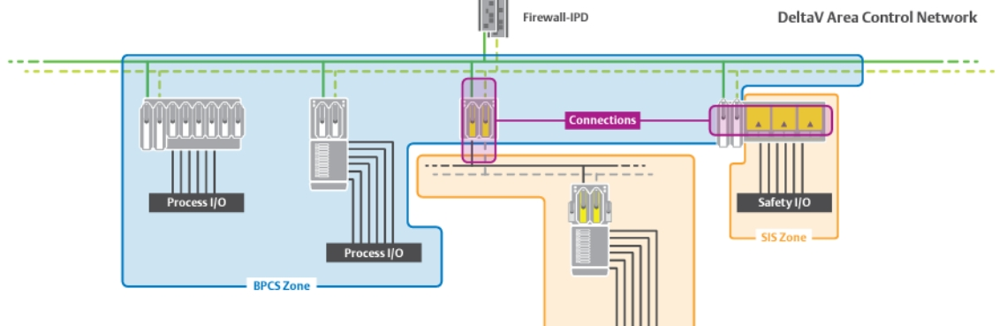
SIS Systems Cybersecurity
Cybersecurity for Safety Instrumented Systems (SIS), includes some important measures:
1.Air Gapping
2.Physical Access Controls
3.Vendor-Provided Cybersecurity Solutions
4.Cybersecurity Image Implementation
5.Log Collection for Non-Repudiation

Slide 16
Safety Instrumented Systems (SIS) in safety-critical industries.
Reduce and mitigate hazards for safe system shutdown.
Offered by various providers.
Wrap
Emphasize independence from other control systems.
Up
Emerging trend: Integrated Control and Safety Systems (ICSS).
Cybersecurity essential for SIS protection.
Measures: air gapping, access controls, vendor-recommended solutions.

