Slide 1
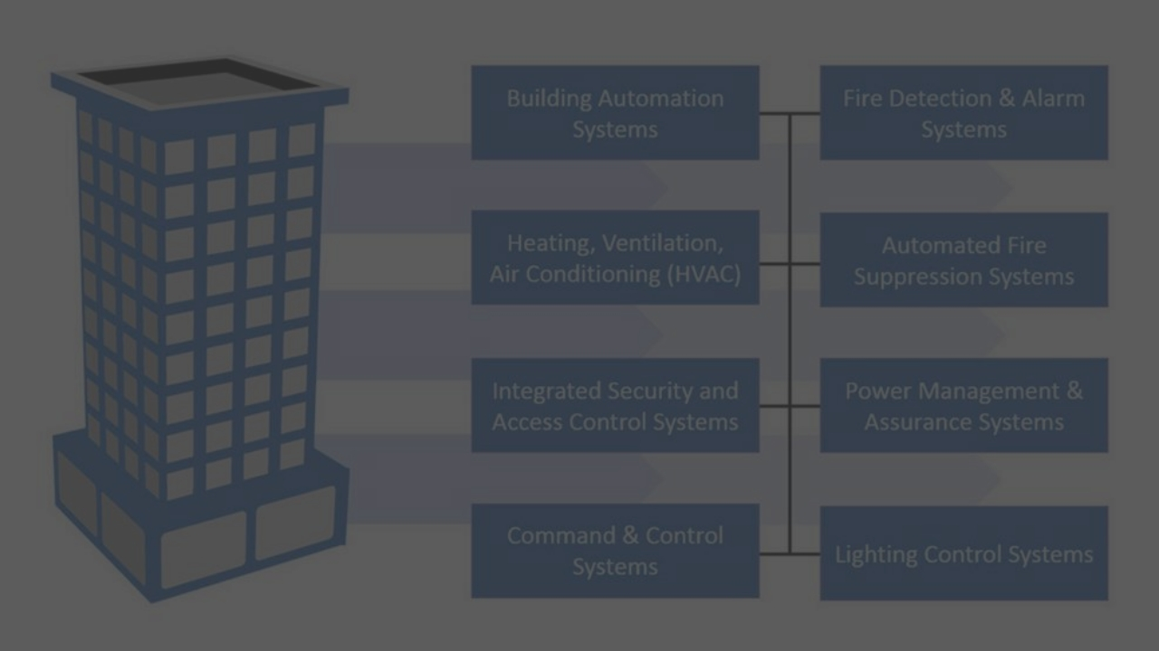
Building Automation

Slide 2
Building Automation

Slide 3
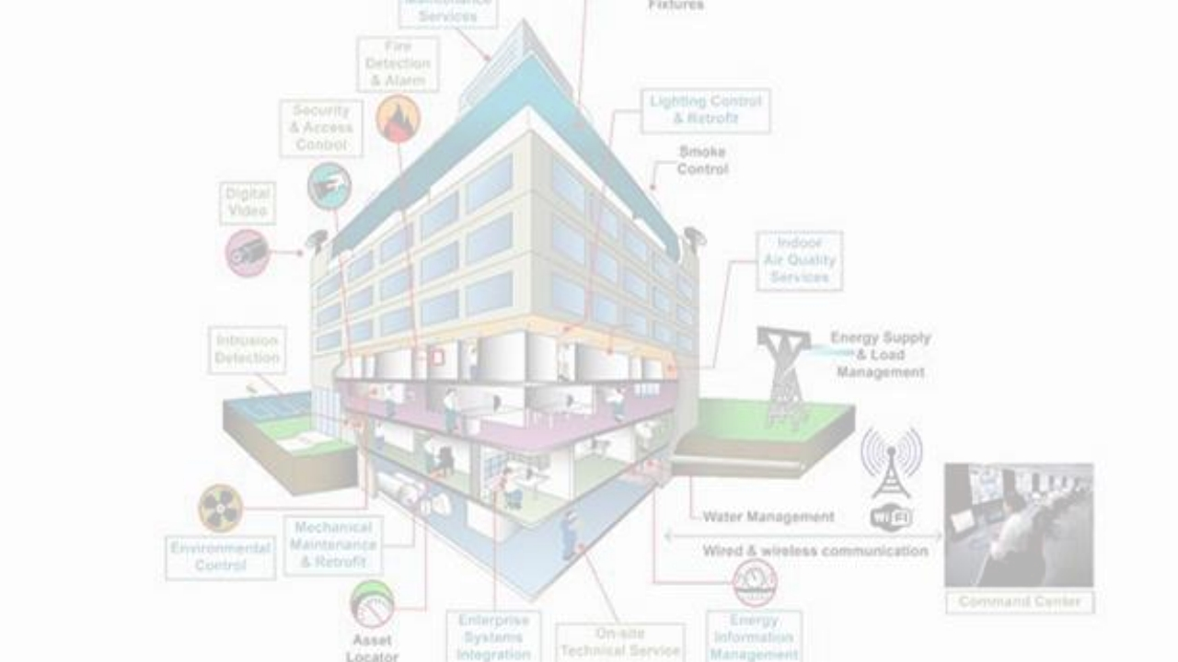
BACS Functions

Slide 4
BACS Functions

Slide 5
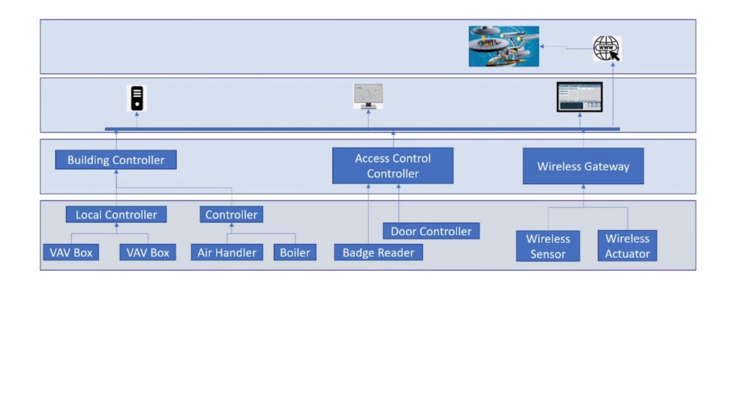
BACS Architecture

Slide 6
BACS Architecture

Slide 7
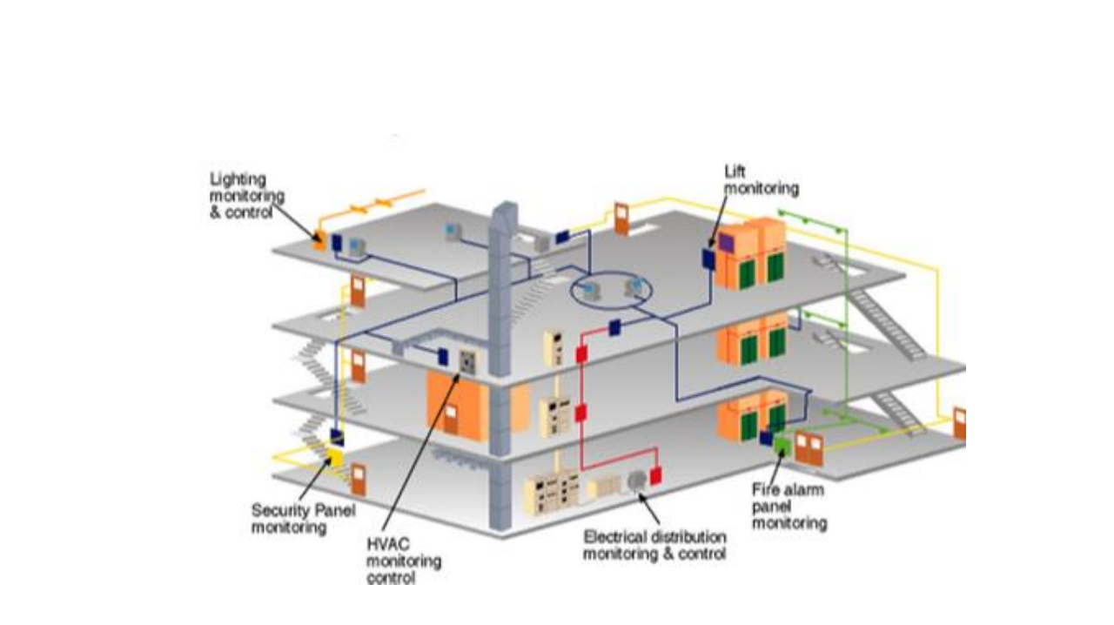
BACS Functions

Slide 8
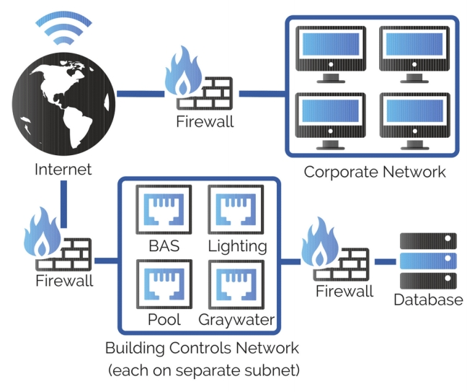
BACS Cyber Security

Slide 9
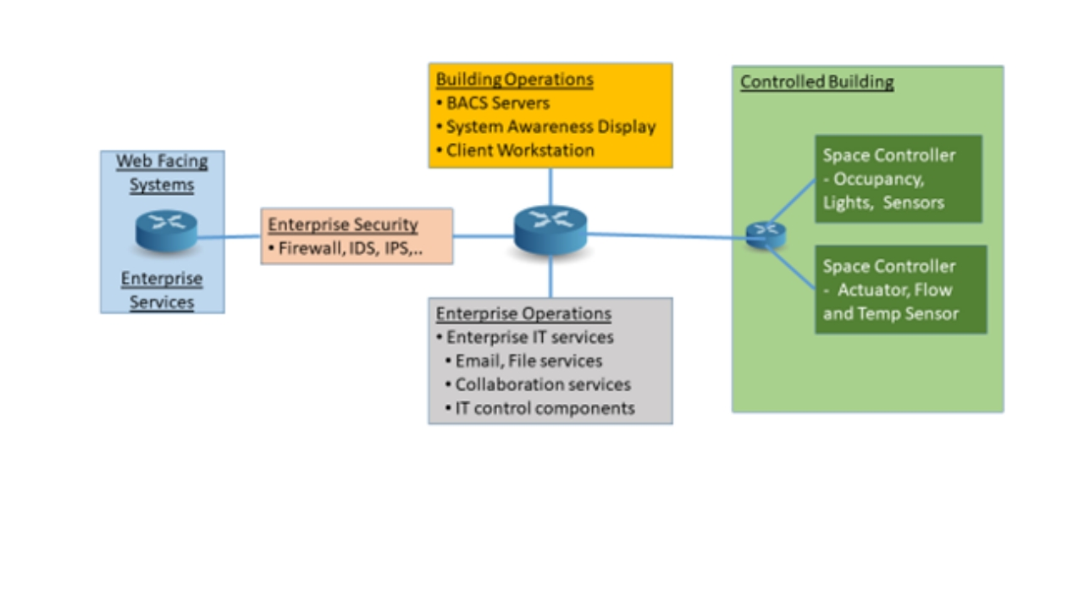
BACS Cyber Security

Slide 10


Slide 11
Health and Safety
Wrap
Financial impact
Up
Reputation

