Slide 1

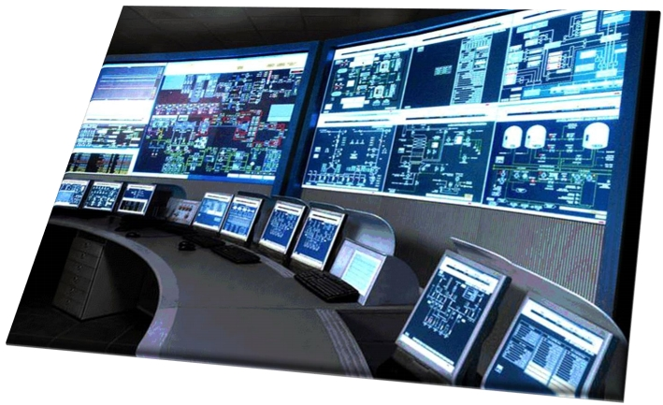
SCADA
Overview
SCADA stands for: Supervisory Control and Data Acquisition. SCADA systems are a crucial component of modern industrial and infrastructure control, allowing for the centralized monitoring and control of various processes and equipment in industries such as manufacturing, energy, water treatment, and more.

Slide 2
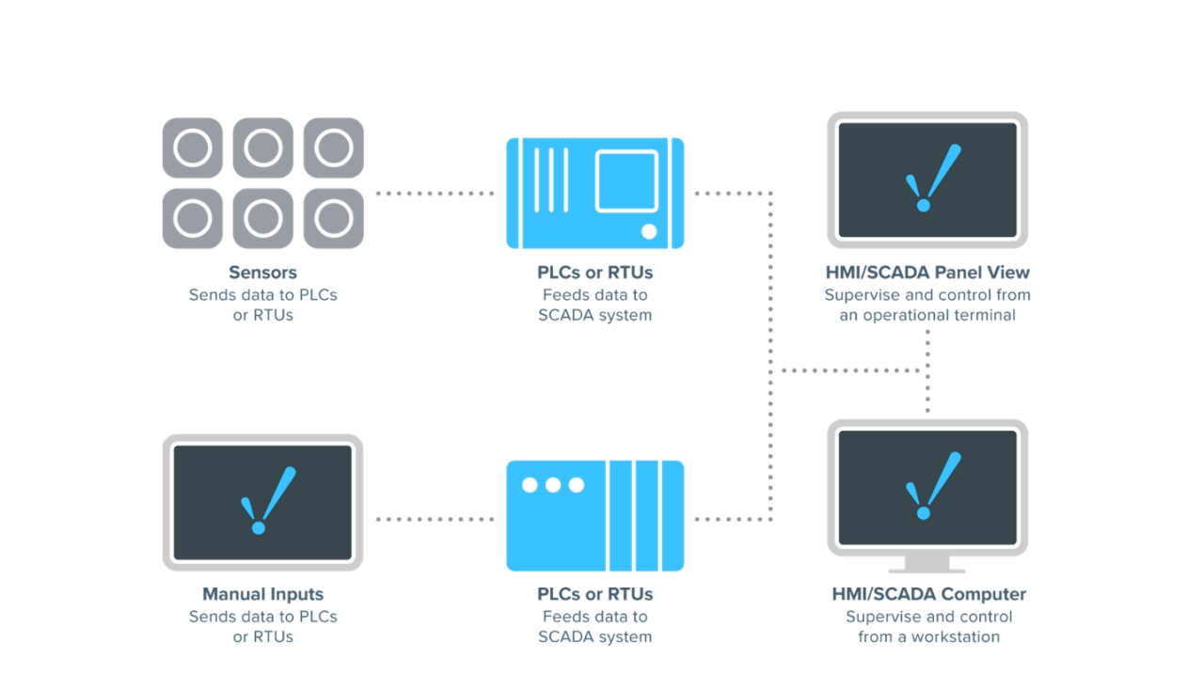
SCADA Explained

Slide 3
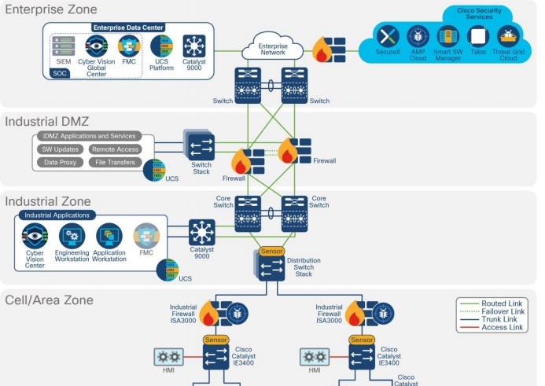
What is a SCADA
System?
We typically encounter primary
substations, secondary
substations, distribution (DR) substations, and households – all of which are interconnected.
These connections are essential because they link to something called a "process zone" or a "SCADA DMZ (Demilitarized Zone) zone" or even an "AMI (Advanced Metering Infrastructure) zone.“

Slide 4
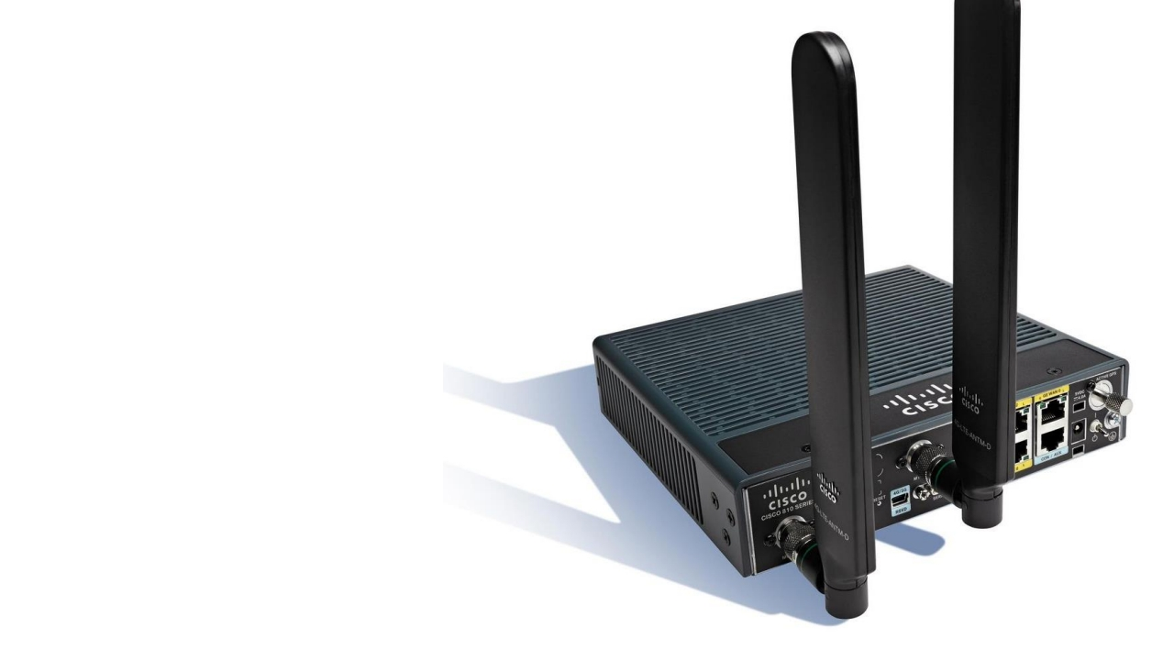
SCADA Networks
Common Methods:
• Fibre
• GPS
• LTE
• GPRS
• LTE

Slide 5
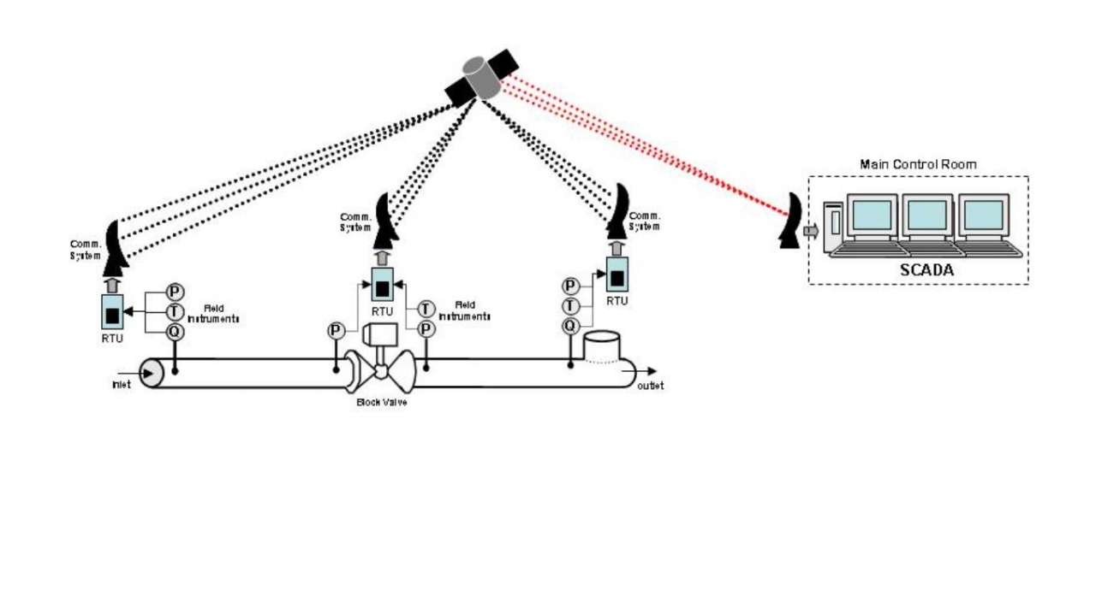
SCADA Remote Locations

Slide 6

SCADA Zone
Process Zone
Engineering Zone
Office LAN
Public DMZ
DSO WAN and Primary Substation
Telecom Operator and Secondary Substation
Energy Supplier Zone

Slide 7
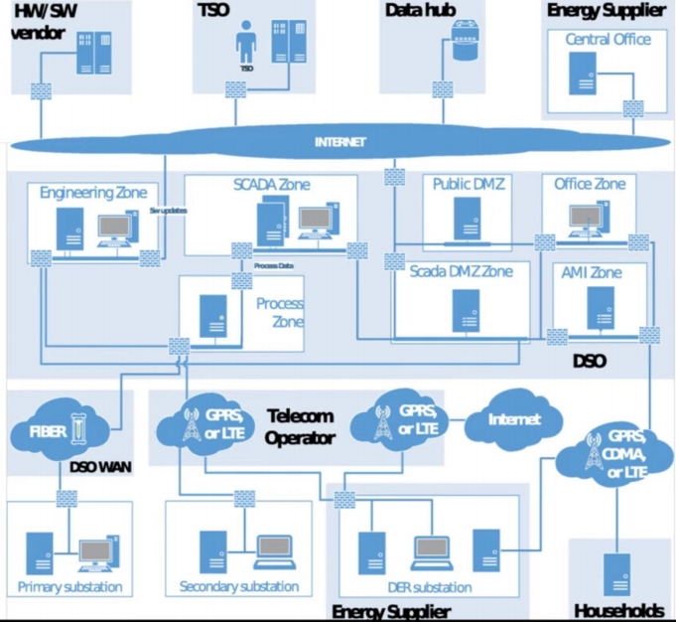

SCADA Zone
Process Zone
Engineering Zone
Office LAN
Public DMZ
DSO WAN and Primary Substation
Telecom Operator and Secondary Substation
Energy Supplier Zone

Slide 8
SCADA Zone
Process Zone
Engineering Zone
Office LAN
Public DMZ
DSO WAN and Primary Substation
Telecom Operator and Secondary Substation
Energy Supplier Zone

Slide 9
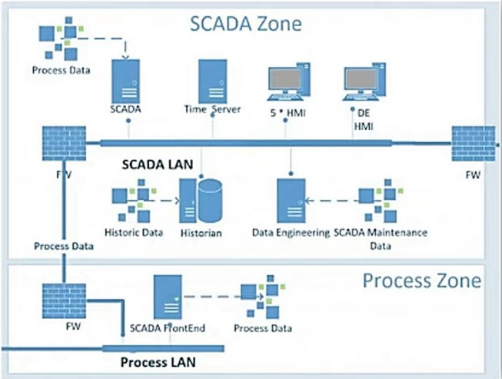
SCADA Zone
The SCADA zone serves as the central and essential part of the system. It acts as the command center, receiving and distributing operator commands to the actual substations.

Slide 10
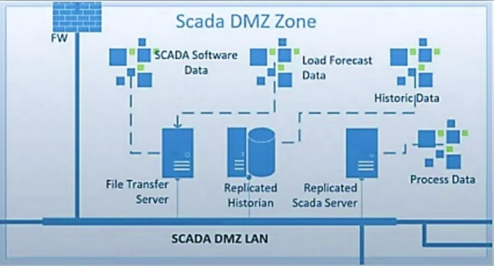
SCADA DMZ Zone
The SCADA DMZ (Demilitarized Zone) zone acts as an intermediate zone for secure data transfer between the SCADA zone and the office zone. It employs firewalls to thoroughly inspect and control the flow of data, ensuring its integrity and security.

Slide 11


SCADA DMZ Zone
Process Zone
Engineering Zone
Office LAN
Public DMZ
DSO WAN and Primary Substation
Telecom Operator and Secondary Substation
Energy Supplier Zone

Slide 12
SCADA DMZ Zone
Process Zone
Engineering Zone
Office LAN
Public DMZ
DSO WAN and Primary Substation
Telecom Operator and Secondary Substation
Energy Supplier Zone

Slide 13
SCADA DMZ Zone
Process Zone
Engineering Zone
Office LAN
Public DMZ
DSO WAN and Primary Substation
Telecom Operator and Secondary Substation
Energy Supplier Zone

Slide 14
SCADA DMZ Zone
Process Zone
Engineering Zone
Office LAN
Public DMZ
DSO WAN and Primary Substation
Telecom Operator and Secondary Substation
Energy Supplier Zone

Slide 15
Beyond these zones, the SCADA architecture incorporates additional zones for hardware and software vendors, TSO (Transmission System Operator) zones, data hubs, and energy supplier zones. These zones are interconnected through the internet, allowing data read and write operations based on defined rules and policies.

Slide 16
Zonal architecture in SCADA improves control and data acquisition.
Diverse communication methods enhance
connectivity across zones.
Wrap
Up
Understanding SCADA architecture is vital for effective cybersecurity.
Next chapters will explore SCADA systems and their security requirements.

