Slide 1
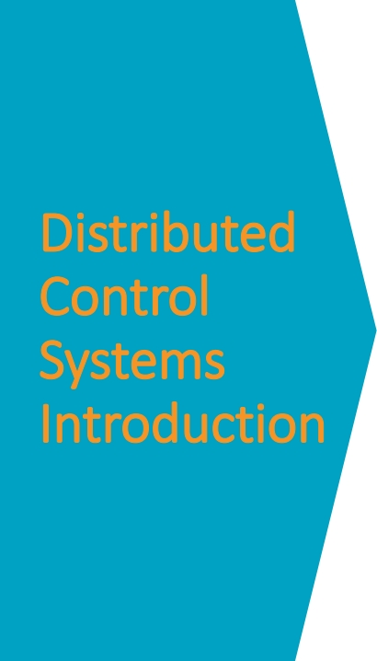
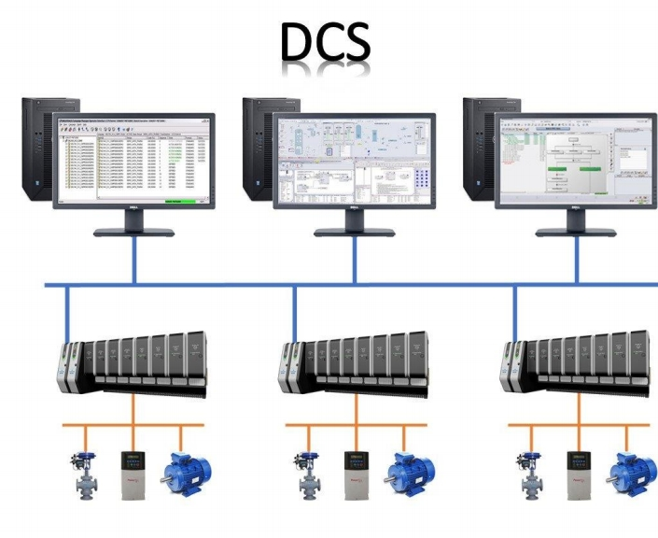

Slide 2
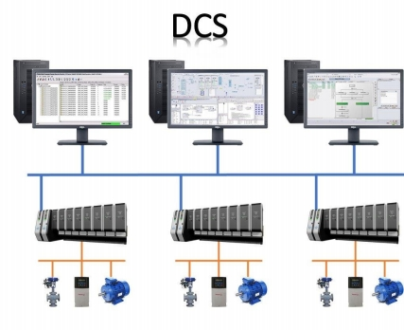
What is a DCS?
DCS refers to a control system where the control functions are distributed rather than centralized on a single controller or algorithm. This distributed nature allows for the placement of multiple controllers and automation systems across a large geographical area, which in turn enables centralized monitoring and control from a single console or operator workstation.

Slide 3
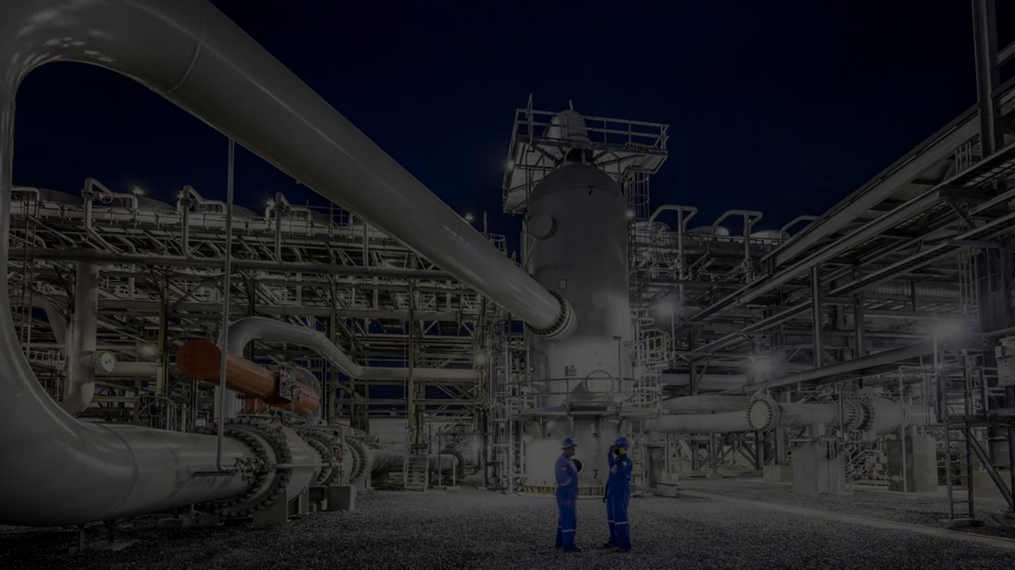
• Oil and Gas
• Energy Utilities
Applications
• Chemical Plants
• Manufacturing Plants
• Pharmaceuticals

Slide 4
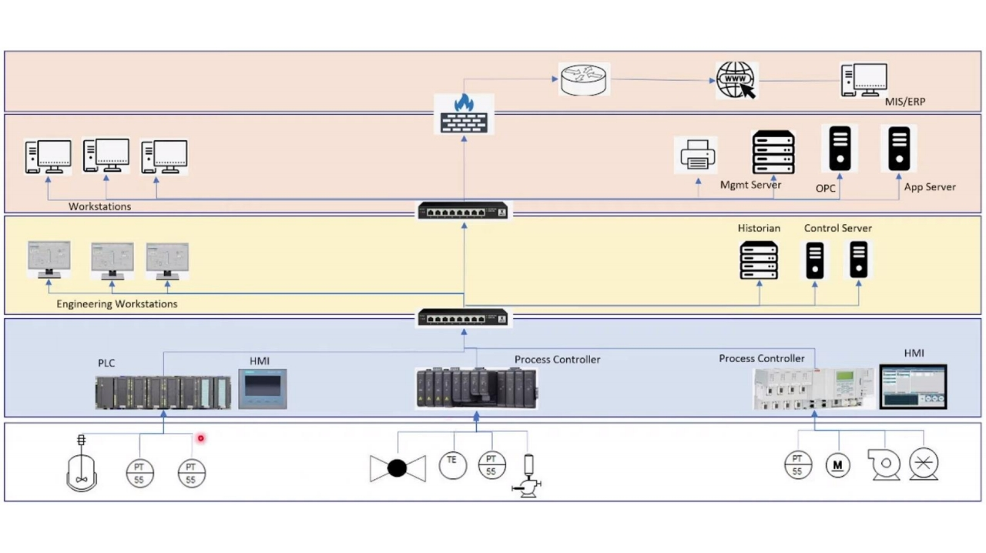

Slide 5
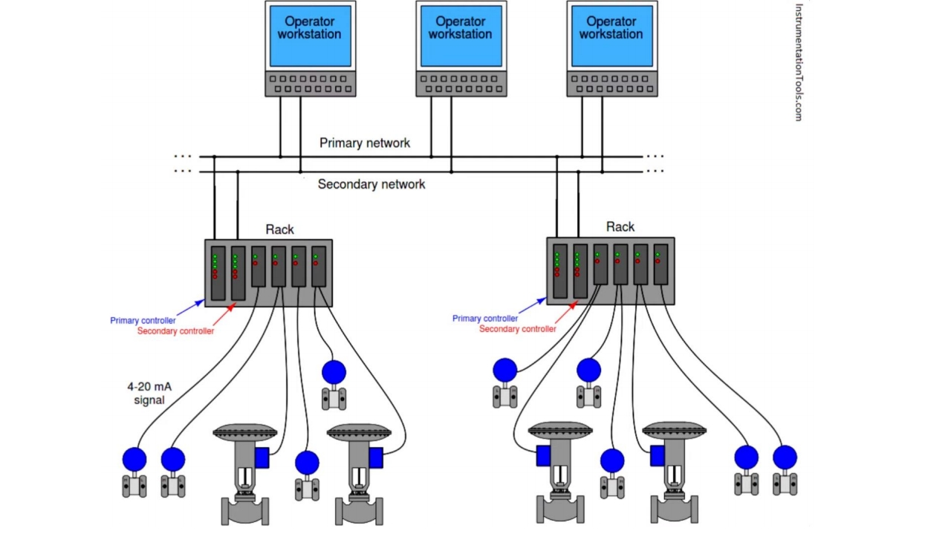

Slide 6
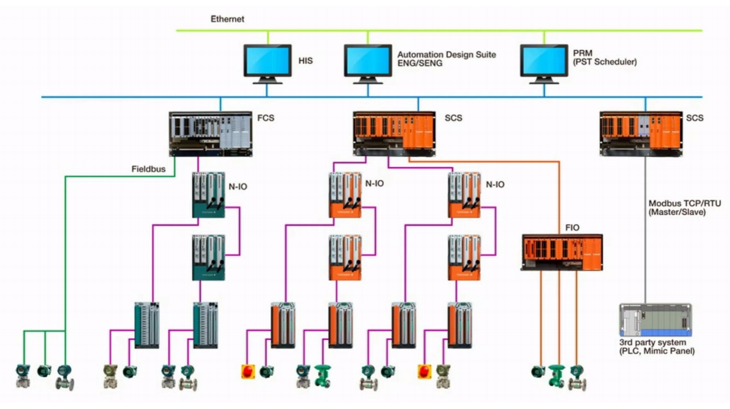

Slide 12
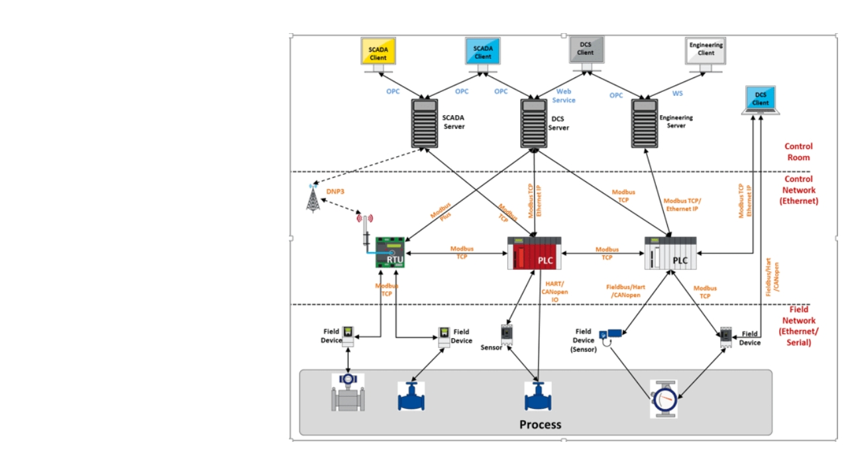


Slide 17
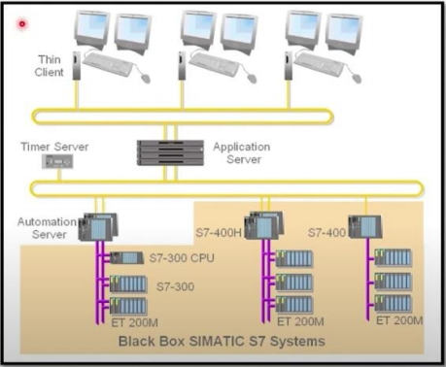
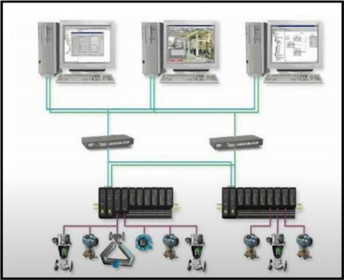
SPPA-T3000 Architecture Delta V Architecture

Slide 18
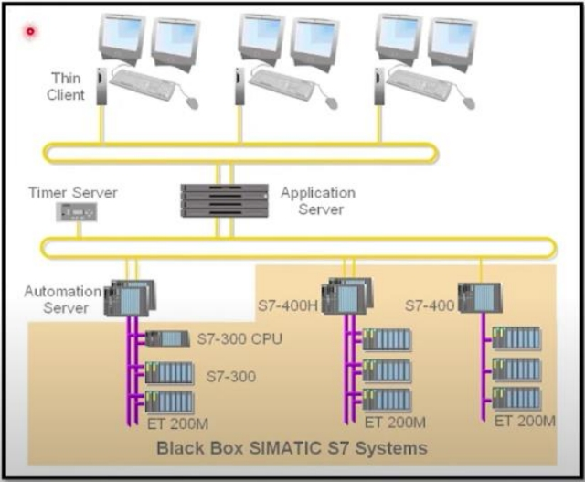
SPPA-T3000 Architecture

Slide 19
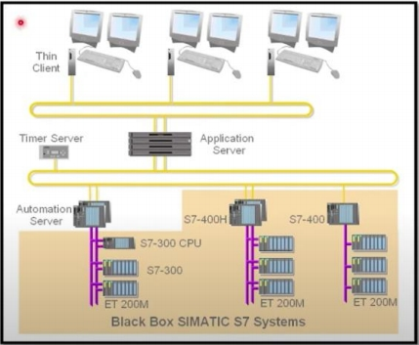
SPPA-T3000 Architecture
In this DCS architecture, exemplified by Siemens' SPPA T3000, several key components work in tandem. At the foundation, field-level I/O cards, such as the ETT 200 models, collect data from sensors and feed it to controllers like the S7-300 CPU.

Slide 20
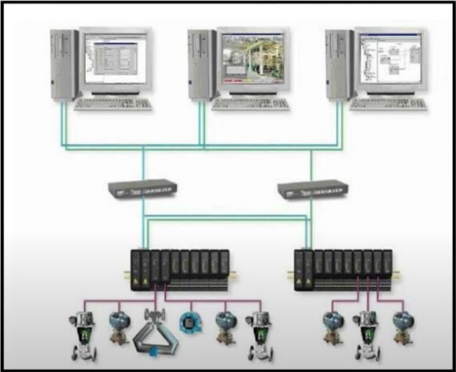
Delta V Architecture
DeltaV Architecture: In this DCS setup, we observe a similar structure as in the previous example. Field automation is facilitated through DeltaV I/O cards, which gather data from sensors and devices in the field. These cards feed data into controllers, forming the foundation of control logic.

Slide 21
DCS enables centralized control and monitoring in industries with complex control loops.
It consists of instrumentations, command elements, and controllers.
Wrap
Software includes HMI, engineering, and operator workstations.
Up
DCS architectures incorporate historians, communication protocols, and servers.
Cloud integration allows for data transmission and advanced analysis.
Understanding DCS architecture enhances process control and system security.

